Slide 1
This is a SAMPLE Powerpoint. The information should be replaced with data and updates from your program.

Slide 2
Breastfeeding in [state]
Maternal, infant, and early childhood Home visiting program stakeholder update

Slide 3
Breastfeeding Benefits
It supplies all the necessary nutrients in the proper proportions.
It protects against allergies, sickness, and obesity.
It protects against diseases, like diabetes and cancer.

Slide 4
Breastfeeding Benefits
It supplies all the necessary nutrients in the proper proportions.
It protects against allergies, sickness, and obesity.
It protects against diseases, like diabetes and cancer.

Slide 5
Breastfeeding Benefits
It supplies all the necessary nutrients in the proper proportions.
It protects against allergies, sickness, and obesity.
It protects against diseases, like diabetes and cancer.

Slide 6
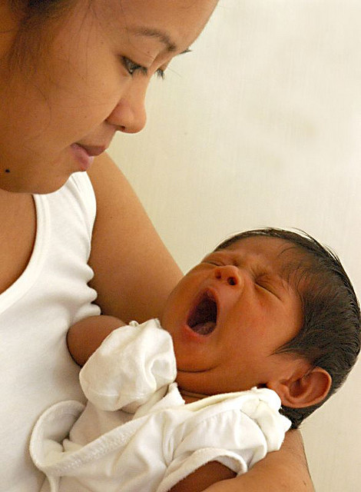
XX%
of infants in our program were
ever breastfed

Slide 7
XX% of infants receiving home visiting services are ever breastfed and XX% are breastfed any amount at 6 months!
Ever breastfed
Breastfed any amount at 3 months
Breastfed any amount at 6 months
Breastfed any amount at 12 months

Slide 8
XX% of infants receiving home visiting services are ever breastfed and XX% are breastfed any amount at 6 months!
Ever breastfed
Breastfed any amount at 3 months
We are working hard to increase the rate of breastfeeding any amount at 6 months.
Breastfed any amount at 6 months
Breastfed any amount at 12 months

Slide 9
Quality improvement projects are aimed at increasing rates of breastfeeding any amount at 6 months from XX% to XX%.
Ever breastfed
Breastfed any amount at 3 months
Breastfed any amount at 6 months
Breastfed any amount at 12 months

Slide 10
XX%
of mothers said the breastfeeding support from their home visitors was very helpful

