Slide 1
This is a SAMPLE Powerpoint. The information should be replaced with data and updates from your program.

Slide 2
Caregiver Depression screening in [state]
Maternal, infant, and early childhood Home visiting program stakeholder update

Slide 3
Why focus on caregiver depression?
Approximately 10–20% of women experience depression either during pregnancy or in the first 12 months postpartum.
Caregiver depression is a significant risk factor affecting the well-being and school readiness of young children.
Caregivers with depression generally show less attentiveness and responsiveness to their children’s needs.

Slide 4
Why focus on caregiver depression?
Approximately 10–20% of women experience depression either during pregnancy or in the first 12 months postpartum.
Caregiver depression is a significant risk factor affecting the well-being and school readiness of young children.
Caregivers with depression generally show less attentiveness and responsiveness to their children’s needs.

Slide 5
Why focus on caregiver depression?
Approximately 10–20% of women experience depression either during pregnancy or in the first 12 months postpartum.
Caregiver depression is a significant risk factor affecting the well-being and school readiness of young children.
Caregivers with depression generally show less attentiveness and responsiveness to their children’s needs.

Slide 6
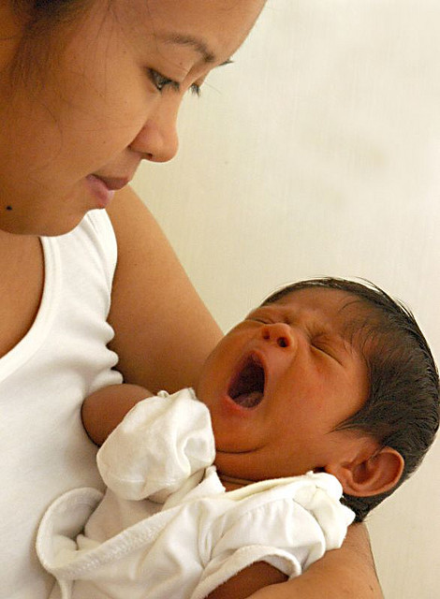
XX%
of our primary caregivers were screened for depression in 20XX

Slide 7
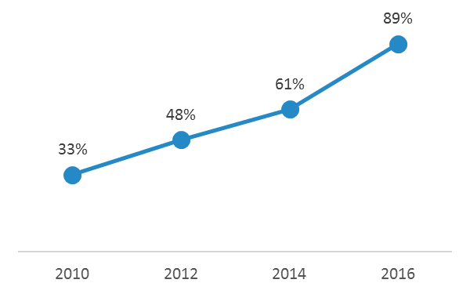
We have been steadily increasing our rates of primary caregiver depression screenings since our program began in 2010.

Slide 8
In 20XX, we screened XX% of caregivers for depression within 3 months of their child’s birth.
Screened within 3 months of birth
Screened within 1 month of birth
We are working hard to increase the rate of screenings within 3 months of a child’s birth!
Screened within 2 weeks of birth

Slide 9
Quality improvement projects are aimed at increasing screening rates within 3 months of birth from XX% to our goal of XX%.
Screened within 3 months of birth
Screened within 1 month of birth
Screened within 2 weeks of birth

Slide 10
XX%
of our home visitors have received training on the depression screening tool!

