Slide 1
This is a SAMPLE Powerpoint. The information should be replaced with data and updates from your program.

Slide 2
[INSERT PRESENTATION TITLE HERE]
[INSERT PRESENTATION SUBTITLE HERE]

Slide 3
Directions
This PowerPoint includes Pro Tips to help you design your own slide deck for presenting information to your stakeholders.
Following each Pro Tip is a designed slide using the tips from previous slides. Type over the existing information to personalize your slides with your own data.
Don’t forget to delete the Pro Tip slides before you finalize your presentation!
Use the chart templates (directions above) to replace the sample chart with a chart that best represents your program’s data. Pasting charts in PowerPoint can be tricky. Make sure you resize your chart to fill the slide and adjust the text size as needed.

Slide 4
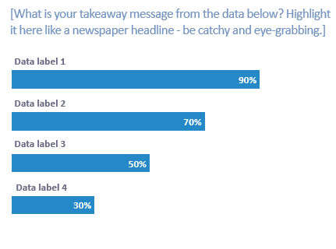
Pro Tip #1
Keep it as simple as possible. One chart per slide is great. Remember, white space is your friend!
Notes:
**Don’t forget to remove this slide for your final version!

Slide 5
XX% of infants receiving home visiting services are ever breastfed and XX% are breastfed any amount at 6 months!
Ever breastfed
Breastfed any amount at 3 months
Breastfed any amount at 6 months
Breastfed any amount at 12 months

Slide 6
Pro Tip #2
Don‘t hesitate to grab an arrow or a circle from the Shapes menu to highlight a key point in your data!
Notes:
**Don’t forget to remove this slide for your final version!

Slide 7
XX% of infants receiving home visiting services are ever breastfed and XX% are breastfed any amount at 6 months!
Ever breastfed
Breastfed any amount at 3 months
We are working hard to increase the rate of breastfeeding any amount at 6 months.
Breastfed any amount at 6 months
Breastfed any amount at 12 months

Slide 8
Pro Tip #3
You can also shade all other bars with a gray color using the Shape Fill function to make a data point pop!
Notes:
**Don’t forget to remove this slide for your final version!

Slide 9
Quality improvement projects are aimed at increasing rates of breastfeeding any amount at 6 months from XX% to XX%.
Ever breastfed
Breastfed any amount at 3 months
Breastfed any amount at 6 months
Breastfed any amount at 12 months

Slide 10
Pro Tip #4
XX%
No chart? No problem! Highlight a single data element using a large percent or number and descriptor text below.
of infants in our program were
ever breastfed
Notes:
**Don’t forget to remove this slide for your final version!

Slide 11
Pro Tip #5
XX%
Keep your slides simple. No need to add more than the one fact here. Add a rectangle of color here to take up space and call it a day!
of infants in our program were
ever breastfed
Notes:
**Don’t forget to remove this slide for your final version!

Slide 12
XX%
of infants in our program were
ever breastfed

Slide 13
Pro Tip #6
Breastfeeding Benefits
It supplies all the necessary nutrients in the proper proportions.
It protects against allergies, sickness, and obesity.
It protects against diseases, like diabetes and cancer.
Need to share some text? Use multiple slides one point per slide to keep your readers’ focused!
Notes:
**Don’t forget to remove this slide for your final version!

Slide 14
Breastfeeding Benefits
It supplies all the necessary nutrients in the proper proportions.
It protects against allergies, sickness, and obesity.
It protects against diseases, like diabetes and cancer.

Slide 15
Breastfeeding Benefits
It supplies all the necessary nutrients in the proper proportions.
It protects against allergies, sickness, and obesity.
It protects against diseases, like diabetes and cancer.

Slide 16
Breastfeeding Benefits
It supplies all the necessary nutrients in the proper proportions.
It protects against allergies, sickness, and obesity.
It protects against diseases, like diabetes and cancer.

Slide 17
Pro Tip #7
Use photos! You can purchase stock photos for a nominal fee to greatly enhance your visual impact.
Notes:
**Don’t forget to remove this slide for your final version!

Slide 18
XX%
of mothers said the breastfeeding support from their home visitors was very helpful

