Slide 1
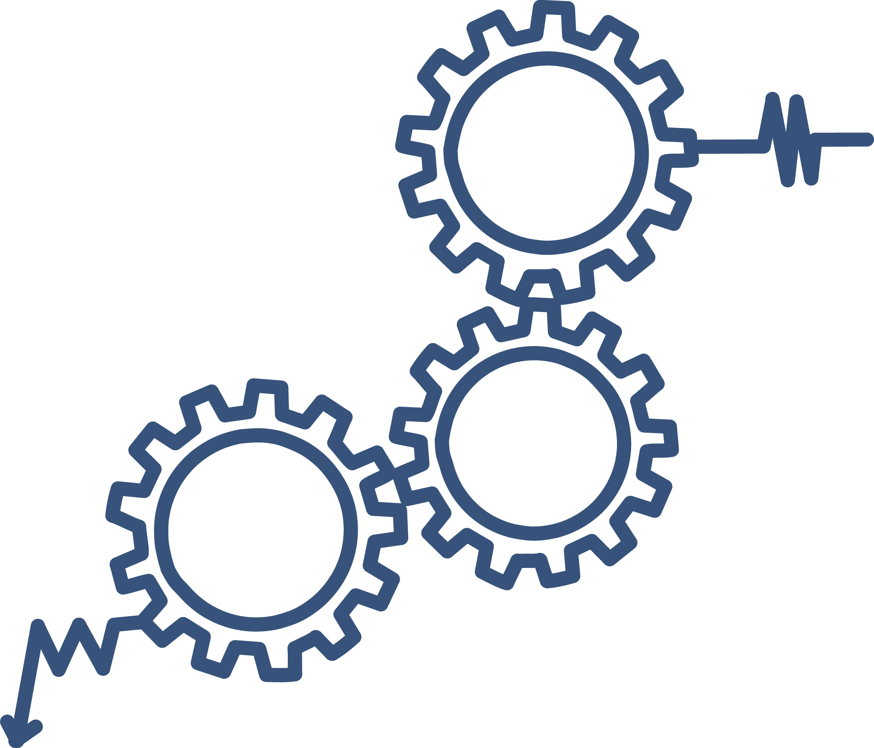

Continuous Quality Improvement Toolkit
A Resource for Maternal, Infant, and Early Childhood Home Visiting Program Awardees
Module 1: Introduction to cqi
This document was prepared for the U.S. Department of Health and Human Services (HHS), HRSA, and ACF by James Bell Associates, Inc., under ACF contract number HHSP233201500133I. For more information, see http://www.jbassoc.com/reports-publications/dohve.
Notes:
This presentation is intended to be delivered by state-level Continuous Quality Improvement (CQI) support staff. The notes are a suggested script for the presenter. Please see the accompanying Facilitation Guide and handouts.

Slide 2
CQI Training Overview
1
2
3
4
5
6
7
8
9
Introduction to CQI
Using Data to Drive CQI and Identify Topics
Creating the CQI Culture and Forming a Team
Creating SMART Aims
Understanding the PDSA Process & Measurement
CQI Tools I: Process Maps
CQI Tools II: Root Cause Analysis Tools
CQI Tools III: Key Driver Diagrams
Reliability Concepts and Sustaining Gains
Notes:
This is the first module in a nine-part series.
This session provides a general introduction to Continuous Quality Improvement, or CQI.

Slide 3
Introduction to CQI: Learning Objectives
Understand what CQI means
Learn why it is important for home visiting programs to participate in CQI
Understand the difference between Quality Assurance and Quality Improvement
Notes:
The learning objectives for Module 1 are for participants to:
Understand what CQI means
Learn why it is important for home visiting programs to participate in CQI
Understand the difference between Quality Assurance and Quality Improvement

Slide 4
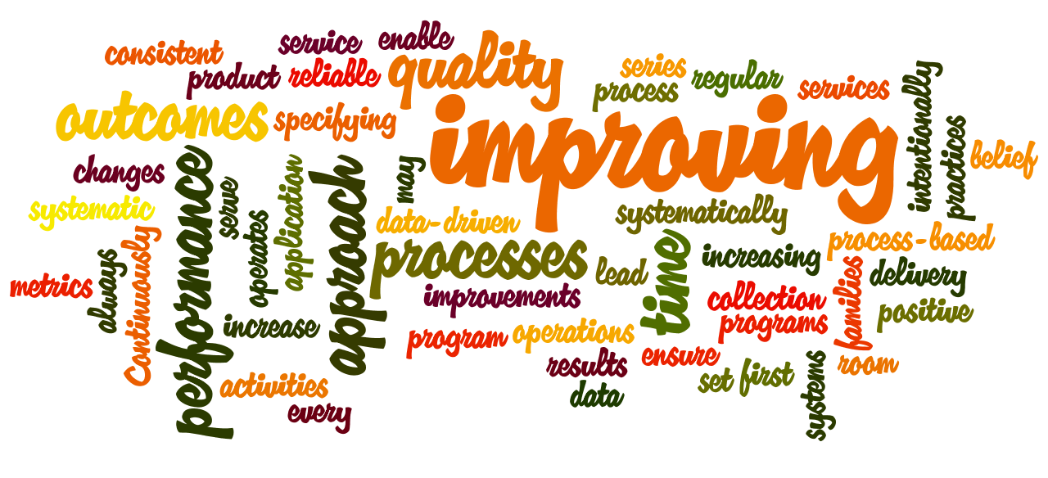
CQI is …
Notes:
There are many definitions for CQI, but all relate to the same process for rapidly testing improvements.
CQI can work in many contexts.
CQI originally comes from the automobile manufacturing industry. The same principles used to ensure that the best possible cars are manufactured can be applied to ensure the best possible home visiting services.

Slide 5

What is cqi?
A systematic approach to specifying the processes and outcomes of a program or set of practices through regular data collection and the application of change strategies that may lead to improvements in performance.
Supplemental Information Request for the Submission of the Updated State Plan for a State Home Visiting Program. http://www.hrsa.gov/grants/manage/homevisiting/sir02082011.pdf
Notes:
This is the definition that we will use for CQI throughout these trainings:
CQI is a systematic approach to specifying the processes and outcomes of a program or a set of practices through regular data collection and the application of change strategies that may lead to improvements in performance.
Sometimes available services don’t fully meet the needs of families. CQI can be a mechanism to find out why and to improve services for families.
CQI is a process-based framework. Its direction and implementation are intentionally flexible so as to meet the needs of the agency and to ensure that programs are systematically and intentionally improving services, as well as increasing positive outcomes, for the families being served.
Please note that CQI is not program evaluation. Program evaluation focuses on understanding program process and the impact of a program, rather than understanding process for the purposes of program improvement.

Slide 6

Notes:
The following is an example of how CQI could be implemented in a home visiting agency to improve caregiver access to depression services.
After analyzing program data, an agency discovers home visitors have a high rate of completing depression screenings with caregivers and providing subsequent referrals. But there is a low rate of caregivers using the referrals to access services. Home visitors, the program manager, and other key stakeholders work together and identify an online scheduling system that clients can use to make appointments with the agency’s mental health provider.
As a small first test, home visitors identify one family and provide support to use the online scheduling system.
After they complete this first test, the team will regroup to discuss the outcomes and determine how to change their approach or scale-up, or expand their efforts with more families and more home visitors.

Slide 7

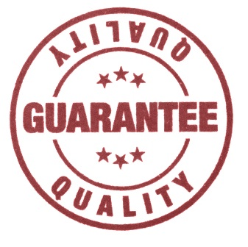
What Does Quality Mean?
What is quality in home visiting services?
What does it mean to improve?
How do you define quality?
How do you measure quality?
How do you know you are offering quality services?
Notes:
Take time here to engage your participants in a discussion on (1) what quality means to them, and (2) what constitutes quality in home visiting services.
These questions are meant to be prompts to begin thinking about your agency’s internal culture of quality.
What is quality in home visiting services?
What does it mean to improve?
How do you define quality?
How do you measure quality?
How do you know you are offering quality services?
Close the discussion by making the point that:
Quality improvement should be framed by an agency’s mission, and that mission should drive the desire to improve services.

Slide 8
CQI Models: Differing Methods, Same Goals
Model Name | Website
Model for Improvement (Institute for Healthcare Improvement) | www.ihi.org
Six Sigma (Six Sigma Methodologies, Design for Six Sigma, or DFSS) | www.isixsigma.com
LEAN (Lean Enterprise, Toyota Production System, or TPS) | www.lean.org
Notes:
Multiple models can be used to engage in quality improvement work. Selecting the model that best fits the agency structure and culture is important.
The first model, called Model for Improvement, has been adopted by the Institute for Healthcare Improvement (IHI). This model is widely used in the medical field by health departments, hospitals, and medical facilities.
Six Sigma is a model developed initially to improve production quality and reduce production errors (sigma) or variance in quality of product produced. This model uses terms that are centered around manufacturing. However, the principles remain pertinent and can easily be adopted by home visiting programs.
LEAN is a client-centered model, based on improving product quality through the “value perspective” of the customer. In Toyota terms, this was about making cars that better met buyers’ needs. LEAN developed the idea of trimming off what did not add value to the customer, and increasing what did. A home visiting agency can treat clients as customers of its product, home visiting services. Clients are more likely to stay engaged if the services are pertinent to their needs.
This training series is based on the IHI Model for Improvement.

Slide 9
Collect Data
Ensure Data Quality
Present Data
Identify Areas for Improvement
Create Process Maps and Key Drivers
Generate PDSA Test Cycles
Track and Interpret Results
Identify Lessons Learned
Engage in Wider Testing
Disseminate Charts
Disseminate Results
Form CQI Team
Notes:
The process on this diagram/flow chart provides an overview of the typical CQI process using the IHI Model for Improvement.
It can be broken down into four components, with smaller steps within each component.
During the first part of the CQI process, an agency forms a CQI team, collects data, ensures that those data are quality, and presents and disseminates the data to CQI team members.
In the second part of the process, the CQI team identifies areas needing improvement based on the data collected and presented previously.
After the area for improvement is identified, the CQI team creates process maps or key driver diagrams to help better understand the need for improvement and identify potential change strategies. The team then completes PDSA (Plan-Do-Study-Act) cycles in which they test change strategies and track and interpret the results.
Finally, the team identifies lessons learned, determines if the change strategy is appropriate for wider testing, and disseminates results.
You’ll learn much more about each step in the process through these CQI trainings.

Slide 10
Why do cqi?
Notes:
Next, we are going to talk about why to do CQI.

Slide 11

Notes:
Let’s use the following analogy – operating home visiting services is like sailing a boat from one island to another.
The captain uses the old standard approach to point the boat toward its target destination. The captain knows the ETA (estimated time of arrival) is within 24 hours.
But neither the crew nor the captain check to see if the boat is approaching its destination until the very end of the 24 hours.
If the compass is a degree off, the captain will miss his target. The captain and crew need to continuously check and measure to reach the appropriate destination, and to also avoid other vessels and potential disasters.
CQI would be the equivalent of keeping the captain at the helm and constantly checking directions, weather, etc. In other words, continuous use of data to check course direction toward a predetermined target would ensure that the boat arrives at its destination, avoids dangerous situations, and wastes little time or effort heading in the wrong direction.

Slide 12
5 Reasons for CQI
Streamline and improve services.
Connect data to practice.
Ensure implemented change strategies are effective and ineffective change strategies are abandoned.
Identify and disseminate best practices and lessons learned.
Engage a broader set of stakeholders and experts.
Notes:
There are five key reasons for using CQI in our work. Let’s discuss each of these in more detail.

Slide 13

5 Reasons for CQI
Streamline and improve services.
Notes:
The first reason to use CQI is because it can streamline and improve services.
CQI can help find what works and is most effective for specific families participating in home visiting, while eliminating practices that are not helpful or interfere with the goals of home visiting.
Home visitors are all different—having different approaches, life experiences, and ideas which may or may not work for the families they serve. CQI can help find those approaches most likely to work with specific types of families.
CQI can increase home visitor effectiveness, thereby increasing the value of the program for families and making it more likely that they will stay engaged in services.
As mentioned previously, there will always be some families that fall through the cracks. CQI can help fill in those cracks.
CQI can be used to adapt service delivery to the local context, culture, and need – again, providing more effective services to families.

Slide 14



5 Reasons for CQI
Connect data to practice.
Notes:
CQI connects data to practice.
Using CQI methods and tools can help you understand (quantitatively) what needs to be improved and if the changes you make toward improvement are successful.
Quantifying home visiting service provision can help tell a story so that home visitors, supervisors, families, and key stakeholders can gain a clearer picture of the services being provided.
Data are critical for understanding practice because opinions and anecdotal observations can sometimes be incorrect or misleading.

Slide 15
5 Reasons for CQI
Ensure implemented change strategies are effective, and ineffective changes strategies are abandoned.
Notes:
CQI ensures that implemented changes are effective and ineffective changes are abandoned.
By connecting data to practice, CQI allows you to determine which changes are successful and which are not.
Monitoring the effectiveness of adopted change strategies allows for successful changes to be fully adopted and for ineffective changes to be abandoned.
CQI also enables you to determine if your services are effective for your local context and conditions.

Slide 16

5 Reasons for CQI
Identify and disseminate best practices and lessons learned.
Notes:
CQI allows users to identify and disseminate best practices.
Once successful change strategies are identified, the CQI team can share them with others within and outside their agency.
If a change strategy was not successful, sharing the lessons learned from the experience can also be helpful. (There are no failures, just different lessons.)
This reflective approach to service delivery helps make all involved more aware of what they are doing, what works, what does not work, and what they should focus on moving forward.

Slide 17

5 Reasons for CQI
Engage a broader set of stakeholders and experts.
Notes:
Finally, CQI engages a broader set of constituents and experts.
Effectively involving content experts in service delivery can sometimes be challenging. CQI can provide an avenue for engaging content experts and provide a specific role for them to play.
For example, imagine home visitors at your agency are finding it challenging to engage families who are struggling with depression in home visiting. The state has a content expert on maternal depression, but this person has never been involved in home visiting work. A CQI project to improve support for mothers with maternal depression could bring the expert in and ask them to provide support in this area by providing trainings on maternal depression, connecting home visiting programs with mental health service providers in the area, helping to introduce effective tools for measuring depressive symptoms, etc. The Local Implementing Agency (LIA) then might ask the person to help identify change strategies to test in PDSA cycles as well.
CQI also can help you tell the story of your program and share that story with a broader set of stakeholders.

Slide 18
QUALITY ASSURANCE vs.
QUALITY IMPROVEMENT
Notes:
Let’s move on to discussing the difference between quality improvement (QI) and quality assurance (QA). The two concepts are closely related, but they serve different purposes. In this section, we will explore the difference.
Pass out the QA vs. QI handout. This handout provides a brief overview of the content covered during the QA vs. QI portion of this module. Direct participants here to follow along as you discuss this component.

Slide 19
Quality Improvement
Quality Assurance
Notes:
QA is the process used to determine if a quality control system is working. Effective compliance is determined by audits of records.

Slide 20
Quality Improvement
Quality Assurance
Notes:
QI uses knowledge gained from QA audits to inform change strategies. QA can be used with a QI lens as a first step in the QI process.
QI encourages consistency across agencies and home visitors.
QI uses small tests of change strategies to increase the understanding of the process.
QI spreads the improvement beyond the original target population, throughout the agency or all agencies state-wide.

Slide 21
Improving Practice
Using Data
Notes:
The cyclical relationship between QA and QI is similar to the cyclical nature of the QI process. QI begins with collecting and sharing data with stakeholders. These data are then used to inform practice by making small program modifications to enhance program outcomes. Data are then analyzed again to review the effects of the program modifications on the targeted outcomes. QI continues this cyclical review of data and making program improvements until the program changes have become institutionalized and consistent.

Slide 22
Quality Assurance (QA) | Quality Improvement (QI)
Reactive Good enough Point in time examination of data Responsibility of few Setting standards or meeting minimum standards Judgmental Example: 90% of mothers have been screened for maternal depression. | Proactive Best possible Examines data over time Responsibility of all Constantly working to meet or exceed standards Educational Example: By the end of the calendar year, increase completed EPDS screening within 8 weeks of birth for all mothers from 45% to 75%.
http://www.hrsa.gov/healthit/toolbox/HealthITAdoptiontoolbox/QualityImprovement/whatarediffbtwqinqa.html
Goldstone, J. (1997). The role of quality assurance versus continuous quality improvement. Journal of Vascular Surgery, 28, 378-380.
Notes:
Here is an overview of the differences between QA and QI.
Let’s look at QA first:
QA is reactive. It looks at what was done in the past.
It asks if expectations were met, in effect just ensuring that services are good enough.
QA looks at a single point in time; for example, were all female caregivers screened for depression at 4 weeks postpartum?
The responsibility for QA rests on those few individuals who collect the data.
QA examines whether the expectation or standard was met, or sets the standard to meet.
Historically, QA has been perceived as judgmental and punitive
An example of QA would be, “90 percent of mothers have been screened for maternal depression at 4 weeks postpartum.”
As for QI:
It is proactive. It looks at what can be done in the coming days, weeks, or months.
Instead of being just good enough, QI seeks out the best possible outcomes. While setting a goal, QI pushes to consistently improve service provision.
QI involves examining data over time to determine how the change strategies worked.
Everyone in an agency has responsibility for QI by looking at internal processes.
QI helps to exceed standards, which then can be used to inform new QA efforts (e.g., new standards).
Finally, it is educational. CQI teams learn as data are examined to see what works and what doesn’t work.
An example of QI would be, “By the end of the calendar year, we will increase completed EPDS screening within 8 weeks of giving birth for all mothers from 45 percent to 75 percent.
QA has sometimes been perceived as a negative process but is an important tool for monitoring if a system is functioning as intended. When used in conjunction with QI, the overall process of monitoring and working to improve services may be more effective.

Slide 23
QA vs. QI Quiz
 | QA | QI
1. Were the recommended number of family home visits conducted this month?
2. Are family relationships being established to promote honest responses to the screenings?
3. What happens when a new policy is implemented and requires screening results data to be entered within 5 days?
4. What are we doing to encourage mothers to breastfeed their infants for at least 6 months?
Notes:
See the Facilitation Guide for more information on this breakout activity. Pass out the accompanying handout (QA vs QI Quiz) for the participants to reflect and write down their responses.
Let’s do a group activity. The following are questions an administrator may want to answer about how his or her home visiting program is doing. After I read each statement, please mark if you think it is an example of QA or QI on your handout and we’ll discuss each one as a group.
Were the recommended number of family home visits conducted this month? Answer: QA
Are family relationships being established to promote honest responses to the screenings? Answer: QI
What happens when a new policy is implemented and requires screening results data to be entered within 5 days? Answer: QA
What are we doing to encourage mothers to breastfeed their infants for at least six months? Answer: QI

Slide 24
QA vs. QI Quiz
 | QA | QI
5. Over the past year, what are the attendance rates at parent socialization events?
6. Why didn’t one-third of the staff receive the required training for infant-mental health?
7. On a daily basis, what percentage of caregivers are reading with their children?
8. What strategies can be implemented to better support caregivers to take their children to well-child visits?
9. How can we reduce time between referral and service receipt?
Notes:
Activity continued:
Over the past year, what are the attendance rates at parent socialization events? Answer: QA
Why didn’t one-third of the staff receive the required training for infant-mental health? Answer: QA
On a daily basis, what percentage of caregivers are reading with their children? Answer: QA
What strategies can be implemented to better support caregivers to take their children to well-child visits? Answer: QI
How can we reduce time between referral and service receipt? Answer: QI
Note that QA and QI can complement each other. For example, take a look at number 6 – while one-third of the staff not receiving required training is QA, this can become a problem for QI to approach. After conducting a root cause analysis, the team may set an aim statement that 80 percent of all staff receive the required training by 3 months. They will attempt to achieve this aim through by increasing in the number of trainings and reducing caseloads by one unit to increase time for training. This becomes QI because the project is looking at the causes of the problem (lack of trainings at times accessible by staff and lack of staff time for training), and removing those barriers, rather than viewing it as a staffing issue.
It is important to acknowledge the interrelationship between QA and QI as noted in the earlier cycle diagram. QI does not replace QA. However, many barriers to high-quality service delivery can be framed through a QI lens, leaving QA to ensure that minimum standards are met. In other words, QI is often a means to overcome the barriers to meeting QA standards, or failures to ensure consistent high-fidelity model services.

Slide 25
QA and QI Experience
What are the experiences your agency has had with QA and QI?
What are some misperceptions that staff and stakeholders have about QA and QI?
What has been done to clarify the difference between QA and QI in your agency?
In your agency, how do QA and QI complement each other?
Notes:
Let’s do another activity. First, please answer the two questions at the bottom of the QA vs. QI quiz. Please provide an example of a QA initiative at your agency and an example of a QI initiative at your agency.
Give participants a few minutes to write responses. Then ask participants to work within their agency groups.
Now, let’s look at these questions and talk about them within small groups. Please think about your agency in particular and your experience with QA and QI, and talk about these questions with the group at your table. Remember, there are no right or wrong answers.

Slide 26
Remember...
CQI is a systematic approach that may lead to program improvements.
There are five main reasons to use CQI.
Quality assurance and quality improvement are closely related, but serve different purposes.
Notes:
Bring the group back together.
Keep these key tips in mind as you learn more about CQI through these modules.
CQI is a systematic approach to specifying the processes and outcomes of a program or set of practices through regular data collection and the application of change strategies that may lead to improvements in performance.
There are five main reasons to use CQI:
It streamlines and improves services
CQI connects data to practice
It ensures implemented change strategies are effective, and ineffective change strategies are abandoned
CQI helps identify and disseminate best practices and lessons learned
It allows agencies to engage a broader set of stakeholders and experts
QA and QA are closely related, but serve different purposes. QA uses a process to determine if a quality-control system is working, and effective compliance is determined by audits of records. QI uses knowledge gained from QA audits to inform change strategies. QA can be used with a QI lens as a first step in the QI process.

Slide 27
Additional CQI Resources
CQI Briefs: http://www.jbassoc.com/reports-publications/dohve
Quality Improvement Toolbox: http://www.hrsa.gov/quality/toolbox/methodology/qualityimprovement/index.html

Slide 28
Disclaimer
The purpose of the Design Options for Home Visiting Evaluation (DOHVE) is to provide research and evaluation support for the Maternal, Infant, and Early Childhood Home Visiting (MIECHV) Program. The project is funded by the Administration for Children and Families (ACF) in collaboration with the Health Resources and Services Administration (HRSA) under contract number HHSP233201500133I.
This publication was developed by James Bell Associates on behalf of the U.S. Department of Health and Human Services (HHS), HRSA, and ACF. Its contents are the sole responsibility of the authors and do not necessarily represent the official views of HHS, HRSA, or ACF.

