Slide 1
Continuous Quality Improvement Toolkit A Resource for Maternal, Infant, and Early Childhood Home Visiting Program Awardees
Module 3: Creating the CQI Culture and Forming a Team
This document was prepared for the U.S. Department of Health and Human Services (HHS), HRSA, and ACF by James Bell Associates, Inc., under ACF contract number HHSP233201500133I. For more information, see http://www.jbassoc.com/reports-publications/dohve.
Notes:
This presentation is intended to be delivered by state-level CQI support staff. The notes are a suggested script for the presenter. Please see the accompanying Facilitation Guide and handouts.

Slide 2
CQI Training Overview
1
2
3
4
5
6
7
8
9
Introduction to CQI
Using Data to Drive CQI and Identify Topics
Creating the CQI Culture and Forming a Team
Creating SMART Aims
Understanding the PDSA Process & Measurement
CQI Tools I: Process Maps
CQI Tools II: Root Cause Analysis Tools
CQI Tools III: Key Driver Diagrams
Reliability Concepts and Sustaining Gains
Notes:
This is the third module in a nine-part series.
This session focuses on (1) how to create an agency culture that is supportive of CQI and (2) how to form a team to carry out CQI activities.

Slide 3
CQI Culture and Forming Teams: Learning Objectives
Create an agency culture that supports CQI
Form a team to carry out CQI activities
Notes:
The learning objectives for Module 3 are for participants to understand:
How to create an agency culture that supports CQI.
How to form a team to carry out CQI activities.

Slide 4
a culture of quality
Notes:
First, we’ll talk about developing a culture of quality.

Slide 5
CQI leadership team
Performance measurement system
CQI plan
Notes:
To develop a culture of quality, the agency or system needs to have in place the necessary quality infrastructure and a shared vision or value system.
Quality infrastructure includes:
CQI leadership team
A performance measurement system (including quality assurance and performance measurement/benchmarking)
A CQI plan (outlining the direction the agency or system will move and how this task will be accomplished)
A shared vision or value system can be difficult to attain. However, it is necessary to develop a culture of quality, which includes representative members from administrators to front-line staff. These members should:
Value data
Strive for process and outcome improvements
To create this shared vision, staff orientation on CQI concepts and ongoing CQI professional development helps create buy-in.

Slide 6
Culture of Quality
Current Culture
Attitude
Data
Outcomes
Commitment
Transparency
Notes:
Current culture, attitude, transparency, commitment, data, and outcomes — all work together to develop a culture of quality.
An agency must first reflect on the current or existing culture.
Consider where the agency is currently, and where it wants to be. The current agency culture does not necessarily need to be fully onboard with CQI, but it should be the direction in which it wants to move. The culture can be changed by showing everyone how powerful CQI can be. By starting with one department, one home visitor, or even one family, initial good results can be used to demonstrate the power of CQI to everyone.
Generating buy-in at all levels is important. Everyone should feel empowered to improve the agency or system. Improvement is the responsibility of all departments rather than just one. Large agencies may have dedicated staff for quality improvement, but that does not mean others are exempt from the responsibility for trying to improve the system. If this is not the current culture, then the agency needs to work toward thinking and behaving as if everyone has a critical role in quality improvement.

Slide 7
Culture of Quality
Current Culture
Attitude
Data
Outcomes
Transparency
Commitment
Notes:
Next, consider attitude(s) toward quality improvement. Individuals’ attitudes are an important part of instilling a culture of quality. If everyone working at the agency does not think and feel collectively (‘we’), improvement is difficult.
Is everyone striving to reach predetermined and ambitious targets?
Does everyone recognize that all situations, good or bad, are a learning experience?
Does everyone feel comfortable sharing their experiences without fear of being penalized for poor performance?

Slide 8
Culture of Quality
Current Culture
Attitude
Data
Outcomes
Transparency
Commitment
Notes:
Next, consider your agency’s approach to transparency. To make progress toward improvement, staff must be willing to be open and reveal everything they do while serving families.
To avoid “reinventing the wheel,” do practices, methods, and results get shared? Do staff learn from each other, or do individuals or groups operate in silos?
Are individuals or groups possessive of their innovations, or do they freely give them away?
Does your agency have open communication, and do leaders and coworkers welcome constructive feedback? If you see how a system can improve, are you comfortable sharing a suggestion? What about others in the agency — do they share potential improvements?
If someone makes a mistake, does he or she feel safe discussing this with coworkers or their supervisor?

Slide 9
Culture of Quality
Current Culture
Attitude
Data
Outcomes
Commitment
Transparency
Notes:
The next component in a culture of quality is commitment.
Are all members committed to the process of improvement?
Everyone plays a role in improving services for families. If any one member is not committed, he or she may stand in the way of progress.
Improvement is guided by a team approach and accountability. When working together to make improvements, everyone has a role.

Slide 10
Culture of Quality
Current Culture
Attitude
Data
Outcomes
Commitment
Transparency
Notes:
Data is the next component in a culture of quality. Data need to be a central part of the culture to measure where we are and where we are going.
Does a data collection infrastructure exist? This could include a data system, training on data collection, staff understanding the measures, and/or high-quality data collection tools.
Is there a commitment along with an investment from the agency to collect high-quality and useful data?
Are the reporting metrics meaningful? In other words, are the collected data reflective of the services provided? If the data do not accurately reflect the services provided to families, they are not useful.

Slide 11
Culture of Quality
Current Culture
Attitude
Data
Outcomes
Commitment
Transparency
Notes:
The final component in a culture of quality is outcomes.
Outcomes need to be clearly articulated and understood. For example, for MIECHV, everyone in the agency should have the same understanding of why the performance measures matter, why we measure them, and what the data collected reflect.
In addition, targets for each outcome should be established. Establishing targets defines a baseline and progress towards an outcome, which is similar to when mapping software is used to plot out a course. Knowing where we are is insufficient; we must also know where we want to go. Trying to improve without targets is like looking at a map and saying, “I want to be somewhere better.” Where is better?

Slide 12
CQI Team development
Notes:
Now let’s discuss how to develop a CQI team.

Slide 13
How do you eat an elephant?
Notes:
How do you eat an elephant?
One bite at a time! But also, with help. This is the best way to tackle a large problem.

Slide 14
Notes:
Achieving improvement can be thought of like a puzzle with multiple, interconnected pieces. Each piece plays a part in making the puzzle (or project) complete. The system is often too large to change all at once, or to be changed by one person; a team with multiple members, each with a specific role, is necessary to make effective, lasting change.
Identifying the roles and responsibilities of team members is important. Each team member needs to understand what he or she will have to do to make the project successful, or to put the puzzle pieces together. By working together and taking advantage of each other’s strengths, ‘elephant-sized’ problems can be solved.

Slide 15
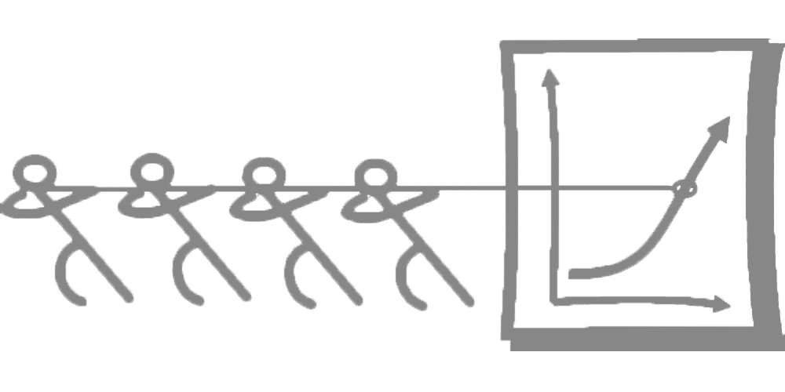
Forming CQI Teams
Notes:
Making CQI work involves strategic team effort, requiring planning and a dedicated staff with sufficient time and resources. Here are some important concepts to keep in mind when forming a CQI team.
An effective team can vary in size and composition. Ideally, teams consist of 5-10 members; teams that are too small often don’t have all the right people on board to be effective, and teams that are too large may have trouble making decisions.
Teams should include representatives from all groups affected by the CQI aim, including home visitors and supervisors, management or leadership, and families served by home visiting.

Slide 16
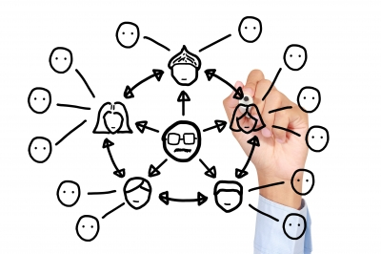
Forming CQI Teams
Notes:
An organizational chart of the CQI team can be helpful in articulating staff member roles and seeing where there are overlaps or gaps where additional resources might be needed.
An important aspect of CQI is the bidirectional flow of information. An organizational chart also helps identify how information flows from CQI team members to CQI users. While part of the CQI team’s role is to obtain and review data, it also ensures the data, reports, and information are shared with staff and other users outside of the CQI team.
Identifying whether additional training is necessary is another important step in forming a team.
Would the team benefit from having a CQI training on fundamental concepts?
Are there other areas of training that would help set the groundwork for the team?
Once the CQI team is formed, a CQI project charter outlining the scope of a project is developed. More detail will be provided about developing a CQI project charter in a later module.

Slide 17
Key CQI Team Members
Agency-level leader
Supervisors
Home visitors
Data analyst
Family members
Notes:
Including the right members in the CQI team is critical for success. This slide includes a list of agency staff members and/or stakeholders who are key members of a strong CQI team. We will talk through the primary roles for each member as it relates to the CQI team.
Agency-Level Leader:
The agency-level leader provides the authority to dedicate time to CQI efforts, can help make decisions to keep the process moving forward, assigns appropriate staff to tasks, and supports partnership-building within or outside the agency.
Supervisors:
Supervisors can also assign appropriate staff to tasks, make decisions about services, provide important insights that can help identify causes underlying the data, and problem-solve strategies for improvement.
Home Visitors:
Home visitors provide essential insights about the day-to-day work with families; like supervisors, they can help identify causes underlying the data and problem-solve strategies for improvement. Home visitors can also provide insight into the implications of potential change strategies. A potential change strategy that sounds good to others on the CQI team might be identified by a home visitor as making their job more difficult, or as having unintended consequences for families.
Data Analyst:
The data analyst is responsible for gathering data/information through a variety of mediums (emails, surveys, interviews, focus groups, etc.), working with the team to construct data/information gathering instruments, providing existing data for the project (from databases), and ensuring that data are compiled and shared on a regular basis.
Family Members:
Families should also be included in the CQI team. Families can provide a unique perspective on issues, potential change strategies for improvement, and how these change strategies will affect the services they receive. Strategies for partnering with families in CQI will be discussed in more detail later in this module.
The state CQI specialist or CQI lead provides support for the local teams but is typically not a member of the local team.

Slide 18
Example CQI Team
Team Member job title | Team Member name | Meeting Frequency
CQI Leader | Mary Smith | Weekly (meets with Data Liaison, Supervisor, Home Visitor)
Data Analyst | Maxwell Smart | Weekly (meets with CQI Lead, Supervisor, Home Visitor)
Home Visiting Supervisor | Mindy Sweet | Weekly (meets with CQI Lead, Data Liaison, Home Visitor)
Home Visitor | Laura Buttons | Weekly (meets with CQI Lead, Supervisor, Data Liaison)
Family Member | Jenny Q. Public | As needed
Program Director | Katherine O’Malley | Monthly
Notes:
This table provides an example of a CQI team, including members’ job titles, names, and expected meeting frequency.
Each of the following should be taken into consideration when assigning staff to CQI efforts and allocating time:
Staff most dedicated to quality improvement and/or serving families should have the greatest time commitment for CQI.
The agency positions or titles of the team members do not reflect their CQI roles. The only exception is the CQI Leader. Many agencies find it helpful to have a single person/role dedicated to CQI. However, for some agencies, this is not possible. In these instances, the role of the CQI Lead is taken on by an individual who also serves in another position.
Once the members of the team have been identified, it’s necessary to make sure that each person serves a specific CQI purpose. As a result, roles are assigned. In the next slide, specific CQI roles are discussed.

Slide 19
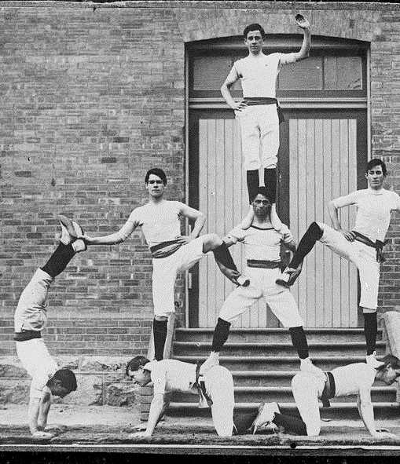
Team Roles
Sponsor
Champion
Facilitator
Subject matter expert
Meeting scribe
Data liaison
Notes:
Key CQI team roles include a Sponsor, Champion, Facilitator, Subject Matter Expert, Meeting Scribe and Data Liaison. Any team member can potentially fulfill any CQI role. Matching a person’s capabilities and resources to the needs of each role is essential.
Sponsor:
Similar to the Agency-Level Leader, the Sponsor has the authority to dedicate time to CQI efforts, offers a mechanism for support outside the authority of the CQI team, and supports partnership-building within or outside the agency.
The Sponsor is critical to empower the CQI team members to help understand and accept that they have the authority to make a difference.
Champion:
The Champion staff member is the ‘cheerleader,’ always talking about how great CQI is, going to new trainings, and encouraging everyone to do better.
The Champion also supports and reinforces the team for productivity and idea generation, ensures issues are understood across the team, and communicates team efforts and accomplishments to the team members and outside parties.
His or her love for CQI should be infectious!
Facilitator:
The Facilitator is responsible for preparing and introducing the meeting agendas and time parameters, drawing out opinions of quieter team members, keeping everyone focused on the task, ensuring meeting objectives are met, and summarizing next steps agreed upon by the team.
Subject Matter Expert:
A Subject-Matter Expert has a deep knowledge of the process or CQI topic area and uses his or her experience or expertise to help the team members understand how processes work. This role also contributes ideas for potential CQI topics or suggestions for change strategies to test.
Meeting Scribe:
The Meeting Scribe takes notes at each meeting, updates the team charter on a regular basis, and shares notes and updates with all team members.
Data Liaison:
The Data Liaison is responsible for gathering data/information for the project through a variety of mediums (emails, surveys, interviews, focus groups, etc.), working with the team to construct data/information gathering instruments, providing already existing data from databases, and ensuring data are compiled and provided to the team on a regular basis.
Data Liaisons also help to ensure accurate data interpretation.

Slide 20
Wait, families?
Yes, families! Families should be involved in all levels of CQI activities.
Notes:
You may have noticed the suggestion to include families in CQI work.
Engaging families in CQI has many potential benefits, including:
Collaboratively setting aims to help the team focus on areas that provide direct value to families
Helping the team prioritize its work by identifying topics of a range of importance to families (this can save on costs by reducing efforts that do not add value)
Sharing data with families helps build trust and increases ownership of the results
Developing and testing new change strategies stemming from ‘lived’ experiences
Expanding the team’s capacity to help frontline home visitors who are often overstretched
Motivating the teams to sustain their CQI work by providing a constant reminder of why home visiting is important to families.

Slide 21
Stages of Partnering with Families in CQI
1
2
3
4
Team engages families in ad hoc ways. | Team prepares to involve families in CQI. | Team learns how to involve family partners in CQI through experimentation. | Family partners actively lead or co-lead improvement initiatives.
Zeribi, K., Mackrain, M., Arbour, M., & O’Carroll, K. (2017). Partnering with families in continuous quality improvement: The Maternal, Infant, and Early Childhood Home Visiting Program. OPRE Report #2017-47. Washington, DC: Office of Planning, Research and Evaluation, U.S. Department of Health and Human Services. Produced by James Bell Associates.
Notes:
This slide displays a continuum of strategies for engaging families in CQI work.
The first stage is when the team engages families in ad hoc ways, including surveys, focus groups, or brief feedback from families on ideas related to CQI.
In the second stage, the team prepares to involve families in CQI by creating methods to recruit family partners and creating family adviser role descriptions, or offering CQI training to families.
The team learns how to involve family partners in CQI through experimentation in the third stage. Potential ways to involve family partners include adapting CQI team meeting structure and facilitation methods, offering recognition for contributions to CQI work, and taking steps to build future family partners.
In the fourth stage, a family partner can actively lead or co-lead improvement initiatives. Family partners may eventually have a permanent role within the agency’s CQI infrastructure and may assist with engaging other families in CQI work.
Please note that the stages are not always linear. Teams with family partners who actively lead CQI initiatives may still need to survey a larger group of participants, recruit additional participants, and experiment with new ways to engage team members.
Pass out the Resources for Partnering with Families in CQI handout and the Partnering with Families in Continuous Quality Improvement: The Maternal, Infant, and Early Childhood Home Visiting Program tipsheet.
More information on partnering with families in CQI and strategies and resources for engaging family partners in each of these stages can be found in the Partnering with Families in Continuous Quality Improvement: The Maternal, Infant, and Early Childhood Home Visiting Program tipsheet and the Resources for Partnering with Families in CQI handout.

Slide 22
Examples of Partnering with Families in CQI
Notes:
Here are some examples of progressively engaging families in CQI work:
One potential way is to engage a single family member on the CQI team in initial CQI discussions to help choose a topic and potential change strategies.
Eventually, that family member can then have increased involvement by helping in with other stages. For example, the family member can also be part of reviewing and interpreting the data.
Finally, having the family member lead CQI projects as part of an overall CQI initiative — strong, well-developed CQI teams often have multiple tests of change being carried out at the same time — may be an important strategy for expanding the CQI team’s capacity and engaging other families in CQI work.

Slide 23
Forming a CQI Team Activity
Identify potential members at your agency who may fit into each role on the CQI team:
Sponsor
Champion
Facilitator
Subject matter expert
Meeting scribe
Data liaison
Why is a potential member a good fit for the role identified? What are his/her qualifications?
What are some capacity gaps or reasons a team member may struggle in a role?
Notes:
Pass out the Forming a CQI Team handout and ask participants to break up groups into teams of four to six based on agency.
Using the Forming a CQI Team handout as a guide, begin to think about the following:
Who are the most appropriate individuals to fit into each of the roles? Don’t worry if they have the time or would agree, this is just an exercise.
What are some of the activities that each role performs on the team? How would each contribute?
What makes an individual a good fit for a role?
Why is an individual qualified for the specific role?
Are there gaps in CQI capacity among team members?
As you consider individuals for each role, consider both the reasons they would be a good fit for a role and why they might struggle. The following questions can help teams identify capacity gaps:
For each team member, what are some capacity gaps or reasons that a team member may struggle in a role? ​​
To what extent are team members familiar with CQI principles? Is the group level of capacity foundational, or more advanced?
Does every team member have previous experience with CQI?
Are there any roles for which you have no qualified individuals?
If so, which one and why do you think you do not have an individual who meets the required capacity needs? How might you be able to fill that role?

Slide 24
Remember...
A culture of quality is critical.
Identifying staff members and their strengths will help form a successful CQI team.
Partnering with families in CQI work has many potential benefits.
Notes:
Keep these key tips in mind as you move forward with creating a culture of quality and form your CQI team:
A culture of quality ensures a shared vision or value system with a quality infrastructure.
Identifying staff members and their strengths will help form a successful CQI team.
Families should be engaged in the CQI process. Partnering with families in CQI work has many potential benefits.

Slide 25
Additional CQI Resources
CQI Briefs: http://www.jbassoc.com/reports-publications/dohve
Quality Improvement Toolbox: http://www.hrsa.gov/quality/toolbox/methodology/qualityimprovement/index.html

Slide 26
Disclaimer
The purpose of the Design Options for Home Visiting Evaluation (DOHVE) is to provide research and evaluation support for the Maternal, Infant, and Early Childhood Home Visiting (MIECHV) Program. The project is funded by the Administration for Children and Families (ACF) in collaboration with the Health Resources and Services Administration (HRSA) under contract number HHSP233201500133I.
This publication was developed by James Bell Associates on behalf of the U.S. Department of Health and Human Services (HHS), HRSA, and ACF. Its contents are the sole responsibility of the authors and do not necessarily represent the official views of HHS, HRSA, or ACF.

