Slide 1


Continuous Quality Improvement Toolkit
A Resource for Maternal, Infant, and Early Childhood Home Visiting Program Awardees
Module 4: Creating SMART Aims
This document was prepared for the U.S. Department of Health and Human Services (HHS), HRSA, and ACF by James Bell Associates, Inc., under ACF contract number HHSP233201500133I. For more information, see http://www.jbassoc.com/reports-publications/dohve.
Notes:
This presentation is intended to be delivered by state-level CQI support staff. The notes are a suggested script for the presenter. Please see the accompanying Facilitation Guide and handout.

Slide 2
CQI Training Overview
1
2
3
4
5
6
7
8
9
Introduction to CQI
Using Data to Drive CQI and Identify Topics
Creating the CQI Culture and Forming a Team
Creating SMART Aims
Understanding the PDSA Process & Measurement
CQI Tools I: Process Maps
CQI Tools II: Root Cause Analysis Tools
CQI Tools III: Key Driver Diagrams
Reliability Concepts and Sustaining Gains
Notes:
This is the fourth module in a nine-part series.
This session focuses on how to develop SMART aims to guide CQI work.

Slide 3
Creating SMART Aims:
Learning Objectives
Identify the elements of a SMART aim
Evaluate SMART aims
Create a SMART aim
Notes:
The learning objectives for this module are for participants to be able to:
Identify the elements of a SMART aim
Evaluate SMART aims
Create a SMART aim

Slide 4
What is a smart aim?
Notes:
Let’s start by defining what makes an aim SMART.

Slide 5
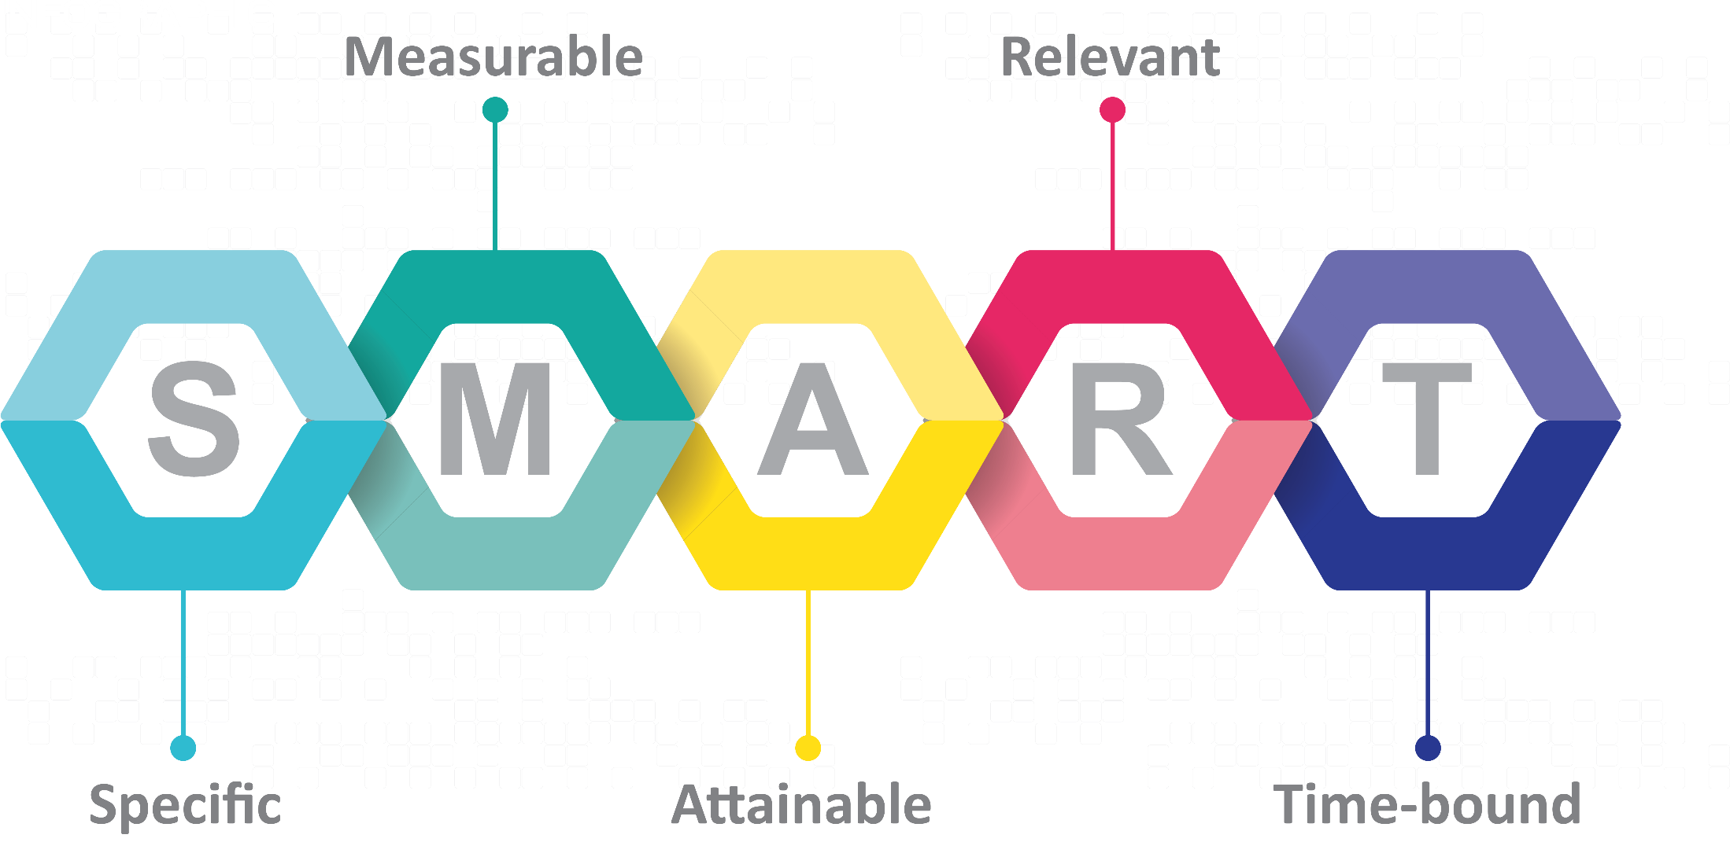
Notes:
SMART is an acronym for Specific, Measurable, Attainable, Relevant, and Time-bound. This acronym helps to set goals for CQI projects.

Slide 6

Aiming SMART
Not SMART
SMART
Families will receive services that ensure their children grow up better.
By September 1, 2018, the number of families enrolled in 2018 in the Happy Homes home visiting program who received the recommended number of home visits prescribed by the model will increase from 60% to 75%.
Notes:
The first aim, on the left, “Families will receive services that ensure their children grow up better,” does not use the SMART format.
The aim is broadly worded and not specific enough to explain who is doing what or how “the what” will be measured.
Since “better” is not defined, no action can be taken.
Also, a timeframe is not identified. Without an identified timeframe, the time when the goal should be achieved is unclear.

Slide 7
Aiming SMART
Not SMART
SMART
Families will receive services that ensure their children grow up better.
By September 1, 2018, the number of families enrolled in 2018 in the Happy Homes home visiting program who received the recommended number of home visits prescribed by the model will increase from 60% to 75%.
Notes:
The second aim, on the right, does use the SMART format: “By September 1, 2018, the number of families enrolled in 2018 in the Happy Homes home visiting program who received the recommended number of prescribed home visits will increase from 60% to 75%.”
The aim is specific; it is measurable.
It is attainable, depending on the home visiting agency. This agency has 60 percent of the families receiving the recommended number of home visits — 75 percent is an attainable goal.
It is relevant, since receiving the recommended number of home visits allows home visitors to deliver program content to the family.
Finally, the goal is time-bound, as it should be completed by September 1, 2018.
In the next slides, we will walk through each element of the SMART acronym.

Slide 8

SMART –
Specific
Notes:
First, specific. Aims must be specific to guide you toward improving an outcome. The more specific the goal, the easier it will be to identify processes for improvement. To guide the specificity of your aim, be sure to answer the following questions.
Who?
What?
Where?
When?
Ensure that the wording is clear and concrete so the goal is understandable. When teams come together to discuss the aim, ambiguity can be clarified by asking team members to indicate what the aim means for them. Be sure each member’s interpretation aligns with the goal. Asking others outside the CQI team who are less familiar with the goals to interpret the aim can serve as another check for clarity.

Slide 9
SMART – Specific
By September 1, 2018, the number of families enrolled in 2018 in the Happy Homes home visiting program who received the recommended number of home visits prescribed by the model will increase from 60% to 75%.
  Who? Families
  What? Will receive home visits
  Where? In their home
  When? By September 1, 2018
Notes:
In the Happy Homes example, the aim is specific because it identifies a target for improvement (75 percent of families), an outcome for improvement (families will receive the recommended number of home visits), and a timeframe for accomplishing the improvement (by September 1, 2018).
The aim also meets the necessary criteria.
Who? Families
What? Will receive home visits
Where? In their home
When? By September 1, 2018

Slide 10

Is the Aim Specific?
 | Yes | No
1. Home visitors will discuss child development concerns during 90% of home visits.
2. Most mothers will breastfeed their newborns by the end of the year.
3. By December 2018, home visitors will increase the rate of client retention from 50% to 75%.
Notes:
Let’s look at the three examples of SMART aim statements on this slide. Are these specific? If so, why? If not, why not?
Go through each SMART aim with participants, allowing them time to respond before revealing the answer and discussing the aim.
The first aim has a target of home visitors discussing child development concerns during 90 percent of home visits. Is it specific? [Allow time for responses.]
A timeframe for the target is not stated. How often the activities are occurring now is also not stated, so it is not clear how much improvement is needed to reach the 90 percent target.
In addition, is the goal to “discuss child development concerns” sufficiently specific? Does this mean the home visitor will ask the caregiver if she/he has developmental concerns about her/his child? Or does it mean the home visitor will tell the caregiver about any developmental concerns identified?
How can this be made more specific? What are your suggestions to improve this SMART aim?
A better SMART aim might be— “By December 2018, home visitors will increase from 80% to 90% the number of families they ask about child development concerns at every home visit.”
Is the second aim, most mothers will breastfeed their newborns by the end of the year, specific enough? [Allow time for responses.]
This SMART aim also lacks specificity. There is no specific number, stating only “most.” What does most mean? While 51 percent is more than half, is that most? What if 52 percent is reached?
It states, “Most mothers will breastfeed their newborns.” Does this mean any amount? What if they breastfed one time, but never again? Is this a measure of initiation of breastfeeding? It states by the end of the year, but what year, and what end? Is it the fiscal year or the calendar year? Thinking through these details and being as specific as possible are important.
Use the following prompts to have participants think through how to improve the SMART aim:
How would you improve this second aim?
What do you want to see improve — initiation of breastfeeding, 3 months of breastfeeding, 6 months of breastfeeding, or breastfeeding for the first year of life?
Who is the target of this SMART aim?
Ask the participants if specifying first-time mothers would be better. This may not matter for the improvement work, but could impact how the data is reported.
When will this goal be accomplished? Select a specific, reasonable date.
What percentage of improvement would meet the goal?
Once the participants choose a percentage, ask them to defend the choice.
Why that percentage?
If baseline data are needed, reinforce that using baseline data can be a critical part of this step. A baseline value can be invented for the purposes of this exercise.
With baseline data, it can be reworded to be more specific: Improve from ‘A’ percent to ‘B’ percent. The improvement would be the difference between A and B.
Is the last example specific? [Allow time for responses.]
Yes — it states the exact date (when) the goal will be accomplished, clearly indicates it is about home visitors retaining their clients, and states an improvement of 25 percent from a baseline of 50 percent (to increase to 75 percent). This has the level of detail needed to make the aim SMART.
What does ‘retention’ mean? Can it be something different for different programs? Operationally defining each term is important so that the meaning is clear. While the SMART aim does not need to contain a detailed definition for each term, it should still be operationally defined by the team.

Slide 11

SMART –
Measurable
Notes:
When creating an aim statement, defining how the outcome will be measured is important. Consider the following questions:
How can the outcome of interest be translated into a measurable data element?
Are there data currently being collected on this outcome? If not, what needs to be done to collect these data?
Does the measure allow visualization of progress over time?
Is the measure quantifiable (e.g., does it give a value or number to be used in the calculations)? If not, it will not be a suitable measurement for CQI projects.

Slide 12

SMART –
Measurable
Notes:
Let’s consider two examples of measures of reading to a child.
Reading to a child could be measured by having home visitors ask parents, “Do you do a good job reading to your child?” But what does a “good job” mean? Does it mean reading to the child daily? Reading once per week? Does it mean reading 10 books, or reading 20?
In contrast, reading to a child could be measured by having home visitors ask parents, “How many times do you read to your child in a typical week?” This is a more quantifiable, objective measure, and can also be used as a measure of change over time.

Slide 13
Is the Aim Measurable?
 | Yes | No
1. By January 2018, 90% of incoming families will receive literacy materials during their first home visit.
2. By January 2018, our moms will have 100% better breastfeeding behaviors than in the past.
3. 100% of mothers will complete a postpartum visit with their healthcare provider within 8 weeks of delivery.
Notes:
Now let’s look at the examples in this slide.
Go through each SMART aim with participants, discussing if each is measurable and why. Allow participants time to respond before revealing the answer and discussing the aim.
In the first example, the goal is 90 percent. What does the goal of 90 percent measure?
Participants should indicate that it is a measure of the percentage of mothers who received literacy materials at their first home visit.
Can incoming families receiving literacy materials be measured? Yes — this is measurable because the number of families who met this criterion can be counted. This count can meaningfully change over time as more or fewer families receive literacy materials.
Is the second aim measurable? [Allow time for responses.]
The second aim states “… 100% better breastfeeding behaviors.” But, how is better breastfeeding behavior measured? Measuring and quantifying breastfeeding behavior may be possible. But as stated in this aim, breastfeeding is not measurable because it does not explain how breastfeeding behaviors were being measured in the past or how they will be measured to demonstrate improvement. To make this measurable, “breastfeeding behavior” and the methods to measure it need to be defined. If the goal is to support mothers in breastfeeding for at least 6 months, then the measure can be defined as the number of mothers who have breastfed their children any amount at 6 months of age.
Is the last aim measurable? [Allow time for responses.]
This example is measurable because the aim is to count the mothers who complete a postpartum visit within 8 weeks of delivery, relative to the total number of mothers who are at or past 8 weeks of delivery.

Slide 14

SMART –
Attainable
Notes:
Often when improvement efforts begin, staff want to get started and are excited to make changes. However, setting goals that are not attainable can impede CQI efforts by slowing us down if we feel we are not able to affect the change we want. SMART aims need to reflect accomplishable goals. Consider the following questions for creating attainable aims:
Can home visitors impact this goal?
Is there evidence in home visiting for this aim? Has past research shown a link with home visiting? For example, there are no studies linking home visiting with improved athletic ability in children, so a SMART aim focused on enhancing children’s athletic ability would not be attainable in a home visiting environment.
Is it changeable? If it does not seem changeable, why not?
This is a complicated concept. First, a condition may appear to be unchangeable when in fact it can be changed. Or, the condition can be changed, but it is outside the scope of the home visiting agency. An example is homelessness:
Transient populations that are homeless at times are served by home visitors, but developing a SMART aim of giving permanent housing to currently homeless families would not make sense. First, home visiting service delivery does not focus on homelessness. Second, homelessness is often a complicated situation with many contributing factors that need to be addressed to lead to permanent housing, and are outside the scope of the home visiting service delivery strategy. However, home visiting agencies can refer families to temporary housing services or housing assistance programs, or can focus on steps to improve families’ life trajectories in such a way that will support permanent housing over time.

Slide 15
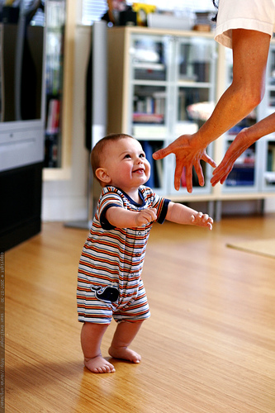
SMART –
Attainable
Notes:
Setting smaller, more incremental goals at the beginning is important. Instead of planning to increase breastfeeding rates from 30 percent to 90 percent in 12 months, start by setting a goal of 30 percent to 50 percent in 6 months. Once the initial goal is attained, the CQI team resets the target to a higher standard for a second period.
An important aspect of CQI is adjusting the strategies used for making improvements as progress is made.

Slide 16
Is the Aim Attainable?
 | Yes | No
1. Home visitors will cure childhood obesity.
2. Home visitors will retain 100% of families on their caseloads until graduation.
3. By December 2018, home visitors will increase the rate of breastfeeding at 3 months from 20% to 40%.
Notes:
Go through each SMART aim with participants, discussing if each is attainable and why. Allow participants time to respond before revealing the answer and discussing the aim.
Is the first aim attainable for a home visiting agency? [Allow time for responses.]
There are multiple reasons why this is not an attainable aim for home visiting. First, the ability to change a population-based outcome like childhood obesity is out of reach for the agency. This outcome cannot be changed within the timeframe of a CQI project, even with additional content or services to address childhood obesity. Also, childhood obesity is not typically addressed in home visiting service delivery. Home visiting agencies can include service components to focus on childhood obesity, but SMART aims should align with the service delivery approach of home visiting and the mission of your agency.
Is the second aim attainable for a home visiting agency? [Allow time for responses.]
The second example indicates a reasonable topic for home visiting CQI. But retaining all families until completion is not realistic; some families will move and others will have legitimate reasons for not being able to complete the program. Stretching goals is good, but 100 percent is typically unattainable.
A better version of this goal might be, “home visitors will retain 80 percent of families on their caseloads until graduation.”
Is the third example an attainable SMART aim? [Allow time for responses.]
This aim is attainable. Improving breastfeeding rates in the stated amount of time seems feasible. The time point of 3 months instead of 6 or 12 months also increases the likelihood that a larger increase is attainable than what might be possible at later ages.

Slide 17

SMART –
Relevant
Notes:
SMART aims should focus attention where it is most needed. This element is about focusing on the aims that agencies want to or can address immediately. Aims can be attainable with reasonable targets, but they may not be relevant to the agency.
For example, an agency might choose to focus on improving the number of mothers observed for parent-child interaction at each child’s 12-month birthday. However, if only 10 percent of all families served remain enrolled in the program until the child’s 12-month birthday, is this relevant? Retention is a more critical and relevant topic.

Slide 18
SMART – Relevant
Is the aim related to home visiting?
Is the aim meaningful to your team or agency?
Of all the things you could immediately work on, is this the most important for your agency and the families served?
Notes:
To ensure that a SMART aim is relevant, ask the following questions:
Is the aim related to home visiting?
Is the aim meaningful to your team or agency?
Of all the things you could immediately work on, is this the most important for your agency and the families served?

Slide 19
Is the Aim Relevant?
 | Yes | No
1. Home visitors will increase rate of child development screenings from 90% to 95% by December 2017.
2. LIAs will accurately report 100% of the data required for performance measurement benchmarks.
3. Home visitors will increase depression referral acceptance rates from 25% to 75% by December 2018.
Notes:
Go through each SMART aim with participants, discussing if each is relevant and why. Allow participants time to respond before revealing the answer and discussing the aim.
Is the first aim relevant for a home visiting agency? [Allow time for responses.]
The first example includes all the criteria for a SMART aim, but the program is already performing well in this area- it’s currently conducting developmental screenings with 90% of children. This is not the most relevant aim because the program is performing well; there are other topics on which the program could be focusing its attention.
Is the second aim relevant? [Allow time for responses.]
This example can be tricky. Accurate reporting of performance measurement data is an important part of agency accountability, but not a relevant SMART aim. SMART aims should focus on services for families and how services are provided so as to have the best possible outcomes. Data quality can be improved as a byproduct of CQI efforts, but improving data collection by itself is not a relevant SMART aim.
Is the third aim relevant for a home visiting agency? [Allow time for responses.]
This is a relevant SMART aim. Following a positive screening, home visitors routinely make referrals for depression services; affecting an increase in the acceptance rate is well within the power of home visiting programs. Further, this is relevant because maternal depression has negative consequences for the whole family, and getting mothers into services is important for ensuring optimal child outcomes.

Slide 20

SMART –
Time-bound
Notes:
An aim without a timeframe is achievable, but difficult to manage. Timeframes are necessary to guide CQI work and continue to propel programs forward. A specific timeframe inherently builds in motivation and accountability.
It’s important to make the timeframe as specific as possible. For example, “by December 2018” is better than “in 6 months.”
To ensure that the SMART aim is time-bound, ask the following questions:
Is the timeframe specific?
Is the timeframe attainable?

Slide 21
Is the Aim Time-bound?
 | Yes | No
1. All families will attend the parent group with their children this month.
2. Over the next year, we plan to support 25% more parents in finding a medical home.
3. By December 31, 2018, we will decrease the number of caregivers using tobacco by 20%.
Notes:
Go through each SMART aim with participants, discussing if each is time-bound. Allow participants time to respond before revealing the answer and discussing the aim.
Is the first aim time-bound? [Allow time for responses.]
This first aim is not time-bound; “this month” is the only timeframe given. Why is “this month” a problem?
“This month” is a problem because the “month” could change depending on when the SMART aim is referenced; it isn’t sufficiently specific.
Is the second aim time-bound? [Allow time for responses.]
While the second aim is measurable and specific in content, it is not specific in time. Without a specific date, a yardstick to measure success is not available, and the ‘we’ cannot be held accountable — reaching this goal could be put off indefinitely.
Is the third aim time-bound? [Allow time for responses.]
This is an example of a time-bound aim because the date (December 31, 2018) is provided. To make this more time-bound, an exact time of day could be included. In fact, that is not an uncommon practice; it ensures specificity and reduces ambiguity in what needs to be accomplished and by when.

Slide 22

“Some is not a number, soon is not a time!”
Don Berwick, Institute for Healthcare Improvement (IHI)
Notes:
This quote from Don Berwick recaps the purpose of making SMART aims.
CQI is a method based on measurement. “Some” or “soon” are not precise and should be replaced with such language as, “increase by 25 percent” and “by September 2018.”
It is important to be as specific as possible when you create a SMART aim.

Slide 23
creating a smart aim
Notes:
The next section will address how to develop a SMART aim.

Slide 24
Set an Aim
By_______, _________ of ________
will ________________.
(when)
(#, % or % change)
(whom)
(what result, change, benefit)
Notes:
The SMART aim format on this slide is used to ensure that all criteria are included when creating an aim statement.
Read the slide to the participants and discuss to what each ‘blank’ refers.
The first space refers to the time by which you want to achieve your aim. This is how to make it time-bound.
The second space is the number, percent, or percentage of desired change. This is how to quantify the desired change.
The third space refers to who will be affected by the change. Is it caregivers, home visitors, children, etc.? This is not who is responsible for the change, but who will be affected by the change.
The last space asks what will happen. Here, indicate the desired change, such as initiating breastfeeding or retaining families until graduation.
Note that this formula does not include a comparison or baseline. A SMART aim does not require stating “from X to Y.” But if this information is available, including it can be helpful.

Slide 25
Set an Aim
By December 31, 2018, 95% of
enrolled children will
be screened for developmental delays with a validated tool.
(when)
(%)
(whom)
(what result, change, benefit)
Notes:
Here is an example of a SMART aim filled in using the template from the previous slide.
Next, let’s evaluate example aims to determine if they meet all the SMART criteria.

Slide 26
Evaluate this Aim
By the end of the year, we will increase the number of children receiving services for developmental delays.
  What needs to be improved?
  How much?
  By when?
Notes:
Does this aim meet the SMART criteria?
Let participants point out what is wrong or missing. Use the following prompts to help facilitate the discussion:
What are they trying to accomplish?
The aim is to increase the number of children receiving services for developmental delays. This topic is relevant to home visiting and can be impacted by home visitors.
Does it indicate how many more children will receive services for developmental delays?
No, there is no number indicating how many more children will receive developmental services. As it stands, this measure does not include a starting point or definition of ‘services.’
Does it say when?
No, there is no date stating when this aim should be completed.
Is it attainable?
Even though this measure seems highly attainable, a quantifiable goal or time-frame is not included. As a result, you do not know what a meaningful increase would be, how to measure it, or when it would be accomplished.

Slide 27
Evaluate this Aim
By December 31, 2018, 90% of children with parental concerns about development who are not eligible for Early Intervention or other community services will receive individualized development support from home visitors.
  What needs to be improved?
  How much?
  By when?
Notes:
Read the aim aloud, and then read the questions below the aim. Allow the participants to answer the questions. Facilitate the discussion using the following talking points:
Does this aim meet the SMART criteria?
This is a good SMART aim and meets all the criteria.
This aim includes a challenging task, but the goal is clear. For parents who are concerned about their children’s development, if the children are not eligible for early intervention services or other related services, the agency will make sure the parents’ concerns are addressed by the home visitor providing individualized support.
In this case, the aim does state how much: 90 percent of the children not eligible for other services will receive individualized support. The aim does not include a baseline indicating where the agency stands; that’s okay, there is not a requirement to state “from A to B.” But again, including the baseline in the aim would make it more specific.
The aim includes a date (December 31, 2018), which is the date the agency plans to achieve the 90 percent threshold.

Slide 28
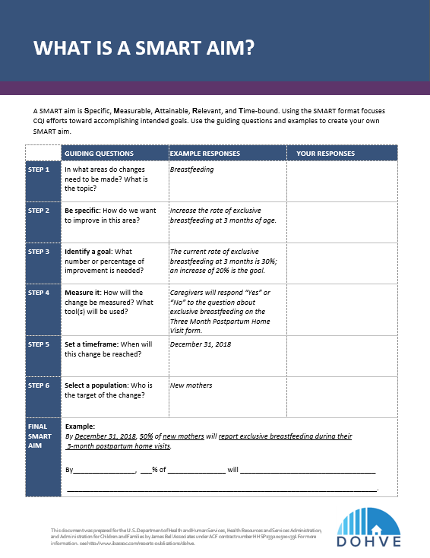
Create Your Own SMART Aim
Your CQI team is interested in improving breastfeeding rates. Your analyst shows you data on low rates of breastfeeding among new mothers. Only 60% of mothers initiate breastfeeding and just 30% of those who initiate are exclusively breastfeeding at 3 months.
Notes:
Pass out the What is a SMART Aim? handout. Ask participants to break into small agency teams of four to six members to complete this handout together. Note that the What is a SMART Aim? handout has a slightly different format and approach to developing an aim, but that all of the same information is being captured.
The What is a SMART Aim? handout will walk you through the components of the aim statement to ensure that all criteria are met.
Let’s go through the example together first, and then you will work as teams to create your own SMART aim.
Imagine that your CQI team is interested in improving breastfeeding rates. The data analyst shows you data on low rates of breastfeeding among new mothers. Only 60 percent of mothers initiate breastfeeding and just 30 percent of those who initiate are still exclusively breastfeeding at 3 months.
First, in what areas do changes need to be made? What is the topic? [Allow time for responses.]
Breastfeeding
Next, be specific. How do we want to improve in this area? [Allow time for responses.]
The focus is on increasing exclusive breastfeeding at 3 months.
Next, identify a goal. How much of an improvement do you want to see? [Allow time for responses.]
There are two important baseline numbers on the slide: 60 percent initiate breastfeeding and 30 percent breastfeed until 3 months. The aim is to improve exclusive breastfeeding at 3 months, so these two numbers can be used to set a target to improve breastfeeding rates at 3 months. An increase of 20 percent is the goal.
How is this measured? What tool(s) will be used? While the specifics will not be included in the aim statement, the aim is on track if it can be measured. [Allow time for responses.]
The agency has a form that captures breastfeeding; so, it can be measured. On the form, the questions should be worded carefully. Is the word exclusively used in the question(s)? Are there questions about initiation and ongoing continuous breastfeeding? Reviewing how the agency currently measures breastfeeding and whether it meets the criteria for this aim are important.
When will this change be reached? When will this improvement be seen? [Allow time for responses.]
Sufficient time needs to be given to implement the PDSA (Plan-Do-Study-Act) cycles. But also, a distant timeframe could impede the motivation to accomplish your goal. Examples like December 2018 (the end of the calendar year) and September 2018 (the end of the federal fiscal year) are used because they are often meaningful check-in points for CQI projects.
Who is the target of the change? Define the population with whom you are going to work. [Allow time for responses.]
Here, the target population is new mothers.
When we take all of this information and put it together to fill in the template at the bottom of the page, we have a meaningful SMART aim. Make sure to read the SMART aim aloud to see if it meets all the criteria.
Now, using the What is a SMART Aim? handout and the information on the slide, please come up with your own breastfeeding SMART aim. We will come back together as a group and share SMART aims along with rationale. For this exercise, please focus on creating a SMART aim and hold off on coming up with potential solutions.
Give the groups time to create their SMART aim, and then bring the groups back together to share. Use this as an opportunity to highlight what was done well and what elements still need to be added or improved, being careful not to criticize the statements. Remind everyone that this is new and time is needed to learn a new skill, such as developing a SMART aim. Note that groups could intentionally include both initiation and 3-month exclusive breastfeeding. This could become useful later. When bringing the groups back together to discuss their SMART aims, see if someone comes up with this idea. If nobody includes the idea “Of those who initiated breastfeeding,” highlight this idea for the group. Explain that since a mother can’t breastfeed at 3 months if she never initiates, and the initiation rate is not as high as it could be, initiation should be looked at first. The number of mothers who breastfeed at 3 months will increase if the number who initiate is increased. Some projects looking to increase breastfeeding rates might start with the population who initiated and work from there. In this case, there could be an increase in those who initiate, since 40 percent of the potentially eligible population is not initiating. This also gives more room later to develop projects that focus on all aspects from initiation through continuation, instead of just one area, such as continuation at 3 months.

Slide 29
Remember...
SMART aims are:
  Specific
  Measurable
  Attainable
  Relevant
  Time-bound
Notes:
Remember, SMART aims are:
Specific — by answering the questions who, what, when, and when.
Measurable — by ensuring the outcome can be translated into a measurable data element.
Attainable — meaning it is possible to achieve the aim.
Relevant — meaningful to the agency.
Time-bound — by providing a specific timeframe within which to accomplish the goal.

Slide 30
Additional CQI Resources
CQI Briefs: http://www.jbassoc.com/reports-publications/dohve
Quality Improvement Toolbox: http://www.hrsa.gov/quality/toolbox/methodology/qualityimprovement/index.html

Slide 31
Disclaimer
The purpose of the Design Options for Home Visiting Evaluation (DOHVE) is to provide research and evaluation support for the Maternal, Infant, and Early Childhood Home Visiting (MIECHV) Program. The project is funded by the Administration for Children and Families (ACF) in collaboration with the Health Resources and Services Administration (HRSA) under contract number HHSP233201500133I.
This publication was developed by James Bell Associates on behalf of the U.S. Department of Health and Human Services (HHS), HRSA, and ACF. Its contents are the sole responsibility of the authors and do not necessarily represent the official views of HHS, HRSA, or ACF.

