Slide 1
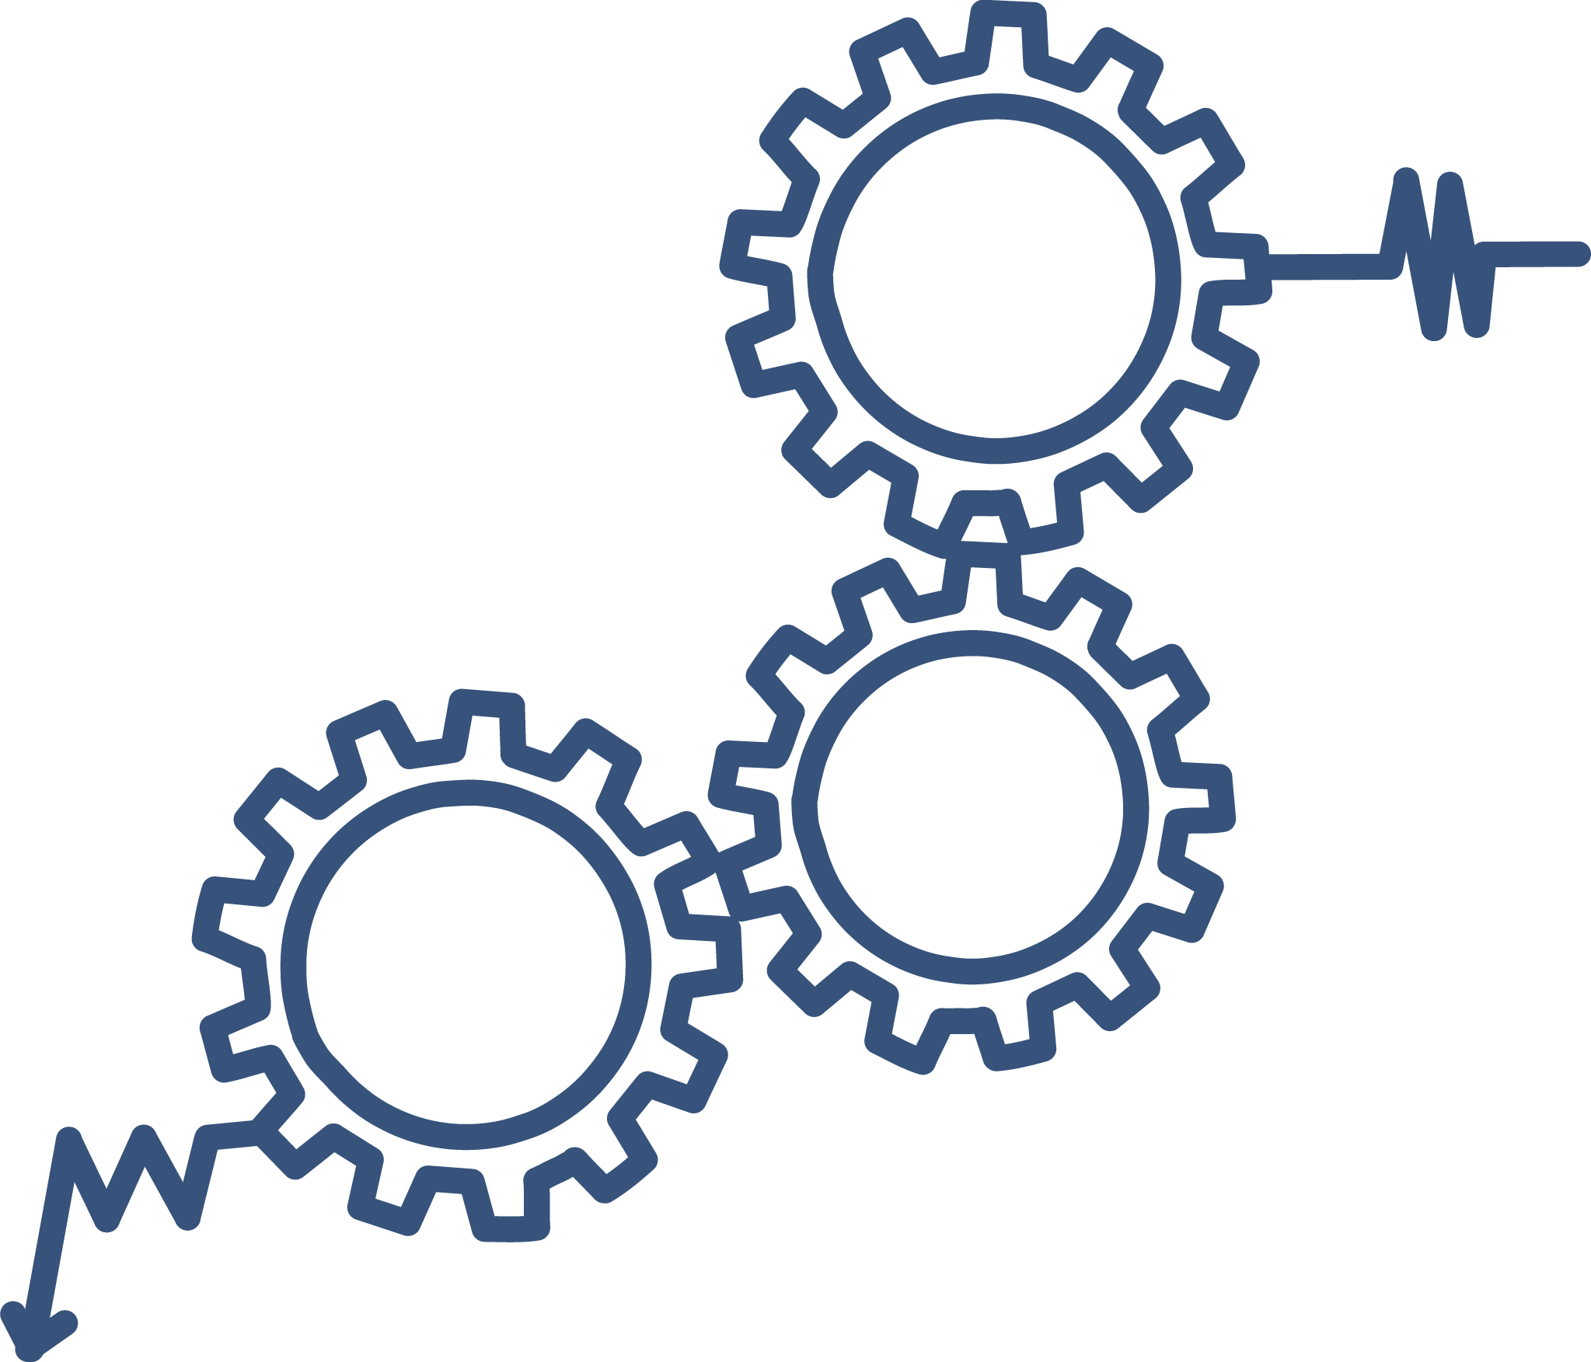

Continuous Quality Improvement Toolkit
A Resource for Maternal, Infant, and Early Childhood Home Visiting Program Awardees
Module 5: Understanding the PDSA Process and Measurement for CQI
This document was prepared for the U.S. Department of Health and Human Services (HHS), HRSA, and ACF by James Bell Associates, Inc., under ACF contract number HHSP233201500133I. For more information, see http://www.jbassoc.com/reports-publications/dohve.
Notes:
This presentation is intended to be delivered by state-level CQI support staff. The notes are a suggested script for the presenter. Please see the accompanying Facilitation Guide and handouts.

Slide 2
CQI Training Overview
1
2
3
4
5
6
7
8
9
Introduction to CQI
Using Data to Drive CQI and Identify Topics
Creating the CQI Culture and Forming a Team
Creating SMART Aims
Understanding the PDSA Process & Measurement for CQI
CQI Tools I: Process Maps
CQI Tools II: Root Cause Analysis Tools
CQI Tools III: Key Driver Diagrams
Reliability Concepts and Sustaining Gains
Notes:
This is the fifth module in a nine-part series.
This session focuses on (1) understanding the Plan-Do-Study-Act (PDSA) process and (2) measurement for CQI.

Slide 3
Understanding the PDSA Process:
Learning Objectives
Describe the PDSA cycle and explain its use
Understand three types of measures for PDSA cycles
Understand how to conduct rapid improvement cycles
Notes:
The learning objectives for this module are for participants to be able to:
Describe the PDSA cycle and explain its use
Understand three types of measures for PDSA cycles
Understand how to conduct rapid improvement cycles.

Slide 4
Pdsa cycles
Notes:
The Plan-Do-Study-Act cycle is a hallmark of nearly all CQI models. It is also referred to as the Plan-Do-Check-Act cycle but in this training, the PDSA terminology will be used.
The PDSA cycle is a structured approach to testing improvement ideas.

Slide 5




Plan-Do-Study-Act
Do
Act
Plan
Study
Commonly referred to as PDSA, Plan-Do-Study-Act is a cycle of activities used to achieve process or system improvement.
Notes:
Plan-Do-Study-Act is a cycle of activities used to achieve process or system improvement.
It was first proposed by Walter Shewhart, one of the pioneers of quality control, and popularized by his student, quality expert W. Edwards Deming.

Slide 6




Benefits of the PDSA Cycle
Scientific approach to improvement
Rapid identification of effective solutions
Small scale testing to reduce waste in resources
Structured and organized improvement process
Systematic documentation to facilitate learning and dissemination of ideas
Do
Act
Plan
Study
Notes:
There are many benefits to using the PDSA cycle in CQI work:
First, the PDSA cycle relies on a scientific approach to improvement. A standard framework is used, improvement efforts are measured and documented, results are replicable, and errors are identifiable.
Second, it allows for rapid identification of effective solutions in real time.
Next, because the process begins with a small-scale test of a change strategy, for example using just one home visitor or one family for just 1 day or 1 week, it reduces potential waste of resources. Once a change strategy is successful on a small scale, it can then be carried out on a larger scale (this concept will be discussed in greater detail shortly).
Use of planning sheets and other tools keeps the process structured and organized (this will be demonstrated later in this session).
Last, documenting improvement efforts helps facilitate learning and spreads ideas.

Slide 7
PDSA: Plan
Do
Act
Plan
Study
What is the objective of the test?
How will you measure the impact of the test?
What is your plan to collect the data needed?
What do you predict will happen?
Notes:
The first stage in the PDSA cycle is the ‘Plan’ stage. In this stage, the CQI team thoroughly analyzes the problem to identify the underlying causes and the potential solutions. The team develops a change strategy that is used in the second step of the PDSA cycle.
The questions on this slide can help to guide the planning of this change strategy.
A key component of the Plan stage is to identify the underlying cause of the problem in order to find an appropriate solution (change strategy). The reason the solution could work should be clear.

Slide 8

PDSA Plan Example: Identifying Root Causes
Problem =
Low breastfeeding rates among babies who are 6 months of age
Notes:
A home visiting agency may have low breastfeeding rates among babies who are 6 months of age. To identify potential solutions, the root or underlying causes of the problem must be identified. If the CQI team thinks the underlying cause is that mothers are not aware of the benefits of breastfeeding until their infants are up to 6 months old, it may plan to launch an educational campaign on the benefits of breastfeeding. However, if the real underlying cause is that many of the mothers are struggling with breastfeeding once they return to work, then a campaign to increase awareness of the benefits of breastfeeding may not be effective.
The solution to the problem must be directly related to the actual underlying cause of the problem in order to create real results.
Another point to consider in this example is the potential for unintended consequences. By focusing on the benefits of breastfeeding, the team could unknowingly call into question the mother’s parenting efficacy, which would be counter-productive to its efforts. Being aware of potential consequences and measuring them is important (these are known as balancing measures, which will be discussed more later). CQI teams should measure the mother’s parenting efficacy during the second stage of the PDSA cycle, the ‘Do’ stage, to be sure that these efforts are not undermining other parts of the system.

Slide 9

Example of Change Strategies:
Family Retention
Try a variety of communication strategies to enhance the relationship between the home visitor and family.
  Motivational interviewing
  Active listening
  Texting to support the family’s early goals (e.g., “How is it going?”)
Notes:
Part of the Plan phase of the PDSA cycle is to identify potential change strategies and to select one to test in the PDSA cycle. It’s likely that you will have change strategies in mind that you can test, or that you can brainstorm as a team to come up with potential change strategies. There are also tools that can be used to help identify change strategies; those will be covered in the next three modules.
Here, we are going to use the topic of family retention and go through example change strategies and think about how each of these strategies may lead to improved family retention. We will return to the breastfeeding example later.
Lead the group through a discussion of how each of the change strategies displayed would lead to enhanced family retention. Ask for volunteers to choose one of the strategies listed and provide rationale/logic as to why that change strategy would help retain families. If the example and explanation are sound, reinforce the key points and thank the person for sharing. If the idea does not fully explain why a family would be retained, keep asking more questions to help participants think through the underlying logic. For example, if a participant selects “Texting to support the family’s goals,” he or she may explain, “This will help the family feel more supported.” Ask the participant the following questions:
Why does feeling supported matter for retention?
Why text? Why not email or call? What is unique about texting?
If texting is how family members typically communicate, how might the home visitor texting them lead to their retention in the program?
Is it possible that at first the family does not value home visiting? If so, is it also possible that texting with the family member to support their goals increases their perceived value of home visiting, thus reducing the likelihood that the family will leave?

Slide 10
PDSA: Do
Do
Act
Plan
Study
Was the cycle carried out as planned?
What were the results of the test?
What did you observe that was not part of your plan?
Notes:
The next stage part of the PDSA cycle is the ‘Do’ stage. In this stage, the change strategy identified and developed in the ‘Plan’ stage is carried out. Observations are made and recorded.
The questions on this slide are prompts to use when going through the Do stage of the PDSA cycle. There are three key components of this stage: monitoring implementation, measuring outcomes, and documenting balancing measures.
For a change strategy to be effective, every step of the plan must be implemented as it was intended. Monitoring the implementation of the change strategy can help identify places where it is not being implemented as intended. This information will help explain the outcomes of the change strategy, as well as what needs to be adjusted.
To determine if change strategy tests are successful, the outcomes must be measured.
Finally, balancing measures must be documented during the Do stage. Balancing measures, outcome measures, and process measures will be discussed later in this presentation.

Slide 11

PDSA: Do Example
Problem = Low breastfeeding rates among babies 6 months of age
Solution = Home visitors inform mothers of their pumping rights at work
Notes:
Let’s return to the example of low breastfeeding rates among babies who are 6 months of age.
During the Plan stage of the PDSA cycle, the CQI team determined the actual underlying cause of the problem is that mothers are struggling to continue breastfeeding once returning to work. The change strategy that the team will test to address this problem is to have home visitors inform breastfeeding mothers of their rights regarding pumping during work hours. Monitoring each step of the change strategy can help to identify places where the plan is not being implemented as expected. For example, monitoring how home visitors are delivering the information and whether it is accurate are important. If a key piece of information is not communicated by the home visitors, then mothers may not change their behaviors.

Slide 12
PDSA: Study
Do
Act
Plan
Study
Did the results match your prediction?
What did you learn?
What do you need to do next?
Notes:
The next part of the PDSA cycle is the ‘Study’ stage. Here, the change strategy is carefully analyzed to understand the results and how the change strategy was implemented.
The questions on this slide are prompts that can be used when going through the Study stage of the cycle.
One key component in the Study stage is to identify whether the Plan was implemented as intended. If the results indicate that it was not, studying why is important.
Fully understanding how the Plan was implemented guides the interpretation of the next key component: outcome measures.
First, the CQI team studies whether the outcomes match the predictions.
Then the team considers how the implementation of the Plan affected the outcomes of the change strategy.
Next, the CQI team needs to analyze the balancing measures to determine if there were any unintended consequences of the change strategy on other parts of the home visiting program.
Last, taking all of the results and how the strategy was implemented together, you need to decide what to do next.
Involving the entire CQI team in this Study stage of the cycle is important to fully understand and interpret the data collected.

Slide 13

PDSA: Study Example
Problem = Low breastfeeding rates among babies 6 months of age
Solution = Home visitors inform mothers of their pumping rights at work
Results = Plan not implemented as intended, expected outcomes not achieved
Notes:
Let’s return to the example of low breastfeeding rates among babies who are 6 months of age. In the Study stage of the PDSA cycle, the CQI team discovers the Plan was not implemented as expected. When considering why this happened, they identified that the home visitors did not communicate accurate information. The CQI team discovered from speaking with the home visitors that the home visitors did not completely understand the information and could not communicate it effectively. When the CQI team analyzes the results, it sees that the test did not have the expected results. Since the change strategy was not implemented as intended, the results are understandable
Facilitate a discussion about this example to help participants understand the steps in the Study stage using the following prompts:
What did the CQI team learn? Was the change successful on a small scale?
If yes, then the next step is to use this information to make decisions on the steps in the ‘Act’ stage.
If not, then the next step is to use this information to decide not to continue as is in the Act stage. However, this decision should be informed by the process data as well.
Was the change strategy implemented as intended?
If yes, then document carefully what was done for future replication.
If not, then study the data to identify why (e.g., consider interviewing the home visitors or families to better understand what happened; this will not tell the CQI team if the strategy worked, but can provide critical context for how the change strategy was implemented and what barriers were faced). Documentation of what did not go as planned, and why, is also important.
Were there any unintended consequences in other parts of the system?
Balancing measures are helpful to monitor unintended consequences in other parts of the system. These will be discussed in greater detail later in the presentation.
The previous example measured the mother’s breastfeeding and/or parenting efficacy. Do the results suggest that over the course of the change strategy, the mother’s efficacy went down? If so, it is important to document this. If her ability to breastfeed did go up or stayed the same, this too is an important consideration for future scale-up.

Slide 14
PDSA: Act
Do
Act
Plan
Study
Three A’s of Acting:
  Adapt
  Adopt
  Abandon
Notes:
The last part of the PDSA cycle is the ‘Act’ stage.
There are three courses of action to take in this stage: adapt, adopt, or abandon the tested change strategy. The information gathered in the Study stage is used to determine the appropriate action.
If the change strategy produced the expected results and was implemented as intended, then the appropriate action is to adopt the change strategy.
If the change strategy did not produce the expected results and/or was not implemented as intended, then the appropriate action is either to adapt or to abandon the change strategy.
If it’s possible to make changes to implement the change strategy as intended, then it’s appropriate to adapt and test it again in another PDSA cycle. However, if it’s determined there’s no way to implement the change strategy as intended, then it’s necessary to abandon it.
If the change strategy was implemented as intended but did not produce the expected results, then whether or not improvements could be made to produce the expected results must be determined. Some areas that may need adjusting include sample size, length of time provided to measure changes in the outcome, tools used to measure the outcomes, or the outcomes themselves. If adjusting the change strategy is feasible in any of these ways, then it is appropriate to adapt and test it again in another PDSA cycle. However, if there is no way to adjust the change strategy, then it should be abandoned.
The decision to abandon should not be taken lightly; the consequences of wasted time and resources on ineffective ideas should be considered.
One important factor to consider is whether there were unintended consequences resulting from the change strategy. If there are unintended consequences that negatively affect other aspects of the home visiting program, the intervention may need to be adapted or abandoned.
It is important to involve the entire CQI team in this stage of the PDSA cycle when making decisions about the next steps.

Slide 15
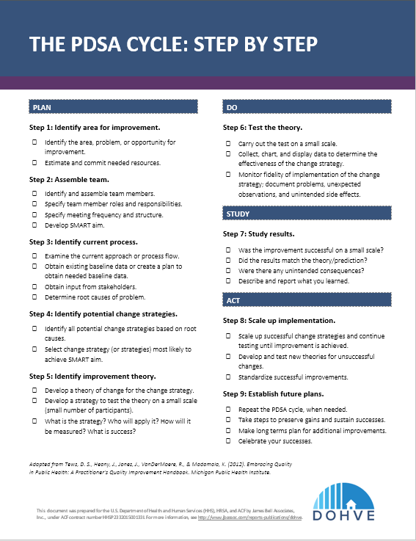
The PDSA Cycle: Step by Step
Notes:
Pass out The PDSA Cycle: Step by Step handout.
This handout summarizes the steps within each stage of the PDSA cycle. Please refer to it as you plan and implement your first PDSA cycle to help guide you through the process.

Slide 16
PDSA in Action
Notes:
Now let’s put the PDSA cycle into practice.

Slide 17
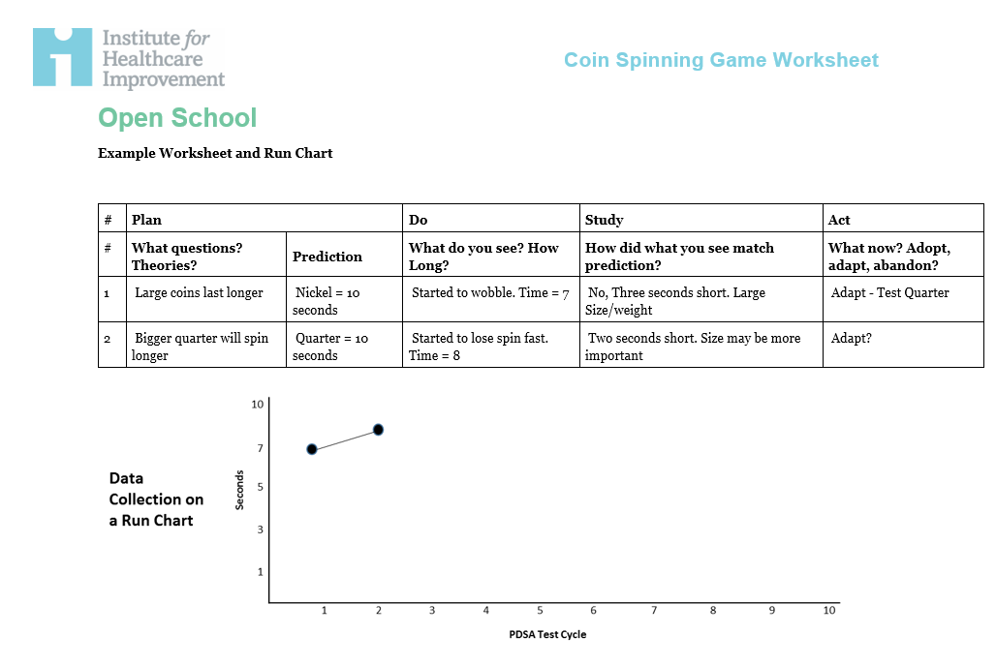
Coin Spinning Game
What will you need?
4 coins of different sizes
A timepiece
A time keeper
Coin Spinning Game worksheet
Developed by Dave Williams, Institute for Healthcare Improvement: https://www.youtube.com/watch?v=3U9lLiPOhtM
Notes:
Please click on the YouTube link on the slide (https://www.youtube.com/watch?v=3U9lLiPOhtM) and watch the video explaining how to facilitate and play the coin spinning game prior to facilitating this session (if clicking on the slide doesn’t work, copy the link and paste it onto your browser). This activity is designed to show how quickly and easily a change strategy can be tested and meaningful data obtained. Ask participants to break up into agency teams of 4-6 to complete the activity together. Pass out the Coin Spinning Game Worksheet and a penny, nickel, dime, and quarter to each table.
We will now play a game to see how PDSA cycles work. The “Coin Spinning Game” was developed by Dave Williams at the Institute for Healthcare Improvement.
The goals of the activity are to:
Understand rapid-cycle PDSA cycles
Understand how theory and prediction help you learn
Collect real-time data for measurement
Learn as a team.
Each team has four coins of different sizes. The object of the game is to have one coin spin for as long as possible. Your team will create PDSA cycles to test different strategies for getting the longest spin. Use any of the four coins, any technique, and any surface available to try to get to the longest spin.
Use the Coin Spinning Game Worksheet to document each of the PDSA cycles. Designate one person from each team to be the time keeper. A watch with a second hand or a phone with a timer is needed. The timer should be started as soon as the coin starts spinning, and end when the coin comes to a complete stop.
Remember to be intentional when you are testing different strategies and to document the entire process on the Coin Spinning Game Worksheet. Start by writing your change strategy on the plan section of the Worksheet along with your prediction.
Spin the coin and conduct the test. As you do each test, record the observations in the ‘Do’ column of the Worksheet and document your findings in the Study column. Then, decide if you should adopt, adapt, or abandon that change strategy.
Make sure to document your results on the run chart on the bottom of the page as you go along.
Do as many cycles as possible in the next 10 minutes.
Give teams 10 minutes to play. Walk around while they are playing to ensure they are using the Coin Spinning Game Worksheet as intended.

Slide 18
Coin Spinning Game Debrief
What brought you to the longest spin?
How many tests did your team run?
How much data did you collect? How many data points are on your run chart?
Notes:
Bring the group back together and use the questions on the slide and the prompts below to facilitate a discussion around the results of the game.
How did your team get to the longest spin?
Creativity — Did you get creative about the definition of surface?
Theory — Who at the table was the best spinner? Which coin spins the best?
Ability to formulate and ask questions — Did you notice the ability to explore a theory or assumption without judgment from your colleagues?
How many tests did your team run?
Often, the more change strategies you test, the more success you have.
How much data did you collect? How many data points are on your run chart?
Were you surprised how quickly you could collect the data? How quickly you could fill out a run chart? When you are implementing your own PDSA cycles, it is helpful to use a run chart template in Excel, but if that is intimidating or not readily available, you can always use a paper and a pen to create a run chart like this one.
If any groups did not fill out the chart on the Worksheet, note that it is important to document all change strategies to see which ones are the most effective. If the PDSA cycles achieve the desired result and the team did not track each of the change strategies, it is impossible to determine which change strategy was successful and use it going forward.
The longest spin is typically 13-15 seconds, which is the limit of the system. Teams must acknowledge these limits of the system and understand that at times we are trying to force the system to perform at a level higher than is possible. Sometimes, the system must be redesigned.

Slide 19
Measurement in pdsa cycles
Notes:
Let’s move on to talking about measurement in PDSA cycles.

Slide 20

When is change an improvement?
Notes:
Measurement is a key aspect of PDSA cycles.
Measurement is used to understand what took place when the change strategy was tested, whether the plan was implemented as intended, and whether the test produced the expected results.
There are three types of measurements utilized in PDSA cycles:
Process measures
Outcome measures
Balance measures
All three types of measures are collected during the Do stage and analyzed during the Study stage of a PDSA cycle. The next few slides will provide more details about these types of measures.

Slide 21

Process Measures
  Used to understand implementation of the change strategy
  Help assess fidelity when testing a change strategy
  Support scaling up
Notes:
Process measures are used to understand how a change strategy was implemented.
Process measures help assess whether a change strategy was implemented with fidelity, but cannot be used to determine the effectiveness of a change strategy.
Process measures are also useful when change strategies are scaled up to carry out bigger tests. Scaling up means carrying out tests of the change strategy on a larger scale, with more home visitors, clients, and home visits. Continued monitoring of implementation helps to maintain the effects of the change strategy once it is scaled up.

Slide 22
Example Process Measures
  Number of times home visitors discussed pumping rights at work
  Number of mothers who received information about pumping rights at work from their home visitors
  Number of mothers who felt comfortable pumping while at work
Notes:
Here are examples of process measures related to the example of low breastfeeding rates among babies who are 6 months of age. In the example, the change strategy was to have home visitors inform breastfeeding mothers of their rights regarding pumping during work hours. To monitor the implementation of this change strategy, some process measures include:
Number of times home visitors discussed pumping rights at work with mothers
Number of mothers who received information about pumping rights at work from their home visitors
Number of mothers who felt comfortable pumping while at work.
What are other process measures related to this change strategy? [Allow time for responses.]

Slide 23

Outcome Measures
  Used to determine if there is a change as a result of the change strategy tested
Notes:
Outcome measures are used to determine if there is a change as a result of the change strategy tested.

Slide 24
Example Outcome Measures
  Number of mothers who are breastfeeding their babies at 3 months of age
  Number of mothers who are breastfeeding their babies at 6 months of age
  Number of working mothers who are breastfeeding their babies at 6 months of age
Notes:
Using the same example about low breastfeeding rates among babies who are 6 months of age, example outcome measures for this change strategy include:
Number of mothers who are breastfeeding their babies at 3 months of age
Number of mothers who are breastfeeding their babies at 6 months of age
Number of working mothers who are breastfeeding babies at 6 months of age.

Slide 25

Balancing Measures
  Used to identify unintended consequences of the change strategy
Notes:
Balancing measures are used to identify any unintended consequences of the change strategy.
It can be challenging to anticipate unintended consequences of a change strategy, making it hard to identify balancing measures. Only one or two balancing measures may be used initially, with more added as the change strategy is scaled up and new unintended consequences are identified.

Slide 26
Example Balancing Measures
  Early dropout rates
  Early breastfeeding discontinuation rates
  Delayed home visitor data entry
Notes:
Referring back to the example about low breastfeeding rates among babies who are 6 months of age, example balancing measures include:
Early dropout rates — Having home visitors talk to mothers about pumping rights at work could put pressure on some mothers to continue breastfeeding when they do not want to. Mothers who are not interested in breastfeeding may think the program no longer fits their needs or interests, and may decide to drop out.
Early breastfeeding discontinuation rates — If the focus is to increase the number of mothers initiating breastfeeding and this happens during the first few weeks after birth, there could be an increase in mothers who discontinue breastfeeding.
Delayed home visitor data entry — If there is an increase in the number of events the home visitor needs to coordinate after a mother gives birth, he/she might struggle to keep up with parts of their workload, such as data entry.
What are other balancing measures related to this change strategy? [Allow time for responses.]

Slide 27
What Type of Measure?
 | Process | Outcome | Balancing
1. Alcohol use
2. Number of referrals to a quitline
3. Number of primary caregivers who quit smoking within 6 months of enrollment
4. Number of home visitors trained in motivational interviewing
5. Number of home visits attended
Notes:
Now let’s look at the measures on this slide and discuss if they are process, outcome, or balancing measures. Let’s use a different example — for the topic of tobacco cessation, imagine that your agency has set a SMART aim that by October 1, 2018, 10 out of the 20 primary caregivers who reported smoking at enrollment will quit smoking within 6 months of enrollment.
What type of measure is alcohol use? [Allow time for responses. After participants respond, click “Enter” to show the check mark and note:]
Decreasing tobacco use may cause an increase in other substance use, so the home visitor should carefully monitor other substance use to make sure that alcohol or drugs are not being substituted for tobacco.
What type of measure is the number of referrals to a quitline? [Allow time for responses. After participants respond, click “Enter” to show the check mark and note:]
Referrals to a quitline (a telephone-based resource used to support individuals in efforts to quit smoking) is a change strategy that may increase the likelihood that primary caregivers quit smoking.
What type of measure is the number of primary caregivers who quit smoking? [Allow time for responses. After participants respond, click “Enter” to show the check mark and note:]
This is what we hope will be affected by the change strategies we implement.
What type of measure is the number of home visitors trained in motivational interviewing? [Allow time for responses. After participants respond, click “Enter” to show the check mark and note:]
This is another change strategy the CQI team can consider testing to see if having home visitors implement these techniques when talking with primary caregivers will increase the likelihood that they quit smoking.
What type of measure is the number of home visits attended? [Allow time for responses. After participants respond, click “Enter” to show the check mark and note:]
Families may not attend home visits as often or may stop attending home visits if they feel pressure from their home visitor to quit smoking.

Slide 28
Rapid Testing
Notes:
Now we’ll talk about why rapid testing is an important part of the PDSA cycle and CQI process.

Slide 29

What is Rapid Testing?
Iterative, small, and quick tests of change strategies to accelerate improvement
Notes:
Rapid testing is implementation of iterative, small, and quick tests of change strategies to accelerate improvement.
Conducting small tests reduces the risk of big failures while allowing tests to build on one another sequentially, using the new knowledge gained from the previous attempt to improve the next test.

Slide 30
Benefits of Rapid Testing
Risk/cost reduction
Increase (or decrease) belief that the change results in improvement
Learn to adapt change to other conditions
Gain buy-in for the change
Notes:
It is not unusual to feel overwhelmed by the rapid pace of CQI work, but there are good reasons for this rapid approach:
First, the rapid testing approach provides an opportunity to learn without severely impacting performance. If every change strategy is tried with large numbers without regard to outcomes or scale, there is a risk of major failures with high expense. Smaller, rapid tests reduce the risk and the potential costs associated with a change strategy.
Next, conducting rapid tests can increase (or decrease) the belief that the change tested resulted in improvement. While a change strategy may appear to be a good idea, it might not work when implemented. Rapid testing provides an opportunity to use a small and quick trial to test whether a change strategy will result in improvement.
Third, rapid testing helps to adapt a change strategy to new situations and environments. What worked in one place might not work the same way in another, but with small changes, it could. Using quick, small change strategies that can be adjusted provides an opportunity to understand how they work in a different environment.
Last, engaging in short, low-stakes change strategies leads to greater buy-in because participants see that implementing the change strategy is not overly difficult and that results can be seen quickly. Change is sometimes hard to accept, but it is a lot easier to accept when it is supported by evidence.

Slide 31

Major
Consequences of Failure
Minor
Small
Large
Size of Test
Notes:
This image displays why small tests are so important.
Wanting to solve every identified problem is understandable. However, not every problem has an obvious solution, and some solutions can be risky, expensive, and time consuming.
Implementing a change strategy with a small number of home visitors and families limits the consequences if the change strategy fails. The change strategy can be studied, adapted, and tried again.
However, if you implement a large test — for example, with every home visitor in your agency — and the test fails, it can have huge negative consequences.
Again, starting small reduces the consequences of failure and avoids undermining overall efforts to improve home visiting.

Slide 32

The Power of One
One family
One visit
One day
One home visitor
Notes:
The “Power of One” is an important concept, especially in early PDSA cycles.
The smaller and faster the test, the lower the risk that resources will be wasted, and the quicker new knowledge can be gained.
When implementing PDSA cycles, try to reduce the scale of the initial test to the smallest size possible. For example, rather than identifying one supervisor and all his or her home visitors, identify one supervisor and one home visitor. Rather than implementing a change for a month, see what can be accomplished in 1 week, or better yet, in 1 day or one visit.
Even though the test is with one family and on one home visit, this does not mean that the entire time to complete the PDSA is 1 day. Possibly 1-2 weeks might be needed to fully plan, implement, study, and interpret the results.

Slide 33
Each PDSA cycle is just one test…
A ramp cycle is an iterative set of PDSA cycles that result in system improvement
Changes resulting in improvement
Hunches
Theories
Ideas
Notes:
Small change strategies can have a big impact when used together in a ramp cycle process.
A ramp cycle is an iterative set of PDSA cycles that can together result in system improvement. Each cycle builds on what was learned in the previous cycle.
PDSA cycles within a ramp cycle typically go from very small tests to progressively larger tests.
When planning the first PDSA, consider what future PDSA cycles might look like. For example, if the first cycle is to have a home visitor practice motivational interviewing with one family at one home visit, the second cycle might be to have the same home visitor practice the techniques with the same family at multiple visits, the third cycle might expand to have the same home visitor use the techniques with a second family, and if things continue to go well, a fourth cycle might have the same home visitor try with a third family.

Slide 34
“Small-scale” tests refer to the timing and size of a test itself; small scale does not mean small results.
Notes:
Small-scale tests can achieve big results.
The idea to remember is to start small and ramp up as the change strategy shows success.

Slide 35
PDSA Scaling Process
Implementation of Change
Wide-Scale
Tests of Change
Changes resulting in improvement
Follow-up Tests
Very Small Scale Test
Hunches
Theories
Ideas
Notes:
This diagram shows how to scale up (increase the size) of PDSA cycles within a ramp cycle.
The first PDSA cycle is a test using a change strategy done on a small scale. Follow-up tests are then conducted, then wider-scale tests of change are implemented; finally, the change strategy is implemented system-wide.
Determining early when to increase the scale of the test is important.
If the first test of a change strategy yields promising results and changes are minor, it can be scaled up because there is evidence the change strategy works and big failures are unlikely.
However, if results were not positive, scaling up the change strategy does not make sense. Instead, the change strategy can be adapted and tested again on a very small scale.
The scaling process should be purposeful and iterative.
Each new test of a change strategy should be clearly related to the last test.
The scale of the test should be increased by just one increment at a time. Depending on the test, one increment could be one client or one home visitor.
Tests of change strategies should be scaled (up or down) based on results.
Teams frequently test more than one change strategy or part of a change strategy at a time. This builds new knowledge faster and informs future scale-up efforts. For example, two home visitors may test two different change strategies regarding increasing breastfeeding initiation at one time. If one or both tests are successful, the agency can scale-up the change strategy that was successful.

Slide 36
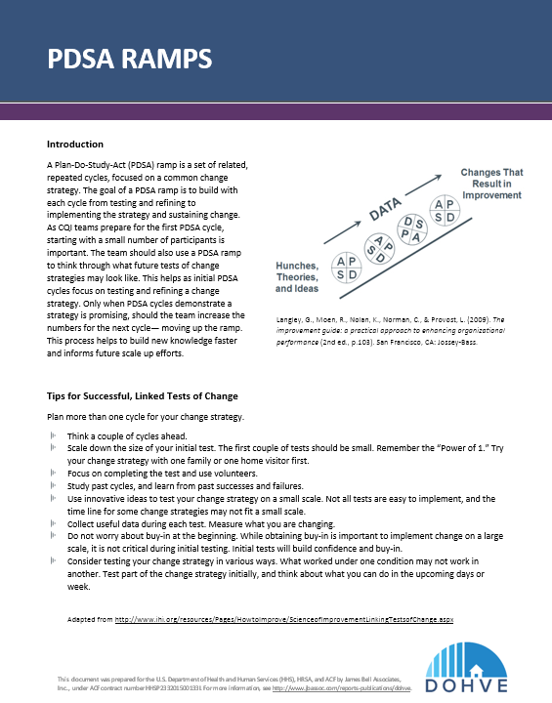
PDSA Ramps
Notes:
Pass out the PDSA Ramps handout.
This handout summarizes the guiding principles for conducting ramp cycles. It includes tips, an example, and a worksheet that can be helpful as you plan your first PDSA cycles.

Slide 37
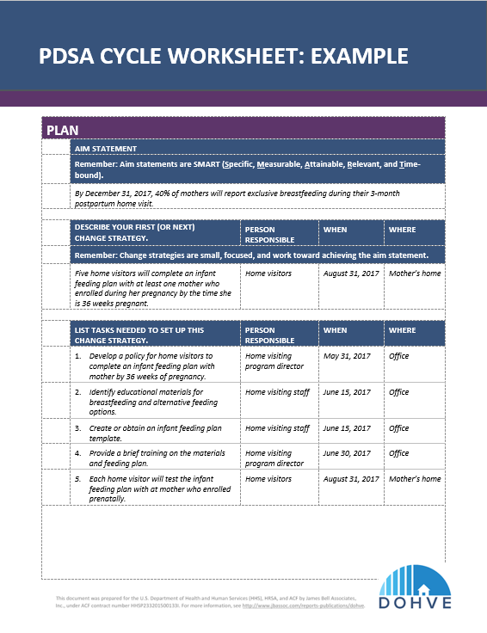
PDSA Group Work
Develop initial PDSA
Base PDSA cycle on previously developed SMART aim statement
Develop a timeline for initial PDSA
Discuss next PDSA in RAMP cycle
Regroup and share PDSAs
and timeline
Notes:
Pass out a filled-in PDSA Cycles Worksheet with an example as well as a PDSA Cycles Worksheet that is blank to each participant, and ask participants to break up into agency teams of four to six.
The PDSA Cycle Worksheet will help teams plan a PDSA cycle that reflects the “Power of One” using the SMART aim statements created in the last module.
If your team has already been working on CQI activities related to your aim statements, select a change strategy that you have not yet implemented.
As you fill out the sheet, complete only the Plan section. Include an aim statement, describe the change strategy to test, the list of tasks needed to set up this change strategy and a timeline for each step, and note your prediction of what will happen when the change strategy is tested. Then discuss a potential next PDSA cycle. The worksheet with the example filled out can be used as a guide.
We will regroup and share after about 15 minutes.
Once everyone has completed their PDSA cycle planning, bring the group back together and invite someone from each team to share their planned PDSA cycle, the timeline, the scale, and what the next cycle will look like. Some teams may be resistant to the idea of a small initial test. Ask teams that have larger tests to think about what a smaller scale test would look like. What would their change strategy test be like with just one family?

Slide 38
Remember...
Keep it simple
Keep it small
Make it quick
Be open to new discoveries
Notes:
Keep these key tips in mind as you move forward with planning and implementing PDSA cycles to test change strategies.
Testing change strategies should be simple, quick, and on a small scale.
Always stay open to new discoveries.

Slide 39
Additional CQI Resources
CQI Briefs: http://www.jbassoc.com/reports-publications/dohve
Quality Improvement Toolbox: http://www.hrsa.gov/quality/toolbox/methodology/qualityimprovement/index.html

Slide 40
Disclaimer
The purpose of the Design Options for Home Visiting Evaluation (DOHVE) is to provide research and evaluation support for the Maternal, Infant, and Early Childhood Home Visiting (MIECHV) Program. The project is funded by the Administration for Children and Families (ACF) in collaboration with the Health Resources and Services Administration (HRSA) under contract number HHSP233201500133I.
This publication was developed by James Bell Associates on behalf of the U.S. Department of Health and Human Services (HHS), HRSA, and ACF. Its contents are the sole responsibility of the authors and do not necessarily represent the official views of HHS, HRSA, or ACF.

