Slide 1
Continuous Quality Improvement Toolkit A Resource for Maternal, Infant, and Early Childhood Home Visiting Program Awardees
Module 6: CQI Tools I—Process Maps
This document was prepared for the U.S. Department of Health and Human Services (HHS), HRSA, and ACF by James Bell Associates, Inc., under ACF contract number HHSP233201500133I. For more information, see http://www.jbassoc.com/reports-publications/dohve.
Notes:
This presentation is intended to be delivered by state-level CQI support staff. The notes are a suggested script for the presenter. Please see the accompanying Facilitation Guide.

Slide 2
CQI Training Overview
1
2
3
4
5
6
7
8
9
Introduction to CQI
Using Data to Drive CQI and Identify Topics
Creating the CQI Culture and Forming a Team
Creating SMART Aims
Understanding the PDSA Process & Measurement
CQI Tools I: Process Maps
CQI Tools II: Root Cause Analysis Tools
CQI Tools III: Key Driver Diagrams
Reliability Concepts and Sustaining Gains
Notes:
This is the sixth module in a nine-part series.
Modules 6–8 are devoted to CQI tools. Home visiting programs operate in complex systems and CQI tools can provide insight into how program implementation works within these complex systems. CQI tools serve many purposes and are used to:
Provide a framework for CQI projects
Understand current program processes related to workflow, communication, education, etc.
Identify reasons why program processes breakdown
Brainstorm strategies to improve program processes
Visualize and analyze whether changes took place
This session focuses on one CQI tool: the process map.

Slide 3
CQI Tools I: Process Maps Learning Objectives
Describe the purpose of a process map
Understand when to use a process map
Develop and use a process map
Notes:
The learning objectives for this module are for participants to be able to:
Describe the purpose of a process map
Understand when to use a process map
Develop and use a process map

Slide 4
Process maps
Notes:
Systems are designed to achieve results. However, if system processes are not carried out as intended, the system may not achieve the results expected.
Process maps are used to examine existing system processes, identify deviations in processes from what was intended, and determine where and how change strategies can be tested to improve those processes.
This can help programs identify processes that are ineffective and make changes that can lead to system improvements.

Slide 5
What is a Process?
Notes:
A process is a set of steps or actions that collectively lead to a particular outcome.
This illustration shows the ingredients for making a cake. For example, most cakes start with roughly the same basic ingredients, but the kind of cake you end up with can vary by slightly changing the process: how the eggs are beaten, the temperature of the milk, how long the cake bakes, or the addition of an extra ingredient. Each variation can change the final product.

Slide 6
What is a Map?
Notes:
A map is a picture or chart that identifies certain parts of an area. This map identifies what an area looks like and how to navigate through it.

Slide 7
What is a Process Map?
A visual representation of a series of actions leading to an end
A useful tool to understand how a current system works
Simplify a process by eliminating unnecessary steps or changing inefficient ones
Identify data elements to use
Articulate the roles and responsibilities for individuals in each process step
A useful tool to identify how a new system should work
Identify the necessary process steps needed for a system to achieve desired outcomes
Adapted from: Massoud R., Askov K., Reinke J., Franco L. M., Bornstein T., Knebel E., & MacAulay C. (2001). A modern paradigm for improving healthcare quality. QA Monograph Series 1. Bethesda, MD: Quality Assurance Project, US Agency for International Development (USAID).
Notes:
A process map is a visual representation of a series of actions leading to an end that can be used to improve processes in existing systems, or to develop process steps in new systems.
Process maps are a useful tool to understand how a current system works. It can help:
Simplify a process by eliminating unnecessary steps or changing inefficient ones
Identify data elements to use
Articulate the roles and responsibilities for individuals in each process step.
Process maps can also be used to identify how a new system should work.
If you are designing a new system, creating a process map can help identify the necessary steps needed for a system to achieve the desired outcomes.

Slide 8
Types of Process Maps
 | High Level | Detailed
What are they? | “Bird’s eye view” Show only the basic steps | Detailed view Show all the steps and activities
Advantages | Easy to build Identify key participants quickly Create rapid consensus in the group Inform high-level measures | Identify steps that should be redesigned to improve efficiency
When to use | First step When short on time and need a general shared vision of the process | Identify parts of the process that require improvement
From: Nocito, S. & Zeribi, K. (n.d.) Building a Swim Lane Flow Chart. Tutorial for ImproveCareNow. (n.p.)
Notes:
Process maps can be presented at a high level with few details or at a detailed level with all details shown.
We will discuss and view an example of each type, starting with a high-level process map.
Press “Enter” once to highlight the high level column.
High-level process maps show a “bird’s eye view,” or the basic steps of a process.
They are easy to build, allow for quick identification of key participants, create rapid consensus in a group, and inform high-level measures.
High-level process maps are useful when a team needs a general shared vision of a process quickly.
They can also be used as the first step in building a detailed process map.

Slide 9
High-Level Process Map: Getting to Work
Wake Up
Get Ready
Get into Car
Drive to Office
Arrive at Work
Adapted from: Nocito, S. & Zeribi, K. (n.d.) Building a Swim Lane Flow Chart. Tutorial for ImproveCareNow. (n.p.)
Notes:
This slide provides an example of a high-level process map. Sometimes the easiest way to get familiar with a new tool is to practice using a process that is familiar in daily life.
This simple, high-level process map uses “getting to work” as the process, and it took about 1 minute to create. The map provides a bird’s eye view of the major steps taken, from waking up to arrival at the office.

Slide 10
Types of Process Maps
 | High Level | Detailed
What are they? | “Bird’s eye view” Show only the basic steps | Detailed view Show all the steps and activities
Advantages | Easy to build Identify key participants quickly Create rapid consensus in the group Inform high-level measures | Identify steps that should be redesigned to improve efficiency
When to use | First step When short on time and need a general shared vision of the process | Identify parts of the process that require improvement
Nocito, S. & Zeribi, K. (n.d.) Building a Swim Lane Flow Chart. Tutorial for ImproveCareNow. (n.p.)
Notes:
Detailed process maps try to explain all of the steps and activities in the process.
Press “Enter” once to highlight the detailed column.
A detailed process map can be used to identify which steps could be redesigned to improve efficiency.
Detailed process maps are also used to understand all parts of a process and identify which parts can be improved.

Slide 11
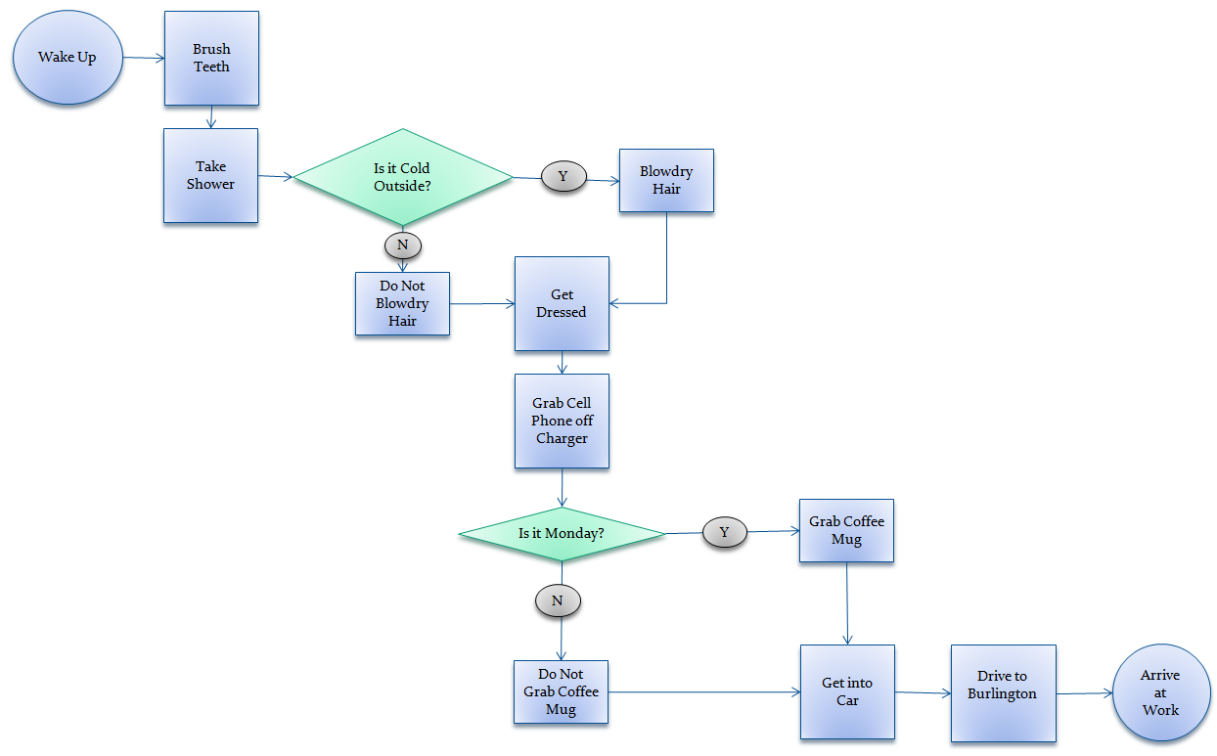
Detailed Process Map: Getting to Work
Nocito, S. & Zeribi, K. (n.d.) Building a Swim Lane Flow Chart. Tutorial for ImproveCareNow. (n.p.)
Notes:
This is an example of a detailed process map. Included are the steps in the high-level process map, but they are expanded to include all the sub-steps. For example, instead of just “getting ready,” there are a series of “getting ready” steps including brush teeth, take a shower, blow dry hair, get dressed, etc.
This process map also includes decision points, which are represented by the diamond shapes. Following each decision point, there is a specific step based on the chosen response.
The next slide provides more information about the shapes or symbols used in process mapping.

Slide 12
Process Map Symbols
START/ END POINT
DECISION POINT
Y
STEP IN PROCESS
N
DOCUMENTATION
UNCLEAR STEP
CONNECTOR
Notes:
This slide includes the most commonly used process mapping shapes or symbols.
Ovals represent the starting and stopping points.
Rectangles represent various steps throughout a process.
The cloud symbol serves as a placeholder. It indicates when a step is unclear or unknown. This symbol can be revisited later to clarify the step or left in the map indefinitely if the step is unknown.
As noted on the previous slide, diamonds represent decision points. Each decision point has at least two options, typically based on “Yes” or “No” responses.
The line with an arrow is a connector to connect each step.
The rectangle with the curved bottom symbol is used to reflect when documentation takes place.
More complicated process maps may introduce additional symbols; however, the above symbols sufficiently represent what is typically needed to create a process map in home visiting.
If the symbols included appear confusing or overwhelming, start by choosing one shape and create a process map using the single shape and connectors; use of many different symbols is not necessary.

Slide 13
Process Map Tips
Include only steps relevant to the scope of improvement effort
Have people who understand the process at the table
Consider role playing to identify all steps in the process
Notes:
When beginning a process map, focus on simplicity, including only the steps relevant to the scope of the CQI effort.
To ensure a simple and relevant process map, identify the start and end points first. Considering the end point before identifying the start point can be helpful.
The end point represents what needs to be accomplished.
The start point is the most distal step to the endpoint, where all steps in between encompass opportunities for testing a change strategy.
Involve all stakeholders who understand the process or specific parts of the process. For example, if the objective of a CQI project is to increase family members’ completion of scheduled home visits, home visitors and program participants should be included in the discussions and creation of the process map.
Role playing can be a useful strategy to identify all steps.

Slide 14
Process Map Logistics
Use a whiteboard or a large flipchart paper and post-it notes to represent each step
Limit each step to 2-3 minutes
Allocate 15 minutes to draft the entire process
Notes:
When developing a process map, keep the following tips in mind:
Use a whiteboard or a large flipchart paper and post-it notes to create a process map. Each post-it note represents a step in the process. This provides flexibility to move the post-it notes around, or insert forgotten steps.
Limit each step to 2-3 minutes. If a step is not clear, mark it with a cloud and move to the next step.
Allocate 15 minutes to draft the entire process. Then, identify steps that are unclear or need improvement — these are opportunities to try new ideas.

Slide 15
PROCESS map example
Notes:
Now, let’s walk through an example of creating a process map.

Slide 16
Maternal Depression SMART Aim
85% of women who screen positive for depressive symptoms and access services will report a 25% reduction in symptoms in 12 weeks (from first service contact).
Notes:
When creating a process map, start with your SMART aim.
This slide includes an example aim statement from the Home Visiting Collaborative Improvement and Innovation Network (HV-CoIIN) maternal depression work.
The next several slides use an example process map that illustrates how to identify potential change strategies for testing that are related to this aim.

Slide 17
Receive Referral
Access Services
Notes:
In this example, we want to understand what happens from the point when a participant receives a referral for services after a positive screening to when that participant accesses services.
As previously mentioned, identify the start and end points of the process map first to limit the focus of what is mapped.
The start and end points in this example are represented with circles or ovals.

Slide 18
Receive Referral
Accept Referral
Y
N
Access Services
Notes:
A decision point, denoted by a diamond, is added to indicate the next step after the referral is received. Does the mother accept the referral from the home visitor?
Additional steps and decision points might occur before the mother accepts the referral; however, it is not necessary to include those in the first draft. Instead, focus on where in the process potential issues exist. After doing so, revisit the process map and add more detail.

Slide 19
Receive Referral
Accept Referral
Y
N
HV continues to encourage mom to seek help
Access Services
Notes:
Each decision point has at least two options for what may happen. This slide represents the next step after a mother does not accept the referral.
In this instance, the home visitor continues to encourage the mother to seek assistance. This is denoted by a rectangle.

Slide 20
Receive Referral
Accept Referral
Mother calls to make appointment
Y
N
HV continues to encourage mother to seek help
Access Services
Notes:
If the mother accepts the referral, the next step is for her to call and make the appointment.

Slide 21
Receive Referral
Accept Referral
Mother calls to make appointment
Appointment
available
Y
Y
N
N
HV continues to encourage mother to seek help
Access Services
Notes:
After the mother calls to make an appointment, there is another decision point: Is there an appointment available?
In many communities, mental health services are limited and access can be challenging.

Slide 22
Receive Referral
Accept Referral
Mother calls to make appointment
Appointment
available
Y
Y
N
N
HV continues to encourage mother to seek help
HV refers to alternative MH provider
Access Services
Notes:
If no appointment is available, the home visitor refers the mother to an alternative mental health provider.

Slide 23
Receive Referral
Mother able to
find ride
Y
Y
Accept Referral
Mother calls to make appointment
Appointment
available
N
Y
N
N
HV continues to encourage mother to seek help
HV refers to alternative MH provider
Access Services
Notes:
If there is an appointment available, this leads to another decision point: Can the mother find transportation?

Slide 24
Receive Referral
Mother able to
find ride
Y
Y
Accept Referral
Mother calls to make appointment
Appointment
available
N
Y
Does not access services
N
N
HV continues to encourage mother to seek help
HV refers to alternative MH provider
Access Services
Notes:
If the mother is unable to find transportation, she is unable to access services.

Slide 25
Receive Referral
Mother able to
find ride
Y
Y
Accept Referral
Appointment
available
N
Mother attends appointment
Y
Mother calls to make appointment
Does not access services
N
N
HV continues to encourage mother to seek help
HV refers to alternative MH provider
Access Services
Notes:
If she can access transportation, she will attend the appointment.

Slide 26
Receive Referral
Mother able to
find ride
Y
Y
Accept Referral
Appointment
available
N
Mother attends appointment
Y
Mother calls to make appointment
Does not access services
N
N
HV continues to encourage mother to seek help
HV refers to alternative MH provider
Access Services
Notes:
This is a high-level example of one process that is an important part of potentially reducing depressive symptoms among mothers who screen positive for depression and need to access services.
There are more steps and decision points that could be included, but when starting a process map, keep it simple. Sketch out the basic process. Once problem areas are identified, more steps can be added.
It is also possible to focus on one area of a process map and further sketch out the process. For example, one team could focus on the complexities of the referral acceptance process, while another team focuses on the transportation component of the process.

Slide 27
Process Mapping Activity
START/ END POINT
DECISION POINT
Y
STEP IN PROCESS
N
DOCUMENTATION
UNCLEAR STEP
CONNECTOR
Notes:
Ask participants to break up into agency teams of four to six members. Hand each group different colored and shaped sticky notes to use for the activity.
Now we’ll work as groups to create a process map using a process related to your team’s SMART aim. Pick any aspect of the process that needs improvement, but only focus on one aspect. There are different colored and shaped sticky notes to use while mapping the process. Teams will have 15 minutes to work on the process map before reconvening as a group to debrief. Please go to a flip chart and get started. [If flip charts are not available, use a blank space on a wall.]
Consult with groups as they work, and check to make sure that:
start and end points align with the aim
decision points are only “Yes” versus “No”
if decision points have multiple options, they are represented as separate decision points.

Slide 28
Process Mapping Activity Debrief
How did you limit your scope?
Did you have the right people on your team to map the process? If not, who was missing?
Did the process map help to identify problem areas in the process?
How would you use this process map to develop change strategies?
Notes:
Lead the group through a debrief session using the questions on the slide and the prompts below as necessary.
How did you limit your scope? [ Allow time for responses.]
What start and end points were chosen?
Did the start and end points change during the activity?
Did you have the right people on your team to map the process? If not, who was missing?
Would it be helpful to have a family member present?
Did the process map help to identify problem areas in the process?
Are the problem areas different than what you would have thought before doing this exercise?
How would you use this process map to develop change strategies?
If participants create a high-level process map, ask some probing questions.
What additional detail is needed to fully explain the process?
Who has the detailed information?
Did the group role play? If not, how could role playing help?
Engage the participants in a discussion about the utility of process maps. Highlight comments that show the value and utility of the process maps.
How did process mapping change participants views of the processes?
How will participants use process maps in the future?

Slide 29
Remember....
Process maps are a useful tool to understand the steps in a process.
Start process maps at a high-level, then move to more detailed steps.
Notes:
Keep these key tips in mind as you use process maps as a tool in your CQI projects:
Process maps are a useful CQI tool and provide visualization of a series of actions leading to an end.
Start by identifying the start and end points, making sure that they align with the aim. Then, move through the high-level steps. More detail can always be added later.

Slide 30
Additional CQI Resources
CQI Briefs: http://www.jbassoc.com/reports-publications/dohve
Quality Improvement Toolbox: http://www.hrsa.gov/quality/toolbox/methodology/qualityimprovement/index.html

Slide 31
Disclaimer
The purpose of the Design Options for Home Visiting Evaluation (DOHVE) is to provide research and evaluation support for the Maternal, Infant, and Early Childhood Home Visiting (MIECHV) Program. The project is funded by the Administration for Children and Families (ACF) in collaboration with the Health Resources and Services Administration (HRSA) under contract number HHSP233201500133I.
This publication was developed by James Bell Associates on behalf of the U.S. Department of Health and Human Services (HHS), HRSA, and ACF. Its contents are the sole responsibility of the authors and do not necessarily represent the official views of HHS, HRSA, or ACF.

