Slide 1


Continuous Quality Improvement for miechv Awardees:
MODULE 7: Cqi tools ii:
root cause analysis Tools
This document was prepared for the U.S. Department of Health and Human Services (HHS), HRSA, and ACF by James Bell Associates, Inc., under ACF contract number HHSP233201500133I. For more information, see http://www.jbassoc.com/reports-publications/dohve.
Notes:
This presentation is intended to be delivered by state-level CQI support staff. The notes are a suggested script for the presenter. Please see the accompanying Facilitation Guide and handouts.

Slide 2
CQI Training Overview
1
2
3
4
5
6
7
8
9
Introduction to CQI
Using Data to Drive CQI and Identify Topics
Creating the CQI Culture and Forming a Team
Creating SMART Aims
Understanding the PDSA Process & Measurement
CQI Tools I: Process Maps
CQI Tools II: Root Cause Analysis Tools
CQI Tools III: Key Driver Diagrams
Reliability Concepts and Sustaining Gains
Notes:
This is the seventh module in a nine-part series.
This session focuses on root cause analysis and three root cause analysis tools: 5 Whys, Brainstorming, and the Fishbone Diagram.

Slide 3
CQI Tools II: Root Cause Analysis Tools
Learning Objectives
Describe root cause analysis and three root cause analysis tools
Apply systematic processes to identify root causes
Analyze findings to determine where to focus CQI efforts
Notes:
The learning objectives for this module are for participants to be able to:
Describe root cause analysis and three root cause analysis tools
Apply systematic processes to identify root causes
Analyze findings to determine where to focus CQI efforts.
This module introduces three root cause analysis tools that are used to help identify the causes of a problem. Participants will learn to apply systematic processes for identifying the causes of a problem, which will help identify change strategies that are most likely to lead to improvement. By understanding the causes of problems, teams can focus their CQI efforts on testing change strategies that address the causes.

Slide 4
Root Cause Analysis
Notes:
A root cause is an initiating cause in a causal chain leading to an outcome.
To change an outcome, it is helpful to identify the factors or causal chain that contributed to the outcome. Although there are many causes that contribute to an outcome — and some are outside of a program’s control — root cause analysis can help identify where breakdowns in program processes may be occurring and what changes in program processes might lead to improvement.
This following section discusses root cause analysis as an approach to help identify root causes of a problem.

Slide 5
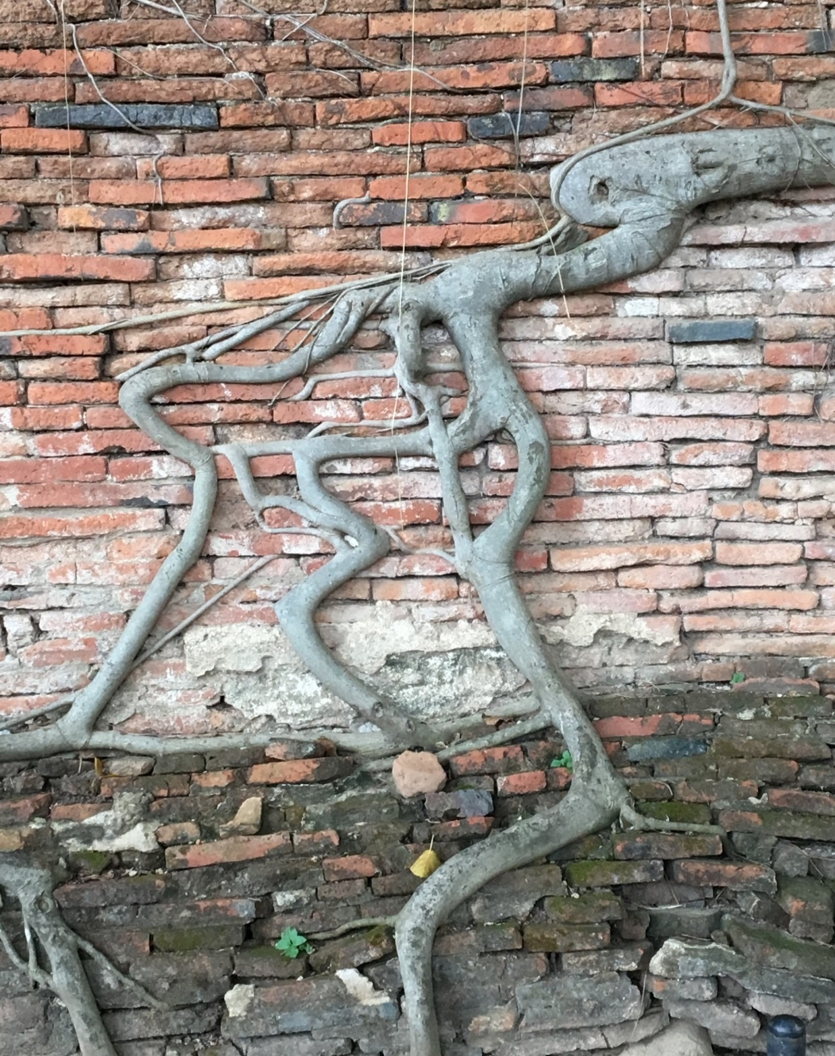
What Is Root Cause Analysis?
Systematic process
Identifies causes associated with a problem of interest
Detects why causes are present
Notes:
Although there are many root cause analysis tools, all rely on a systematic approach to understanding what factors contribute to an outcome. By focusing on the causes of a problem rather than the symptoms, root cause analysis targets change strategies to areas where they are most likely to be successful.

Slide 6

Why Root Cause Analysis?
Reduces inefficiencies
Change strategies are targeted and more likely to be successful
Notes:
When programs understand what exactly is causing a problem, they are more like to identify change strategies that help them to be successful in reaching their goal.
In contrast, when programs operate on hunches, they are more likely to try a series of change strategies that do not effectively address the problem. When change strategies are targeted to align with the root cause, they are more likely to lead to improvements in the desired outcome.
The following example uses the fictitious Happy Healthy Babies (HHB) home visiting program to illustrate how using root cause analysis can yield favorable results by focusing efforts on factors that contribute to an identified problem.
HHB home visiting program found that 60 percent of children received developmental screening. HHB wants to increase the number of children screened from 60 percent to 80 percent. The HHB CQI team met and decided on a change strategy to improve how many children are screened. The team thought one likely cause was that home visitors often failed to remember to administer the developmental screenings, so a solution would be to remind home visitors to administer the screenings. HHB modified their data system to add a screening reminder to prompt home visitors to administer screenings during specific home visits.
After launching the reminder, the team reviewed screening data. Results showed the percentage of children screened increased to 64 percent. All home visitors shared that they received the reminder prior to the home visit where the screening should be conducted.
Since they did not reach the 80 percent goal, the CQI team continued to focus efforts to improve the number of children screened. The team discovered that many home visitors were having difficulty completing screenings. This time, the team engaged in a formal root cause analysis and identified that many families are not comfortable with having their children screened. The team developed a script for the home visitor to use with the families to both identify family concerns and provide information on the importance of developmental screening and activities to promote child development. Starting with one home visitor, HHB will test this change strategy.
Using root cause analysis, the team was able to identify a change strategy that may have a greater impact on increasing the percentage of developmental screenings completed. If the team had started with a root cause analysis prior to launching a new change strategy based on a “hunch,” they might have been able to identify the underlying issue that needed to be addressed more efficiently.

Slide 7
Root Cause Analysis Tools
Notes:
Numerous methodologies and tools are used as part of root cause analysis. This module focuses on three root cause analysis tools: 5 Whys, Brainstorming, and the Fishbone Diagram.

Slide 8
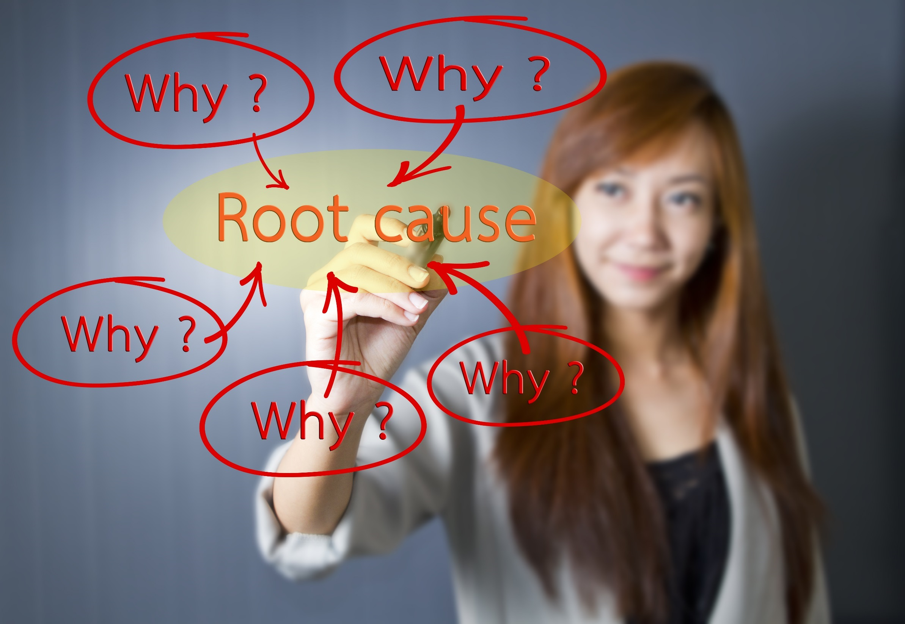
Notes:
Let’s start with the 5 Whys. This is a quick, easy to use tool to determine root causes of a problem.
To use this tool, start with the identified problem and walk backwards from the problem using a series of “why” questions.
The root cause can often be identified after asking five why questions. However, the number of times one asks why can be greater than five. If it is difficult to move past a few why questions, consider what occurred prior to that step.

Slide 9
5 Whys
Problem: Happy Healthy Babies is experiencing staff turnover at a rate of 40% over an 18-month period.
Why is the rate of staff turnover high?
Why are staff applying for other jobs?
Why do other jobs provide more compensation than home visiting?
Notes:
The next two slides use the fictitious HHB program to provide an example of how to use the 5 Whys to do root cause analysis.
This first slide provides an example of where the team ended the 5 Whys process after asking “why” three times.
The problem is that HHB is experiencing staff turnover at a rate of 40 percent over an 18-month period. To determine the reasons for high staff turnover, the HHB CQI team engaged in the 5 Whys process. The team generated the following questions and responses:
Why is the rate of staff turnover high?
Staff are leaving to take other jobs.
Why are staff applying for other jobs?
Staff report that other jobs pay more.
Why do other jobs provide more compensation than home visiting?
Home visiting has traditionally paid lower wages than similar positions.
Based on this information, the CQI team identified staff compensation as the root cause. To improve staff turnover, agency leadership agreed to the CQI team’s recommendation of a 5 percent pay increase for home visitors.
The CQI team monitored staff turnover on a monthly basis. After 12 months, staff turnover remained approximately the same.

Slide 10
5 Whys
Why is the rate of staff turnover high?
Why are staff applying for other jobs?
Why do other jobs provide more compensation than home visiting?
Why is there a discrepancy between pay and job expectations?
Why does home visiting have more expectations and offer less support?
Notes:
In this second scenario, the HHB CQI team raises the same three questions included on the previous slide; however, the team continued with the 5 Whys process to identify a more precise root cause.
In answering the third question (“Why do other jobs provide more compensation than home visiting?”), the team identified that not only does home visiting traditionally pay lower than similar jobs, but home visiting also pays low compared to job expectations. The team posed two additional questions:
Why is there a discrepancy between pay and job expectations?
Home visitors report that expectations include travel, prep work, data entry, ongoing training, high caseloads, and encountering stressful family situations. They think other positions do not have the same expectations, and that other positions receive more support.
Why does home visiting have more expectations and offer less support?
Traditionally, funding was not available to provide additional levels of support. New funding requirements added expectations for serving families in a broader catchment area and expectations for data collection and entry.
The HHB CQI team identified two additional change strategies to test based on the second 5 Whys root cause analysis. These include:
intentional assignment of families to home visitors based on regions where families live
reduction of caseloads from 25 to 22 families to provide additional time for data entry and other tasks.
The CQI team monitored staff turnover on a monthly basis. After 12 months, staff turnover reduced from 40 percent to 25 percent.
By continuing to ask “why” through five questions, the CQI team was able to identify more specific reasons for staff turnover other than pay rates. The team then identified more low-cost/no-cost change strategies to test that were more effective than when they just increased salaries.

Slide 11

5 Whys Activity
Step 1: Identify the problem
Step 2: Ask the first why question
Step 3: Walk the process backward, asking the next why question
Step 4: Continue until arriving at the root cause
Notes:
Pass out the 5 Whys handout and ask participants to break into agency teams of four to six per table to complete a group activity.
The purpose of this activity is to practice using the 5 Whys root cause analysis technique. The “why” questions start with the problem and work backward to arrive at the root cause.
Start by identifying a problem for which the root cause is unknown. Ask the first why question. Typically, one may ask, “Why does the problem happen?” Record the response. This becomes the basis for the next question. Go back another step (walking the process backward) and ask a subsequent why question. Continue to do this until it is no longer possible to think of a response to the why question. The last response represents the root cause.
Give teams 10 minutes to complete the exercise.

Slide 12

5 Whys Activity Debrief
Notes:
Lead the group through a debrief session using these questions:
How many steps did it take to discover the root cause?
Did the team have any difficulty coming up with potential responses to the why questions?
Did the team gain new insight into the problem? If not, why not?
When would this tool be helpful in improvement efforts?

Slide 13

Brainstorming
Notes:
The next tool we’ll discuss is Brainstorming, another quick, easy-to-use tool to determine the root causes of a problem.
Brainstorming is a group approach used to generate ideas about potential root causes and to identify change strategies that can be used to solve problems.
There are several rules to keep in mind when using the Brainstorming approach:
Do not judge others’ ideas. No ideas are more or less important than others. Avoid using positions or titles in the process, as this can reinforce a hierarchy. Make sure the facilitator engages all members. Consider taking turns while sharing ideas.
Encourage out-of-the-box thinking. Do not rely on old processes.
Generate as many ideas as possible. Ideally, Brainstorming is a group process, and ideas should be shared in the larger group. However, consider learning styles and comfort levels. Give individuals a few minutes to think of initial ideas before sharing.
Build on ideas. Encourage team members to expand on the presented ideas and suggestions.
Record ideas. Have a scribe. Take pictures of the end result rather than just writing things down.
Provide an opportunity for analysis after ideas are identified. Try to group ideas by category. Use a tool such as the Fishbone Diagram, which we’ll discuss next, or mind mapping to organize thoughts by ‘why’ (is this an issue) and ‘how’ (will this achieve the desired goal if any suggestions become a change strategy).

Slide 14
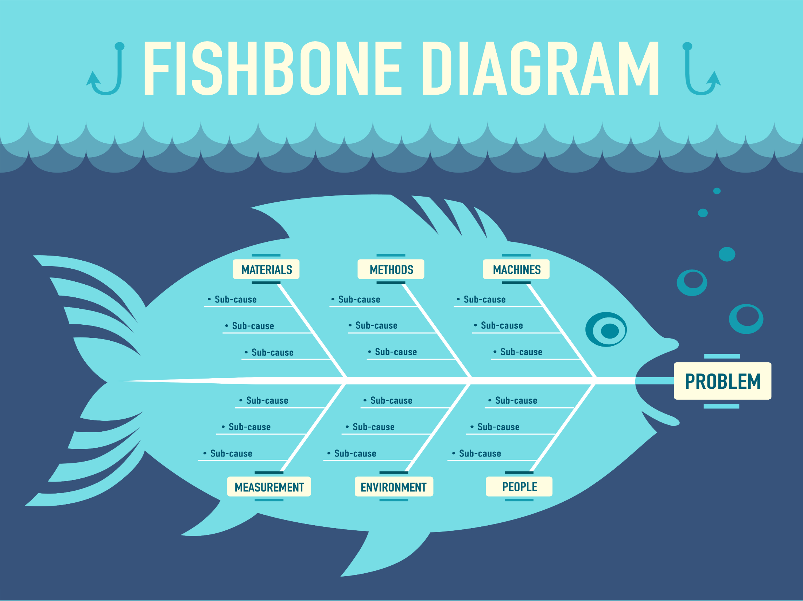
Notes:
The last root cause analysis tool we’ll discuss is the Fishbone Diagram — also known as an Ishikawa or cause and effect diagram. The diagram provides a visual depiction of the potential causes of a known problem. This helps detect areas with the greatest variability and opportunity for improvement.
The Fishbone Diagram consists of several components:
Head — The fish head represents the primary problem of interest for which a CQI team is attempting to determine the root causes.
Spine — The spine connects the stated problem to the ribs of the diagram.
Ribs — The ribs represent the major categories under which the root causes for the problem are captured. Some industries, such as manufacturing or the service industry, have common categories that are frequently used in root cause analysis. These include-
The 6 Ms: machines, methods, materials, measurements, mother nature (environment), and manpower (people)
The 4 Ss: suppliers, systems, surroundings, and skills
It’s not necessary to use predetermined categories; however, these can assist with identifying broader categories for the diagram. In addition to these common categories, it is also possible to group categories by functions. Label categories using terms that are easily understood and make sense given the home visiting context.
Lines — The lines connected to the ribs denote the root causes associated with the categories. As with the 5 Whys, it’s possible to continue identifying causes to stem off an already identified cause (resulting in multiple lines), but it’s sufficient to only have one level of lines off the ribs.

Slide 15
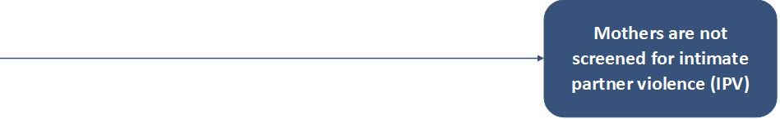
Fishbone Diagram
Notes:
The number of steps necessary to construct a fishbone diagram varies, but it can typically be completed in four steps.
The first step is to state the problem and include it at the head of the fishbone diagram.
In this example, the problem is that the home visiting program is not screening as many mothers for intimate partner violence as it should.

Slide 16
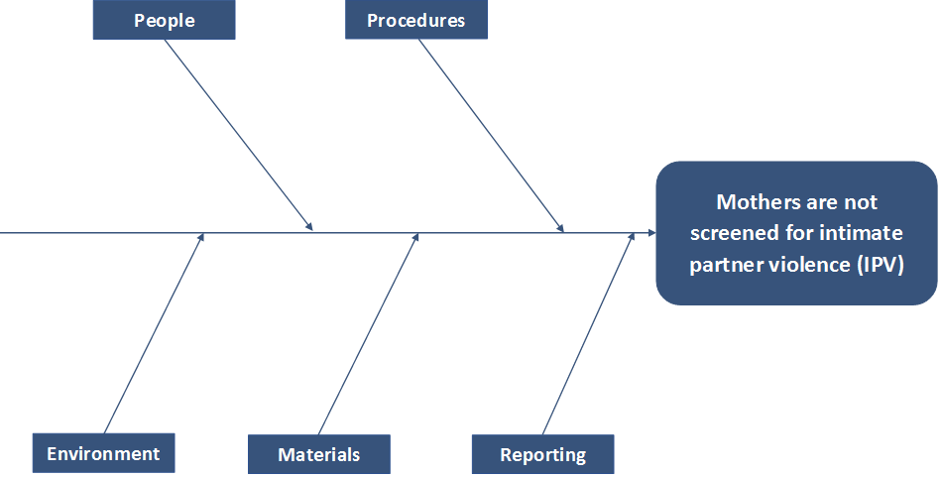
Fishbone Diagram
Notes:
The second step is to identify the main categories that contribute to the problem. Use these categories to label the ribs of the fish.
Potential categories contributing to low intimate partner violence screening rates include people (e.g., home visitors, families), procedures, environment, materials, and reporting.

Slide 17
Fishbone Diagram
Notes:
In the third step, use the Brainstorming or 5 Whys techniques to identify causes.
After identifying all potential root causes, place the causes on the lines connected to the ribs. Do not try to categorize the root causes as they are identified, as causes can be captured under multiple categories. After all causes are identified, place each cause in the category where it fits best.
Potential causes are listed for each category. These include:
People — Home visitors lack training. Some home visitors are not comfortable asking about sensitive topics. Mothers are hesitant to be screened.
Procedures — There is currently no formal screening procedure.
Materials — The screening tool is not validated. The tool is also cost prohibitive to implement as intended.
Reporting — The data system auto-scoring function does not work; therefore, home visitors do not want to input completed screens.
Environment — The community lacks services for intimate partner violence, so even if women are identified, there is nowhere to refer them.
In the fourth step, analyze the final root causes and associated categories to ensure that the entire team agrees with the groupings. Assess which root causes are most likely to affect the identified problem and have the greatest opportunity for improvement. Once a root cause is identified, begin identifying potential change strategies to test that address the root cause.

Slide 18
Fishbone Diagram Activity
Step 1: Identify the problem
Step 2: Identify the main categories
Step 3: Identify root causes
Step 4: Analyze
Notes:
Pass out the Fishbone Diagram handout and ask participants to break into agency teams of four to six per table to complete a group activity.
The purposes of this activity are to:
practice using a Fishbone Diagram to identify the root causes of an identified problem
analyze the results and select an area that is ripe for CQI.
Use the four steps listed on the slide to guide the Fishbone Diagram process. Start by identifying the problem of interest. List the problem on the fish’s head.
Identify categories and place those on the ribs.
Next, identify and write the root causes on the lines coming off the ribs.
Last, consider which area of the Fishbone Diagram presents the most variability related to the problem. Determine whether addressing this or another root cause will be the primary focus for the next step in the team’s CQI process.
Give teams 10-15 minutes to complete the exercise. Encourage teams to use the 5 Whys or Brainstorming tools to identify root causes. If teams finish early and have time to consider potential change strategies, suggest that they use the Brainstorming technique to do so.

Slide 19
Fishbone Diagram Activity Debrief
Prior to completing the fishbone diagram, what were teams’ assumptions concerning the root cause for the stated problem?
How did assumptions change after completing the diagram?
How did teams identify the root cause(s) on which to focus?
How might teams use this process in future CQI work?
Notes:
Lead the group through a debrief session using the following questions:
Prior to completing the Fishbone Diagram, what were teams’ assumptions concerning the root cause for the stated problem?
How did assumptions change after completing the diagram?
How did teams identify the root cause(s) on which to focus?
How might teams use this process in future CQI work?

Slide 20
Remember...
Root cause analysis helps CQI teams identify factors that lead to problems.
5 Whys, Brainstorming, Fishbone Diagram can be used to complete a root cause analysis.
Notes:
Keep these key tips in mind as you use root cause tools in your CQI projects:
Root cause analysis helps CQI teams identify factors that lead to problems through a systematic process. Completing a root cause analysis can identify change strategies to be tested in order to solve a problem.
Numerous tools are available to help teams complete a root cause analysis, including the 5 Whys, Brainstorming, and the Fishbone Diagram.

Slide 21
Additional CQI Resources
CQI Briefs: http://www.jbassoc.com/reports-publications/dohve
Quality Improvement Toolbox: http://www.hrsa.gov/quality/toolbox/methodology/qualityimprovement/index.html

Slide 22
Disclaimer
The purpose of the Design Options for Home Visiting Evaluation (DOHVE) is to provide research and evaluation support for the Maternal, Infant, and Early Childhood Home Visiting (MIECHV) Program. The project is funded by the Administration for Children and Families (ACF) in collaboration with the Health Resources and Services Administration (HRSA) under contract number HHSP233201500133I.
This publication was developed by James Bell Associates on behalf of the U.S. Department of Health and Human Services (HHS), HRSA, and ACF. Its contents are the sole responsibility of the authors and do not necessarily represent the official views of HHS, HRSA, or ACF.

