Slide 1
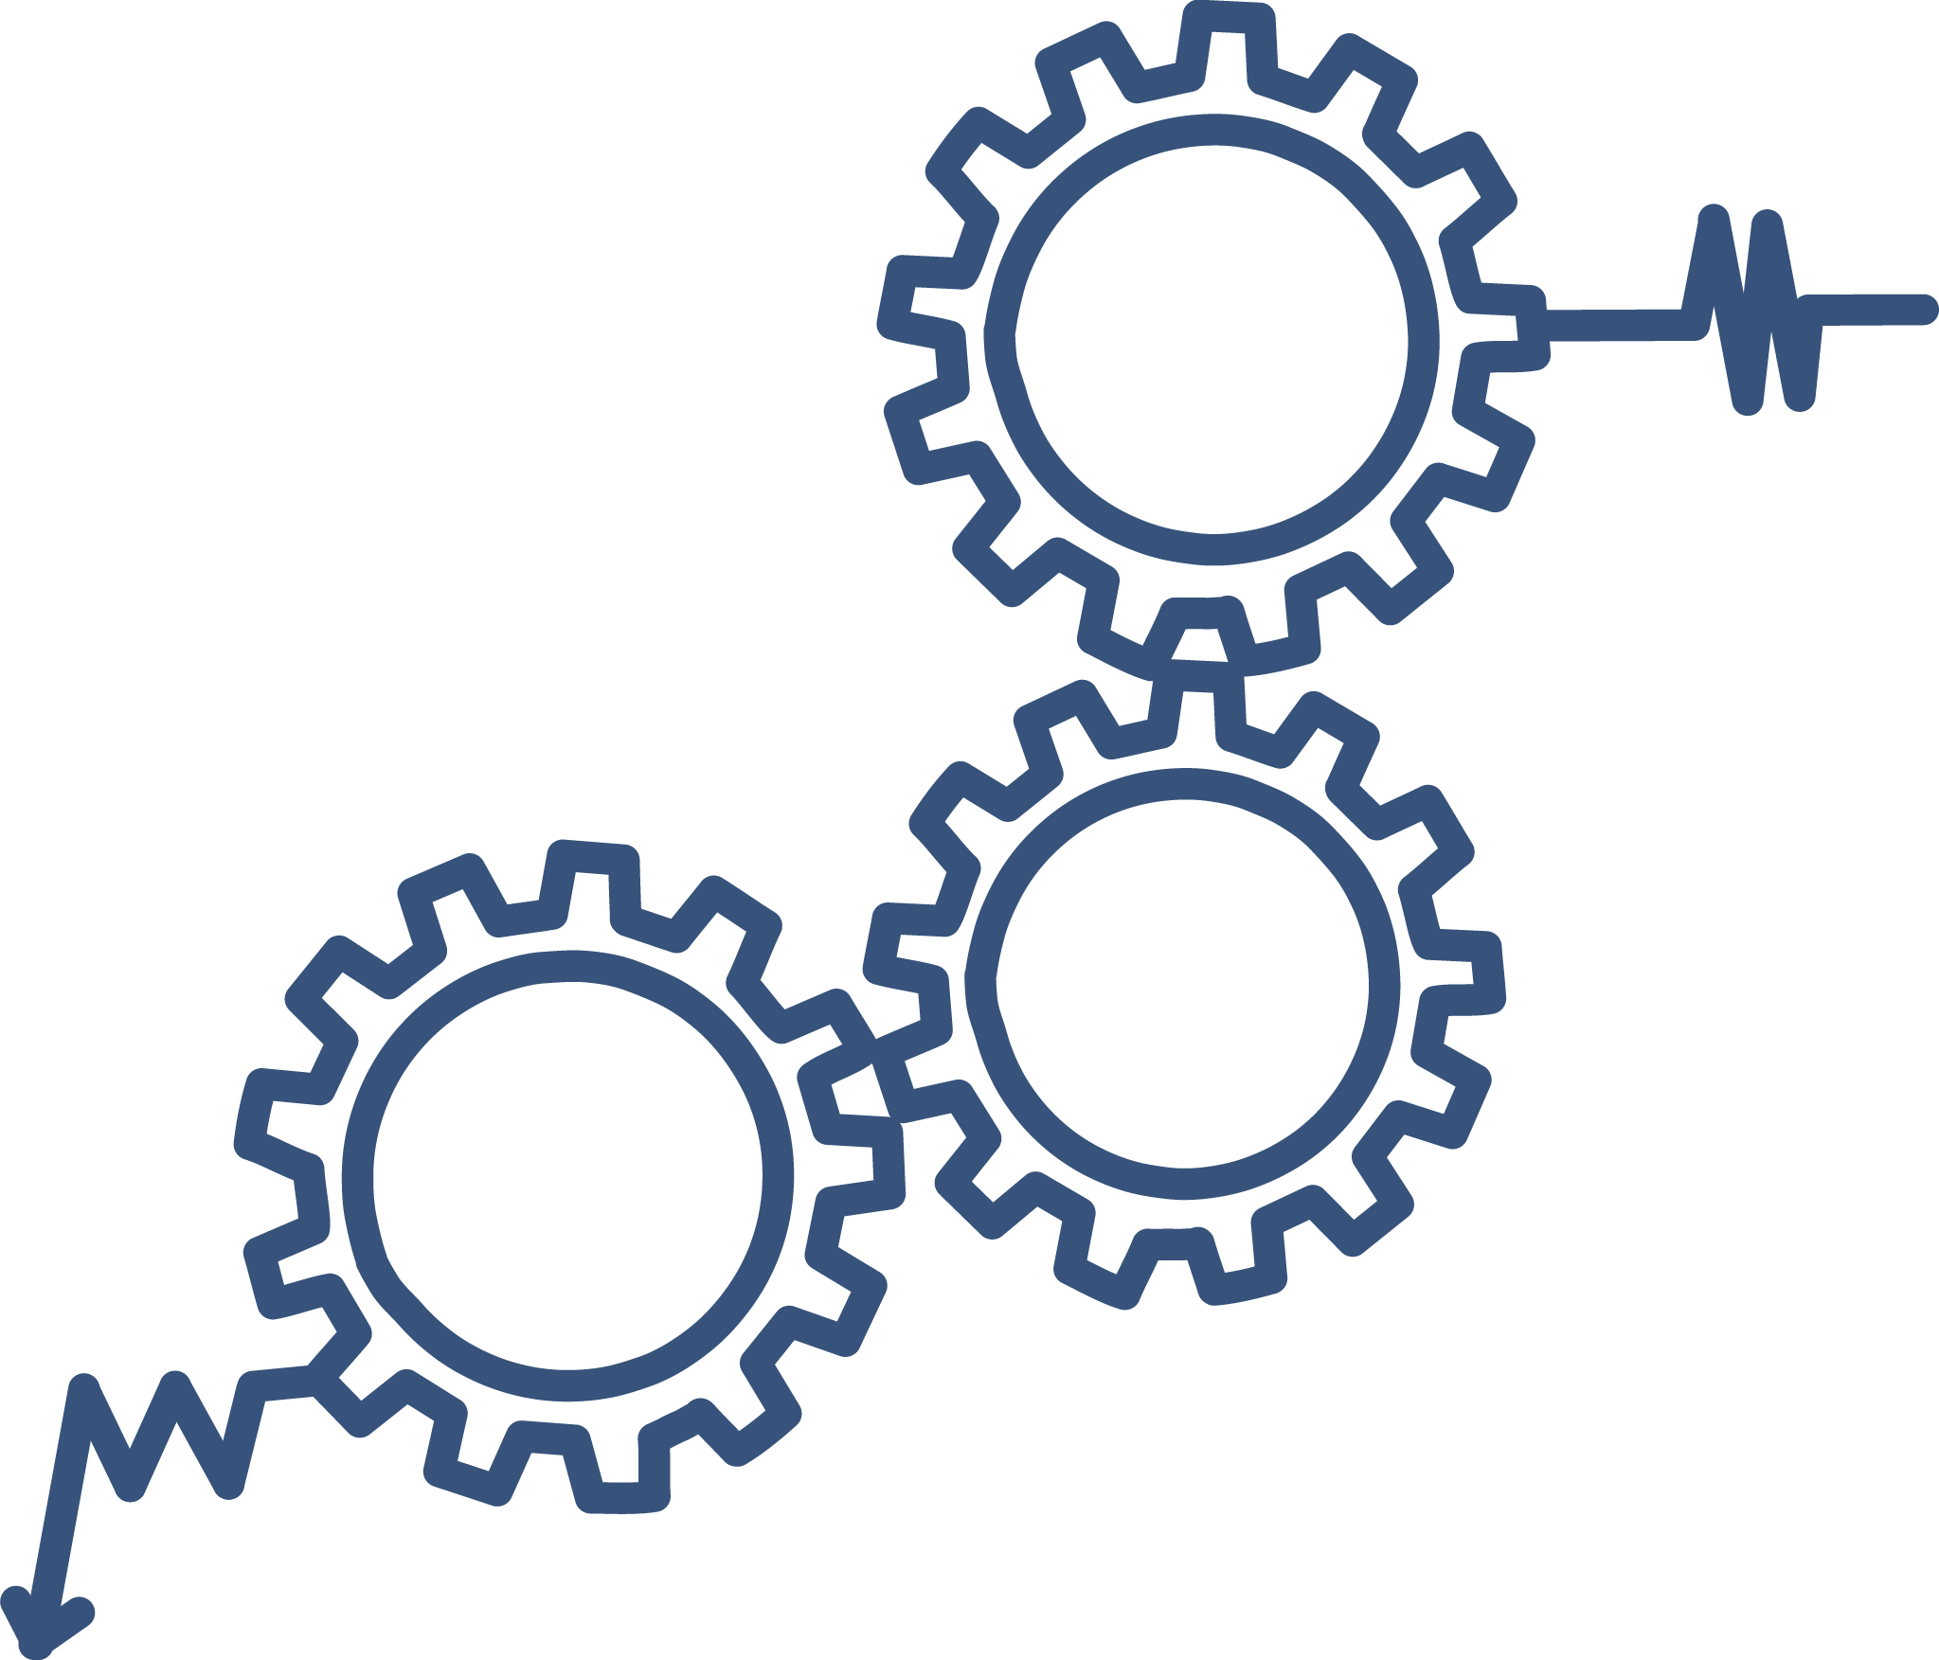

Continuous Quality Improvement Toolkit
A Resource for Maternal, Infant, and Early Childhood Home Visiting Program Awardees
Module 9: Reliability Concepts and Sustaining Gains
This document was prepared for the U.S. Department of Health and Human Services (HHS), HRSA, and ACF by James Bell Associates, Inc., under ACF contract number HHSP233201500133I. For more information, see http://www.jbassoc.com/reports-publications/dohve.
Notes:
This presentation is intended to be delivered by state-level CQI support staff. The notes are a suggested script for the presenter. Please see the accompanying Facilitation Guide and handouts.

Slide 2
CQI Training Overview
1
2
3
4
5
6
7
8
9
Introduction to CQI
Using Data to Drive CQI and Identify Topics
Creating the CQI Culture and Forming a Team
Creating SMART Aims
Understanding the PDSA Process and Measurement
CQI Tools I: Process Maps
CQI Tools II: Root Cause Analysis Tools
CQI Tools III: Key Driver Diagrams
Reliability Concepts and Sustaining Gains
Notes:
This is the ninth module in a nine-part series.
This session focuses on how to incorporate reliability concepts and monitor progress to sustain gains over time.

Slide 3
Reliability Concepts and Sustaining Gains: Learning Objectives
Understand reliability in CQI
Identify change strategies at multiple levels of intensity
Discuss importance of monitoring data
Learn how to maintain improvement
Notes:
The learning objectives for this module are for participants to be able to:
Understand reliability in the context of CQI
Identify change strategies at multiple levels of intensity
Discuss the importance of monitoring data
Learn how to maintain improvement.

Slide 4
What is reliability in cqi?
Notes:
Let’s start by talking about what reliability means in the context of CQI.

Slide 5

Notes:
The Merriam-Webster dictionary defines reliability as “the likelihood a process or system can be trusted to perform consistently well.”
Reliability in CQI for home visiting refers to the concept that subsequent tests of a change strategy will continue to produce the same results as the initial test. In other words, reliability is reducing the rate of failure in testing and institutionalizing change strategies.

Slide 6

Notes:
In Juran's Quality Control Handbook (Juran & Gyrna, 1988), the authors define reliability as “the probability of a product, process, or service performing without failure
a specified function,
under given conditions,
for a specified period of time.”
In home visiting, the specified function is the specific change strategy being tested. The given conditions are the context in which the agency is operating.
The phrase “under given conditions” refers to an agency or family’s particular context. For example, a specific change strategy implemented in a rural agency may not be as successful in an urban setting. Or a change strategy that works for first-time mothers may not be as effective with mothers of multiple children.
Finally, the specified period of time refers to the time before which a product, process, or service fails. Typically, the specified period of time is more of a concern in manufacturing or other fields where a product’s life is limited, as opposed to home visiting. Failure over the specified period of time is often depicted using a bathtub curve. Such a curve demonstrates that after introducing an effective change strategy, performance typically improves and failure rates decrease. Over time, reliability and failure rates stabilize. But after enough time passes, the failure rates start to increase. An example of this in home visiting might be that immediately following a training on a screening tool, screening rates will improve and stabilize. But over time, the screening rates may begin to decrease as the training is no longer fresh in the home visitors’ minds.

Slide 7

Applying Reliability
How can a new change strategy improve reliability and help the agency meet its developmental screening goals?
Notes:
Using the example from the previous slide, consider how the introduction of a change strategy can improve reliability of screening rates so that there is not a drop-off after the initial training.
For example, an agency identifies that it is currently screening only half of its children for developmental delays. The agency decides to test a change strategy — taking 10 minutes to discuss developmental activities and screening at each group supervision meeting to make sure that home visitors are completing the screenings and feel confident in doing so. This change strategy was very successful, resulting in an increase to 85 percent of children receiving developmental screenings. The agency decided to implement the change strategy broadly across the agency and have all supervisors regularly discuss developmental activities and screening at each group supervision meeting.
Applying the concept of reliability, the agency would regularly check the likelihood that they are still accomplishing 85 percent of their developmental screenings with this change strategy. If they were unable to consistently meet their goal through discussions of developmental activities and screening during group supervision meetings, the agency might consider testing a high-intensity change strategy.
Let’s talk now about change strategies of different intensities.

Slide 8
Change strategy intensities
Notes:
Change strategies can fall into three categories of intensity: low, medium, and high.
The level of intensity is characterized by the amount of effort required to implement the change strategy, the amount of improvement expected from the change strategy, and how integrated into the agency’s operations the change strategy becomes.

Slide 9
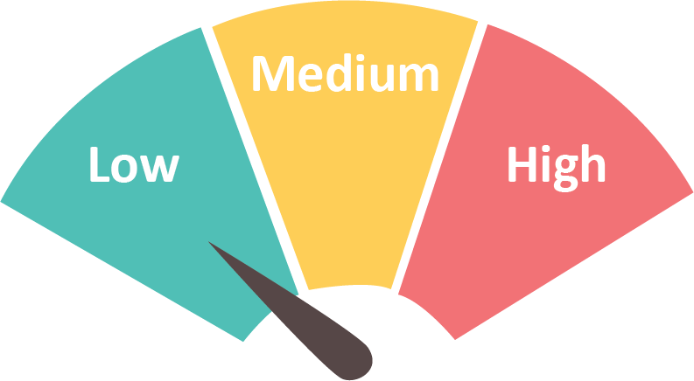
Low-Intensity Change Strategy Examples
Create basic standards and protocols
Provide feedback on compliance
Raise awareness and offer training
Adapted from Tom Nolan and Cincinnati Children’s Hospital and Medical Center. An outline of Design Concepts for Improving Reliability.
Notes:
Low-intensity change strategies are excellent options for the first change strategy in a series of tests. They are often thought of as building blocks, or introductory change strategies, to initially focus CQI efforts and draw attention to a topic. Examples of low-intensity change strategies include reminders, trainings, and incentives.
The downside to these change strategies is that they all rely on human behavior. To achieve higher levels of improvement, higher level change strategies need to be implemented in order to ‘hardwire’ the improvement into agency operations.

Slide 10

Family Engagement Application
Acorn Alley Home Visiting Agency is having difficulty engaging families in regular home visits. Staff tracked the rate of home visit completion and it is currently 63%.
What are some low-intensity change strategies the Acorn Alley Agency can implement as they begin the CQI process to improve their rate of home visit completion?
Notes:
Pass out the Change Strategy Intensity Examples handout.
Imagine that the Acorn Alley Home Visiting Agency is having difficulty engaging families in regular home visits. Their current home visit completion rate is 63 percent.
Using the handout for ideas, consider some low-intensity change strategies to recommend to the Acorn Alley Home Visiting Agency.
Allow time for responses then ask participants to share their ideas. If necessary, offer the following examples of low intensity change strategies to increase home visit completion:
Provide a report on how many visits home visitors are completing each week
Award home visitors who complete the highest number of home visits per month
Set goals during supervision meetings with home visitors to increase the number of completed home visits.

Slide 11
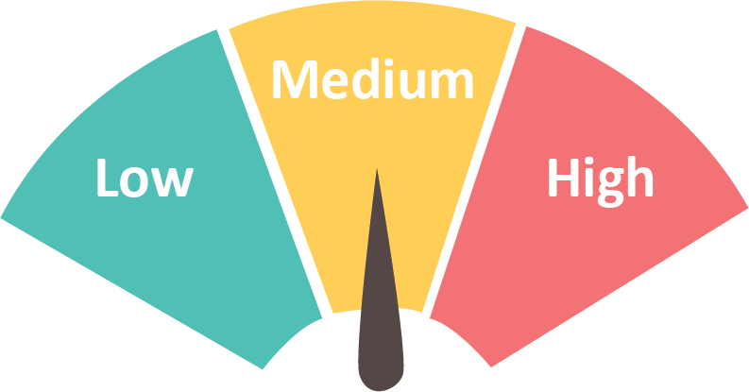
Medium-Intensity Change Strategy Examples
Include decision aids and built-in reminders
Make desired action the default
Increase redundancy to ensure completion
Schedule changes into processes
Standardize processes
Use differentiation in charts
Adapted from Tom Nolan and Cincinnati Children’s Hospital and Medical Center. An outline of Design Concepts for Improving Reliability.
Notes:
Medium-intensity change strategies are more powerful concepts that strive to change individual behavior to make it more efficient and effective.
Examples of medium-intensity change strategies include automated reminders, regularly scheduling tasks in weekly or monthly calendars to ensure completion, and standardizing processes with checklists.

Slide 12
Family Engagement Application
Acorn Alley Agency implemented two low-intensity change strategies with some success. Staff are continuing to monitor the progress of their efforts. Their current home visit completion rate is up to 81%. They are pleased with their results, but would like to keep improving.
What are some medium intensity change strategies the Acorn Alley Agency can implement as they continue trying to improve their rate of home visit completion?
Notes:
Now imagine Acorn Alley Home Visiting Agency implemented two low-intensity change strategies with some success. Their current home visit completion rate is up to 81 percent but they would like to keep improving.
What are some medium-intensity change strategies that the Acorn Alley Agency can implement to try to improve this rate?
Using the Change Strategy Intensity Examples handout for ideas, consider some medium-intensity change strategies to recommend to the Acorn Alley Home Visiting Agency.
Allow time for responses then ask participants to share their ideas. If necessary, offer the following examples of medium-intensity change strategies to increase home visit completion:
Add a step in the scheduling process to call the client the day before the visit to ensure he or she is still available during the scheduled time
Set calendar invitations 1 day in advance to remind home visitors to call families with their reminder
Establish a policy to not leave a visit before scheduling the next visit; home visitors will leave a card or refrigerator note to remind families of the next scheduled home visit before they leave.

Slide 13
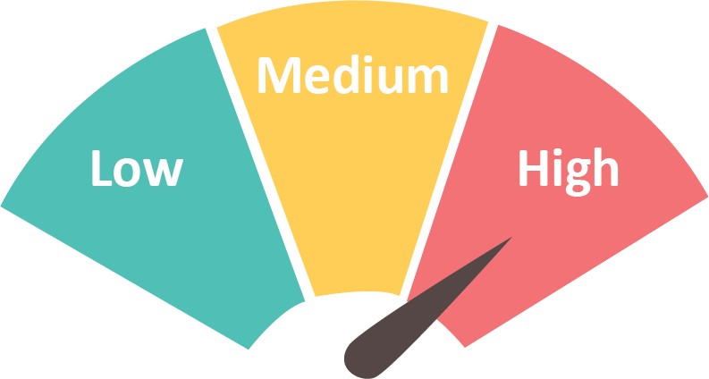
High-Intensity Change Strategy Examples
Take advantage of habits and patterns
Communicate clearly and unambiguously
Identify and mitigate failures immediately
Make the system visible
Adapted from Tom Nolan and Cincinnati Children’s Hospital and Medical Center. An outline of Design Concepts for Improving Reliability.
Notes:
As an agency becomes successful with low- and medium-intensity change strategies, moving to high-intensity change strategies should be next. High-intensity change strategies begin to integrate changes into the system to rely less on individuals’ behaviors. These change strategies are similar to medium-intensity change strategies but the focus is on change throughout the agency rather than at the individual level.
High-intensity change strategies are more complex and consequently will achieve higher results because they involve fully institutionalizing or systematizing an improvement into the regular home visiting agency operations. Ultimately, high-intensity change strategies become the default, making failure more difficult.
Examples of high-intensity change strategies include integrating observation of parent-child interaction into home visiting activities, using standardized approaches to supervising home visitors, creating policies to improve transfer of caseload, and working to visualize where families are in early engagement.

Slide 14
Family Engagement Application
Acorn Alley Home Visiting is continuing to improve. Over the last six months, it has increased their home visit completion rate from 53% to 92%. It has a well-established team with a lot of internal buy-in to continue this improvement project.
What high-intensity changes should the Acorn Alley Agency implement to fully systematize the change?
Notes:
The Acorn Alley Home Visiting Agency has continued to improve their home visit completion rate to 92 percent.
What are some high-intensity change strategies the Acorn Alley Agency can implement to fully systematize the change?
Using the Change Strategy Intensity Examples handout for ideas, consider some high-intensity change strategies to recommend to the Acorn Alley Home Visiting Agency.
Allow time for responses then ask participants to share their ideas. If necessary, offer the following examples of high-intensity change strategies to increase home visit completion:
Create and implement a policy that requires immediate rescheduling of missed or cancelled home visits
Schedule home visits in tandem with other activities or services that families already receive (e.g., a home visit is scheduled following the Story Time session that the family regularly attends at the library)
Have families complete the reminder card during the last home visit to ensure that they are engaged in the scheduling and reminding process.

Slide 15

Weighing the Benefits
Does it make sense to keep moving up in intensity?
Notes:
It is important to consider the benefits of testing higher level intensity change strategies. For example, if an agency is already conducting developmental screenings with 90 percent of its children, consider the benefits of testing additional change strategies to reach a higher percentage of success. Perhaps shifting the focus to safe sleep — where the rate of asking families about safe sleep habits is only at 40 percent of visits — would be more beneficial.
When considering what change strategy to implement next, weigh the benefits of either continuing to move up in intensity on the current topic or shifting the focus to a new topic.

Slide 16

Shifting the Focus
Notes:
Sometimes, an agency needs to consider shifting the focus to continue making improvements.
For example, if an agency has implemented multiple change strategies with success but cannot improve beyond 80 percent of families receiving depression screenings, it may benefit from taking a step back. Using the tools from previous modules (such as one of the root cause analysis tools) can help an agency identify a different angle from which to improve depression screenings. Doing a root cause analysis may reveal that only 80 percent of families are attending the home visit where the depression screening takes place. This information suggests that the agency should shift its focus to help home visitors complete more visits where the screening is being administered.

Slide 17
Sustaining gains
Notes:
Now let’s talk about approaches to sustain gains achieved through CQI work.

Slide 18

MONITORING DATA
Notes:
It’s critical to continue monitoring data during the process of implementing change strategies and after the desired improvement is attained.
Although a change strategy may be highly systematized to address improvement in one area, a new issue may arise that results in lower rates; this would need to be addressed.
Regular monitoring of data ensures that issues are identified early, and new change strategies can be tested before rates of improvement drop again.

Slide 19

Remain Flexible
Notes:
Maintaining flexibility is also important. Often, one change strategy will only result in a certain amount of improvement before results plateau. To continue increasing the level of improvement, agencies need to continue testing new change strategies.
Flexibility allows agencies to recognize natural patterns in the improvement process and to be prepared with a new change strategy to test after results from a previous strategy have been maximized.

Slide 20
Sustain the Gain
Plateau
Implementation of new change strategy
Plateau
Implementation of change strategy
Notes:
The pattern shown on this slide is common in CQI improvement data.
For example, an agency is working to improve its breastfeeding rates. It tests a low-intensity change strategy such as providing a training to home visitors on the benefits of breastfeeding and how to support mothers to overcome social barriers to breastfeeding. This results in increased home visitor enthusiasm for promoting breastfeeding. Since that strategy alone is not enough to result in full improvement, it ultimately results in a plateau. Therefore, the agency then tests another change strategy from the medium-intensity category, and begins adding planning questions that prepare mothers for breastfeeding to its prenatal home visiting forms. This again results in improvement and plateau. That trend will continue as new change strategies are implemented and institutionalized.
Agencies may choose to test multiple strategies at the same level of intensity before testing a new strategy at a higher level of intensity, but a more efficient approach is to shift to a higher intensity change strategy when a plateau is reached.

Slide 21
Lakeside Enrollment Rate
Notes:
Let’s walk through a more detailed example of this type of improvement and plateau trend.
The Lakeside Home Visiting Agency has worked toward improving the percentage of families who enroll in its home visiting program since January 2016. At that time, approximately 15 percent of referred families enrolled in the model. Beginning in March 2016, the agency began testing a low-intensity change strategy in which representatives from Lakeside met with referral partners on a quarterly basis to describe the home visiting model and its eligibility requirements. Enrollment rates improved over the next few months, but began to plateau between July and September 2016.
At that time, Lakeside decided to test a medium-intensity change strategy. The agency created a standardized referral form that included participant contact information, best time of day to call/visit, basic eligibility criteria, and a place for referral partners to make notes. The agency also identified a primary contact at the referral partner agencies who would be responsible for submitting referral forms to Lakeside. This resulted in a gradual increase to 42 percent of referred families enrolling in the home visiting agency by March 2017.
The agency continued to monitor its enrollment rate to ensure that the gains would be sustained. However, between March and July 2017, the enrollment rate dropped to 34 percent. Realizing that this was a trend, Lakeside tested a high-intensity change strategy in which the agency created an engagement policy and scripts for home visitors to use with potential participants while attempting to enroll them. This shifted the trend, and enrollment rates began to increase again. Lakeside will continue to monitor its enrollment rates to ensure that these gains are sustained.

Slide 22
Cherryville Depression Screenings
Notes:
Pass out the Change Strategy Intensity Worksheet and ask participants to break up into agency teams of four to six per table.
The data from this activity comes from the run chart activity conducted during Module 2. At that time, teams created the run chart and brainstormed some initial ideas for what resulted in the desired increase in improvements.
Now, use the Change Strategy Intensity Worksheet to identify one change strategy at each intensity level that could have been used to support the Cherryville Home Visiting Agency’s efforts to increase the rates of depression screenings.
As you identify potential change strategies, indicate where on the run chart the change strategies were implemented.
We’ll regroup and share after about 10 minutes.
Once everyone has completed their worksheets, bring the group back together and invite someone from each team to share change strategies at each intensity level along with the associated timing on the run chart.

Slide 23
Remember...
Use high-level change strategies to institutionalize change
Continue to monitor data
Remain flexible
Notes:
Keep these key tips in mind as you continue your CQI efforts:
Starting with low-intensity strategies is good. However, moving to medium- and then high-intensity change strategies will help to institutionalize change.
Continue to monitor data even after a CQI project on a particular topic is complete. Data can plateau at any point.
Stay flexible, understanding that even after a CQI project on a particular topic is complete, you may need to revisit the topic in the future and test new change strategies.

Slide 24
Additional CQI Resources
CQI Briefs: http://www.jbassoc.com/reports-publications/dohve
Quality Improvement Toolbox: http://www.hrsa.gov/quality/toolbox/methodology/qualityimprovement/index.html

Slide 25
Disclaimer
The purpose of the Design Options for Home Visiting Evaluation (DOHVE) is to provide research and evaluation support for the Maternal, Infant, and Early Childhood Home Visiting (MIECHV) Program. The project is funded by the Administration for Children and Families (ACF) in collaboration with the Health Resources and Services Administration (HRSA) under contract number HHSP233201500133I.
This publication was developed by James Bell Associates on behalf of the U.S. Department of Health and Human Services (HHS), HRSA, and ACF. Its contents are the sole responsibility of the authors and do not necessarily represent the official views of HHS, HRSA, or ACF.

