Slide 1
Planning for a Pay for Outcomes Approach in Home Visiting A Review of Research to Inform Maternal, Infant, and Early Childhood Home Visiting Outcome Selection, Projected Savings, and Pricing
Presenters:
Ann Stock
Health Resources and Services Administration (HRSA)
Kim McCombs-Thornton
DOHVE/James Bell Associates (JBA)
October 2020
Notes:
Welcome and thank you for joining us today. I am Kim McCombs-Thornton with the DOVHE project and James Bell Associates.
I will be presenting today along with Ann Stock, Team Lead for Policy, Technical Assistance, and Communications at the Division of Home Visiting and Early Childhood Systems within the Maternal and Child Health Bureau at HRSA.
The presentation today introduces a new resource to support planning for pay for outcomes or PFO initiatives, titled Planning for a Pay for Outcomes Approach in Home Visiting.
This new resource provides research findings to support MIECHV awardees in selecting outcomes for PFO, estimating potential savings, and developing financial models.

Slide 2
Agenda
Pay for Outcomes (PFO)
- Statutory requirements
- PFO development, application, and reporting process
New Resource
- Overview
- How to Use
- Questions
Notes:
Ann will begin with a brief overview of PFO including:
statutory requirements,
steps in the PFO process,
and an update on the Federal Register Notice or FRN.
I will then walk through the new resource with emphasis throughout on how MIECHV awardees can use it.
We’ll wrap up the session with your questions on the resource.

Slide 3
Pay for Outcomes Authority
Pay for Outcomes – A performance-based grant, contract, cooperative agreement, or other agreement awarded by a public entity in which a commitment is made to pay for improved outcomes achieved as a result of the intervention that result in social benefit and direct cost savings or cost avoidance to the public sector.
PFO Initiative Statutory Requirements:
Feasibility study
Rigorous third-party evaluation
Annual publicly available progress report
Requirement that outcome payments can only be made when agreed upon outcomes are achieved
Notes:
Thank you Kim.
We will spend the majority of the time today discussing this exciting new technical assistance resource.
However I want to spend a few minutes briefly sharing some background information on Pay for Outcomes or “PFO” and the key components and requirements associated with a PFO initiative.
The rest of the webinar will focus on this new TA resource, and how it can help you in developing and meeting the requirements associated with a PFO initiative.
As you likely know, the Bipartisan Budget Act of 2018 which extended the MIECHV program, also created new legislative authority that allows for MIECHV awardees to use a portion of your MIECHV formula grant for a pay for outcomes initiative.
The legislation defines a Pay for Outcomes initiative as:
“a performance-based grant, contract, cooperative agreement, or other agreement awarded by a public entity in which a commitment is made to pay for improved outcomes achieved as a result of the intervention that result in social benefit and direct cost savings or cost avoidance to the public sector.”
To meet statutory requirements, a PFO initiative must include:
A feasibility study that describes how the proposed intervention is based on evidence of effectiveness;
A rigorous, third-party evaluation that uses experimental or quasi-experimental design, or other research methodologies, that allow for the strongest possible causal inferences to determine whether the initiative has met its proposed outcomes as a result of the intervention;
An annual, publicly available report on the progress of the initiative; and
A requirement that outcome payments can be made to the recipient of a grant, contract, or cooperative agreement only when agreed upon outcomes are achieved. This requirement excludes payments made to the third party conducting the evaluation.

Slide 4
Pay for Outcomes Authority
Up to 25% of formula grant award may be used for PFO outcomes payments
No reduction in funding for services
10-year period of availability for a PFO initiative.
Notes:
The legislation further includes several other key provisions related to the implementation of the PFO authority.
It placed a limit on the amount of funds that could be use for PFO outcomes payments to 25% of an awardee’s grant, that will not result in a reduction of funding for home visiting services delivered by the entity while the eligible entity develops or operates such an initiative
Statute further allows for funds for a PFO initiative to be available for up to 10 years.

Slide 5
Potential Benefits of a PFO Initiative
Improving service delivery and performance by targeting specific outcomes for improvement;
Strategically targeting and investing in new or underserved populations;
Expanding service delivery to meet unmet needs by leveraging investors or other funding streams;
Improving data capacity, collection, reporting and management;
Strengthening stakeholder engagement;
Improving government processes and procurement through an emphasis on improved performance management, data capacity, and rigorous evaluation.
Notes:
There are a number of potential benefits associated with implementation of a PFO initiative. For example, implementation of a Pay for Outcomes initiative may:
Improve service delivery and performance,
Strategically target and invest in new or underserved populations,
Leverage additional funding sources into the delivery of home visiting services,
Improve data capacity, particularly regarding program performance and achievement of outcomes,
Strengthen stakeholder engagement with families, communities, service providers, other government entities, evaluators, intermediary organizations, and experts with data capacity, and
Improve government processes and procurement by emphasizing improved performance management, data capacity and evaluation

Slide 6
PFO Initiative Development, Application, and Reporting Process
Complete PFO Feasibility Study
PFO Initiative Implementation
Annual Progress Report
Apply for MIECHV Funds for PFO Initiative
Submit PFO SIR Response
Notes:
If a MIECHV awardee chooses to use a portion of your MIECHV formula funds to implement a PFO initiative, this slide outlines at a high level the process you will follow.
To support awardees implementing a PFO initiative if they CHOOOSE to, HRSA has developed a draft Pay for Outcomes Supplemental Information Request, which was published this past July through a 60-day Federal Register Notice.
The PFO SIR is the mechanism by which HRSA is providing guidance to MIECHV awardees for how to meet the statutory requirements associated with implementing a PFO initiative.
If a MIECHV awardee is interested in pursing implementation of a PFO initiative, the first step is to complete a PFO feasibility study. The PFO feasibility study assesses the likelihood of a PFO initiative’s success, and provides critical information for deciding whether to launch a PFO initiative.
The next step is to apply for MIECHV funds for PFO Initiative
Once you have completed a PFO feasibility study, you can choose to apply to use MIECHV formula funds for outcomes or success payments as part of a PFO initiative, beginning in the FY 2021 MIECHV Formula Funding Application.
The next step outlined here is to submit PFO SIR Response
If you’re applying for MIECHV funds for PFO outcome payments, you must also submit a response to the PFO SIR. This written response is due 120 days after the start of the project period during which the PFO initiative is funded, and includes important detailed information about your proposed PFO initiative, and how you will meet statutory requirements associated with the PFO initiative.
PFO Initiative Implementation
Once the SIR Response is reviewed and approved by HRSA, PFO initiatives must be completed no later than 10 years from the date the funds are made available.
Finally, awardees implementing a PFO initiative are required to produce an annual, publicly available progress report on the PFO initiative.

Slide 7
Next Steps
60-Day FRN comment period ended September 8
30-Day FRN – Fall 2020
Final SIR – Early 2021
Apply to use MIECHV funds for PFO beginning with FY 2021 MIECHV Formula NOFO
Notes:
As I mentioned, this summer a 60-Day Federal Register Notice (FRN) solicited public comment on a draft of the SIR, and that public comment period ended September 8.
A 30-Day FRN seeking comment on a revised version of the SIR is forthcoming, and a final version of the SIR will be available in 2021.
A final version of the SIR will not be available until December 2020 at the earliest.
And again, MIECHV awardees have the option to apply to use MIECHV Formula Funds for PFO beginning with the FY 2021 MIECHV Formula NOFO.

Slide 8
Contact Information
Ann Stock
Team Lead, Policy, Technical Assistance, and Communications, Division of Home Visiting and Early Childhood Systems
Maternal and Child Health Bureau (MCHB)
Health Resources and Services Administration (HRSA)
Email: astock@hrsa.gov
Phone: (301) 443-1525
Web: mchb.hrsa.gov
Notes:
Thank you for your time.
If you have questions, feel free to contact me at the information shared on this slide, or reach out to your HRSA Project Officer.
I will pass it back to Kim for the remainder of the presentation.
Thank you.

Slide 9
Collaborative Effort
Notes:
Thanks Ann.
Developing this resource has been a huge collaborative effort of OPRE, HRSA, DOHVE, and James Bell Associates.
We’d also like to thank Janis Dubno of the Sorenson Impact Center at the University of Utah for her contributions. Janis is a true PFO expert.

Slide 10
Resource Purpose
Review of existing research to inform
PFO feasibility studies
- Outcome selection
- Savings projections
PFO payment models
Notes:
This resource is developed for MIECHV awardees who are considering a PFO project. It summarizes information across a wide body of pre-existing research to inform PFO feasibility studies.
In particular, it will help awardees in selecting an outcome to use for PFO. It will also help you figure out how to monetize your outcome, which is necessary to calculate potential savings. You can use this information to inform your PFO payment model.
This is a large resource. Today we want to give you an introduction to it so when you are ready to consider PFO, you will have a sense of what is in this resource and how to use it.

Slide 11
Resource Overview
Introduction
4 Modules with narrative and study profiles
- Module 1 Home visiting outcomes
- Module 2 Home vising outcome costs
- Module 3 Outcome costs in non-home visiting studies
- Module 4 Administrative and government cost data sources
Navigation guidance
Notes:
The PFO resource begins with an introduction and then has 4 separate modules.
Module 1 summarizes research on home visiting outcomes. This is useful in helping you identify an outcome for PFO.
Module 2 provides cost data from home visiting return on investment or ROI studies.
And because these home visiting ROI studies have not included costs on all home visiting outcomes, Module 3 provides cost data used in other fields that study similar outcomes.
Modules 1, 2, and 3 each have a narrative or summary providing highlights across the studies. They also have individual study profiles that provide more in-depth information for each study.
Module 4 lists the administrative and government cost data sources used throughout this resource.
So while Module 1 can help you identify an outcome for PFO, Modules 2, 3, and 4 can help you monetize your outcome.
Lastly, since this is such a large resource, we have developed a tool to help you navigate through the components.

Slide 12
How to Use
Start with Introduction
Move to module that best meets your needs
Dive in and out as needed
May not be a linear process
Module-specific guidance on How to Use
Notes:
We’ll discuss each component in order. Keep in mind, though, it is not designed to be read cover to cover. Instead, we encourage you to start with the Introduction and then move throughout the components as needed.
For instance, if you already have your outcome selected, you may not need to spend much time in Module 1. Instead, you may want to go straight to Modules 2 and 3 to find cost figures others have used for your outcome of interest.
Later, though, you may realize a funding partner would like an additional outcome, so you go back to Module 1 to identify other outcomes previous studies have shown your model has achieved.
Within each module you’ll also find a How to Use section. We encourage you to take a moment to review this section before you dive into a module. It provides context in how the module can support your PFO project, as well as guidance on how to move through the module.

Slide 13
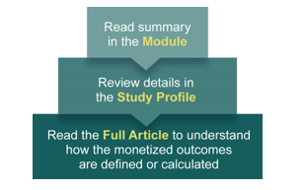
Drill Down
Notes:
The resource is designed so you start with the module narrative or summary and then drill down, going to a study profile of interest, and then potentially the actual article or report for more information.

Slide 14
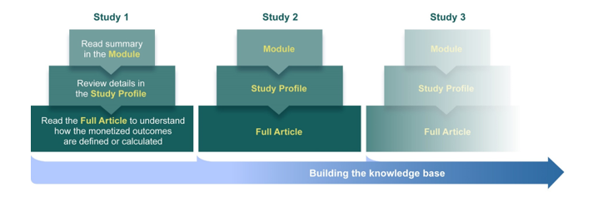
Build Knowledge Base
Notes:
The idea is that when you do this repeatedly, you’ll build your knowledge to inform your PFO outcome selection and cost figures.

Slide 15
Introduction
What is PFO?
Notes:
So now that you have a sense of how you may move through the resource, let’s talk about what you’ll find in each section.
We recommend you start with the introduction. It includes a description of PFO, similar to what Ann just shared.

Slide 16
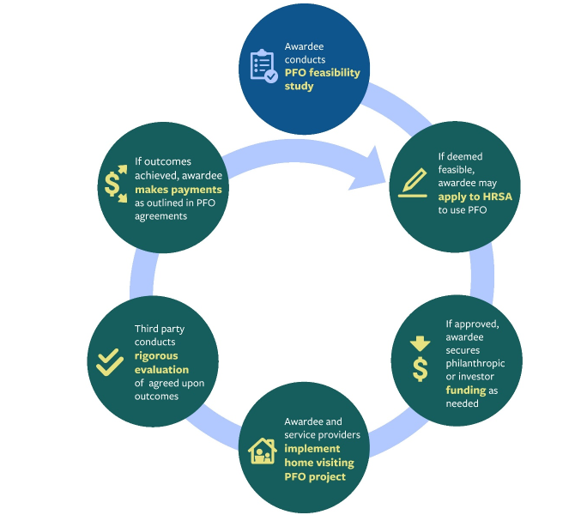
Introduction
What is PFO?
MIECHV PFO process
Notes:
It also includes an overview of the MIECHV PFO application and implementation process.

Slide 17
Introduction
What is PFO?
MIECHV PFO process
PFO feasibility study components
Notes:
Next, the introduction covers components of a MIECHV PFO feasibility study.
As stated here, this resource can help you answer the key feasibility study question:
Can a program achieve results that can lead to cost savings, especially a decrease in future government spending?

Slide 18
Introduction
What is PFO?
MIECHV PFO process
PFO feasibility study components
Role of prior research to support PFO
Notes:
Lastly, the introduction describes how prior research can support your PFO initiative, namely with selecting outcomes for PFO and estimating potential cost savings, both of which can inform a PFO financial agreement.

Slide 19
Module 1
Home Visiting Outcomes
Informs selection of PFO outcome
Summarizes significant outcomes in HomVEE
Preference to use own data
Notes:
An important component of pay for outcomes initiatives is identifying measurable outcomes to assess whether a program is successful and therefore, if payments should be made. MIECHV awardees considering a PFO approach should first seek out evidence that a home visiting model is likely to improve specific, measurable outcomes for a target population.
Module 1 will help you in selecting an outcome for PFO. It summarizes demonstrated impacts on outcomes from home visiting studies spanning the 19 home visiting models deemed eligible for MIECHV implementation as of June 2020.
Now there is a caveat. While this resource summarizes results across studies, keep in mind the preference is for awardees to use your own results when available for the feasibility study. Perhaps you already fund a third-party evaluation that tracks an outcome you’d like to use for PFO. Your own previous results will be the best predictor of the kinds of outcomes you are likely to achieve if you implement PFO.
Module 1 could help you confirm that others have also achieved similar results, helping to create a stronger case for PFO.
If you don’t already have outcome data, then Module 1 can help you identify outcomes that could be good candidates for PFO.

Slide 20
Module 1
Home Visiting Outcomes
Organized by HomVEE outcome domain
Provides results by home visiting model
Notes:
In Module 1 study outcomes are organized across the eight domains used by the Home Visiting Evidence of Effectiveness or HomVEE review. You can see those listed here on the right.
So as you think about using Module 1, you’d likely go to the outcome domain of interest – such as child health or positive parenting practices - rather than reading cover to cover.
Within an outcome domain, statistically significant results are displayed by home visiting model. As models differ, outcomes and size of the results also differ by model so you will want to look for the model you implement once you are in the outcome domain.

Slide 21
Module 1
Notes:
Here’s an example of what you will find within an outcome domain.
[ANIMATION] First, you’ll see a box on the right that shows the home visiting models that have demonstrated results in this outcome domain. If you see your home visiting model listed here, then the outcome domain – in this case, child development and school readiness - could be an option as a PFO outcome domain for you, and you might want to read this section further.
Next, within child development and school readiness, you’ll see that specific outcomes are sorted into two groups [ANIMATION]
The first is socio-emotional or psychological development, and the second is academic achievement and developmental milestones.
Below, [ANIMATION] you’ll notice that outcomes are summarized within each of these categories.

Slide 22
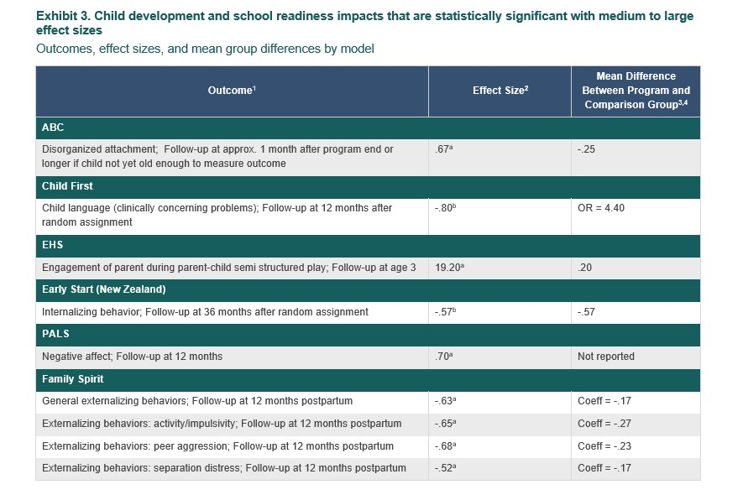
Module 1
Notes:
You’ll also find tables that show outcomes for which studies have shown a medium to large effect size for each home visiting model.
Effect size provides information about the magnitude or how large the reported impact is. In a nutshell, effect size is a number between 0 and 1. A small effect size is about .2, a medium effect size, is around .5, and a large effect size is .8. The effect size can be positive or negative. Using effect size makes it easier to compare across studies. You can find more about effect sizes in Module 1.
So for our child development and school readiness example, you see here [ANIMATION] that Attachment and Biobehavioral Catch-Up or ABC has a documented outcome related to disorganized attachment, with an effect size of .67.
If you are implementing ABC, then this could be a potential outcome for you to consider for PFO.
On the other hand, if you are implementing Child First, [ANIMATION] you’d see that it has a documented outcome related to child language development, and so on.
You can use these tables to pinpoint outcomes you’d want to learn how researchers have measured, because for PFO, you’ll need to measure and assess your own outcomes.

Slide 23
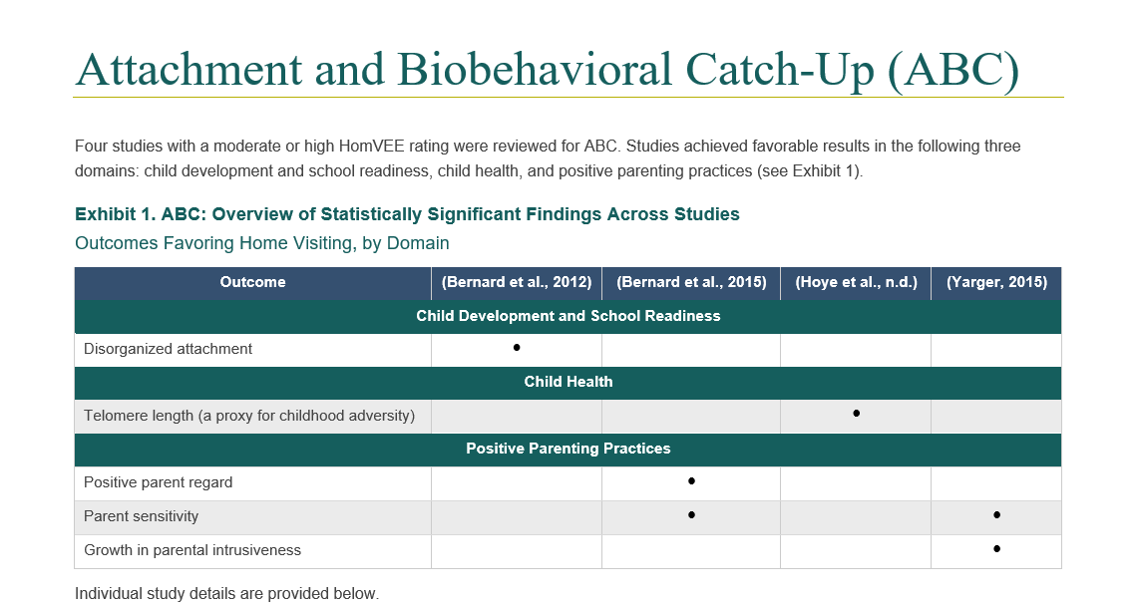
Module 1 Study Profiles
Notes:
In addition to the summary narrative we’ve been discussing, each study in Module 1 has a separate profile. The study profiles are where you can go to learn more about how the researcher assessed your outcome of interest.
The study profiles specify additional factors that awardees should consider when determining which outcomes to select, such as the target population for whom the model was effective, intervention study design, and so on.
When using the study profiles for Module 1, first look for your home visiting model. They are in alphabetical order.
The first table for each model provides an overview of each study included and the statistically significant outcomes found in each.
So let’s say again that you are implementing ABC. When you look up this model, [ANIMATION] you’ll notice there are four studies for ABC summarized in the PFO resource.
Next you want to drill down to a specific study to review. Perhaps you are interested in child attachment as we noted in the summary table earlier. [ANIMATION] Look at each study that has demonstrated impacts on attachment. In this case, there is just one, Bernard et al from 2012. The next step is to look at the profile for that study.

Slide 24
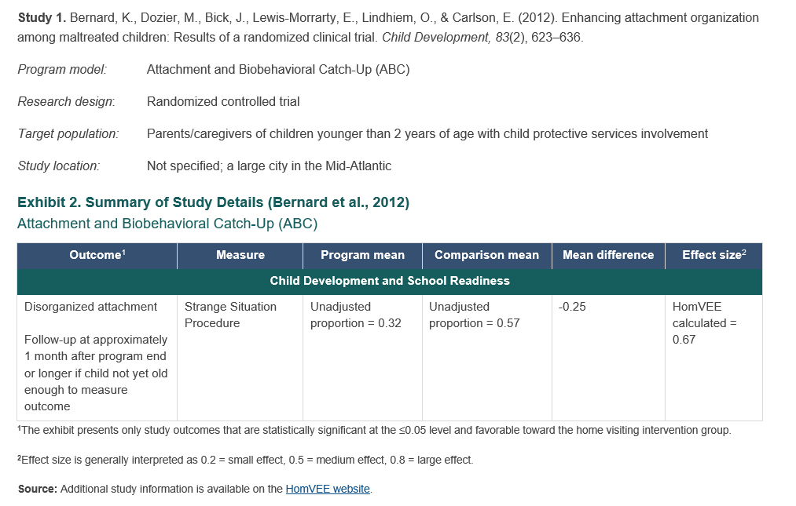
Module 1 Study Profiles
Notes:
You just need to scroll down to find the profiles for each study. Here you see the profile for the study authored by Bernard and colleagues in 2012. All profiles in Module 1 pull information from HomVEE. They each show the program or home visiting model, research design, and target population.
They also have a table showing:
the outcome,
how it was measured,
the average score or result on that outcome for the home visiting participants,
the score for the comparison group,
difference between the groups,
and the effect size.
So for disorganized attachment, [ANIMATION] this study used the Strange Situation Procedure, and [ANIMATION] found a .25 difference in scores between the ABC children and the comparison group.
Lastly, [ANIMATION] you can click on the link at the bottom to find out more about this study on HomVEE.

Slide 25
Module 2
Home Visiting Outcome Costs
Summarizes monetized outcomes, per unit costs, and data sources used in home visiting ROI studies
Informs outcome selection, saving projections, and payment models
Preference to use own data
Notes:
Once you have used Module 1 to help identify an outcome for PFO, you will then want to consider how to establish a monetary value for that outcome. Some home visiting outcomes in Module 1 are easier to monetize than others. Module 2 provides information on home visiting outcomes for which previous studies have calculated a return on investment or ROI.
Module 2 summarizes monetized outcomes, per unit cost figures, and data sources researchers used to inform the economic values. Note these are not studies that were done for PFO projects, but rather studies conducted to determine costs and savings from implementing home visiting programs, so they are very relevant to inform a PFO project.
While this resource provides cost figures that others have used for home visiting outcomes, keep in mind that HRSA encourages awardees to use local cost data when possible. Published research can provide insight for awardees on how to use their local data to project future savings or fill the gap when local cost data are not available.

Slide 26
Module 2
Home Visiting Outcome Costs
Study Inclusion Criteria
Included at least one model reviewed by HomVEE or another parent/child intervention provided in the home
Used ROI or cost analysis
Described methodology and findings
Notes:
We used the following criteria to identify studies for Module 2.
The first is that the study had to include at least one of the models reviewed by HomVEE or the study assessed another intervention for the parent and child provided in the family’s home. As an aside, note that we included all models reviewed by HomVEE, regardless of whether it received an evidence-based designation. That’s because awardees could still gain insights into how researchers monetized outcomes for these models even if the models are not yet considered to be evidence based.
The second criteria is that the study had to use ROI or a similar cost analysis approach.
Lastly, the study had to describe its methodology and analysis findings.
This process identified 24 studies that are summarized in Module 2.

Slide 27
Module 2
Home Visiting Outcome Costs
Organized by HomVEE outcome domain
Provides results by home visiting model
Notes:
As with Module 1, Module 2 is organized by the eight HomVEE outcome domains. As the box shows, we found home visiting cost studies assessing six of these outcome domains, bolded here.
You will likely go to the outcome domain you’ve already selected rather than reading cover to cover.
Within an outcome domain, you’ll see cost figures provided by home visiting model.

Slide 28
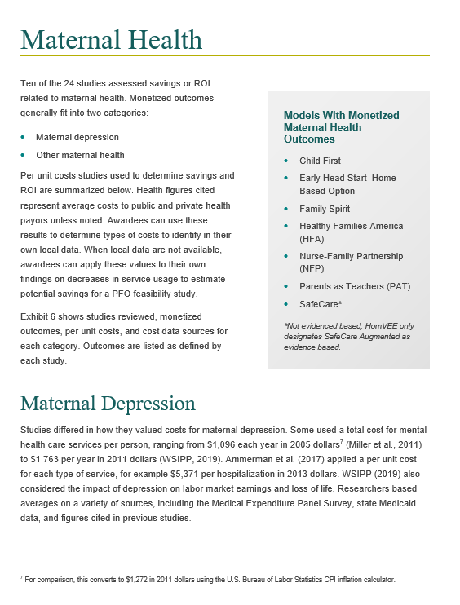
Module 2
Notes:
Each outcome domain follows a common format as you see in this example.
For maternal health, [ANIMATION] monetized outcomes fall into two categories: Maternal depression and other maternal health.
[ANIMATION] Results are then summarized by each category.
[ANIMATION] You’ll also see a box showing the home visiting models for which researchers have monetized maternal health outcomes.

Slide 29
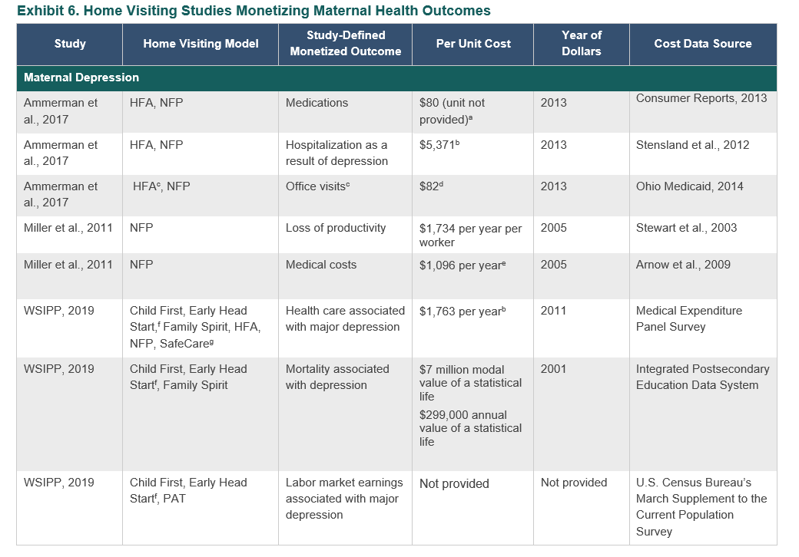
Module 2
Notes:
Each outcome domain includes a table listing each study including:
the home visiting model,
the monetized outcome,
the per unit cost the study used for the outcome,
the year of dollars,
and the cost data source.
This can help you identify a study you would like to learn more about in the study profiles.
So, let’s say you are interested in decreasing health care costs related to maternal depression. [ANIMATION] There are three studies here you could take a look at to learn more about how they handled these costs. Let’s look at one of these, the Miller 2011 study, in the study profiles.

Slide 30
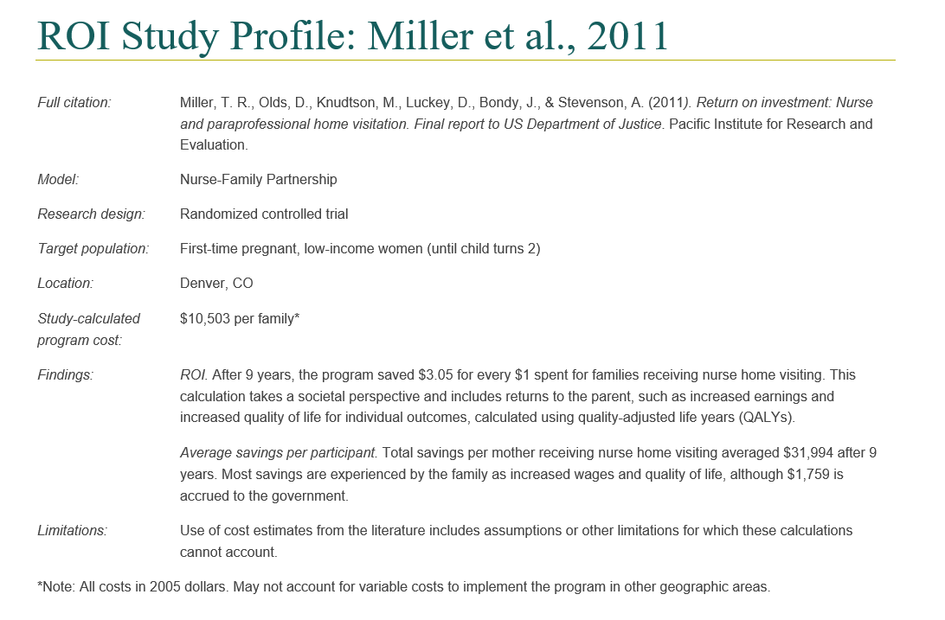
Module 2 Study Profiles
Notes:
Each of the 24 ROI studies in Module 2 has a separate write up in the study profiles. As the Miller 2011 example here shows, each study profile shows:
the study citation,
the home visiting model,
the research design,
the target population,
the location,
the cost of implementing the program,
return on investment results and average savings per participant if available,
study limitations, and
lastly, the year of the dollars

Slide 31
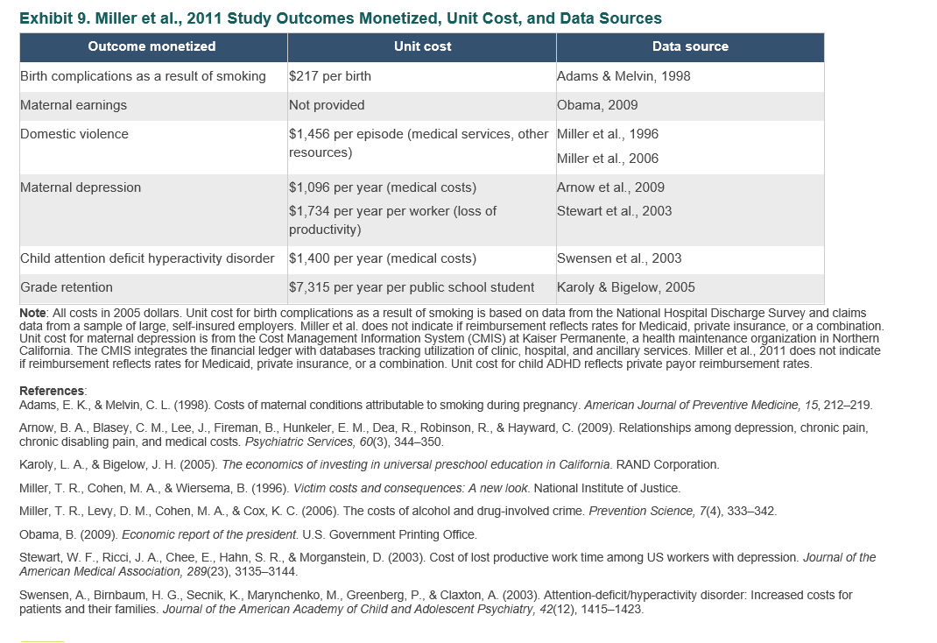
Module 2 Study Profiles
Notes:
Next you’ll see a table showing the outcomes monetized, per unit cost of each outcome, and the data source for the cost figures.
So in this case, Miller et al. [ANIMATION] used figures from Arnow to inform their maternal depression medical costs. You’ll see the reference for Arnow below. You may want to seek out the Arnow article to learn more.

Slide 32
Module 2
Crosswalk between MIECHV performance measures and monetized outcomes
ROI studies have monetized actual MIECHV construct indicators for
- Preterm birth
- Child maltreatment
- Primary caregiver education
Notes:
As you know, HRSA has established a set of performance reporting requirements, including performance indicators and system outcome measures awardees should use to monitor and demonstrate accountability. Some awardees may be interested in using a required MIECHV performance measure as a PFO outcome.
At the end of Module 2 you’ll find a crosswalk between the 19 MIECHV performance measure constructs and the home visiting ROI studies that have monetized outcomes related to each construct. ROI studies have monetized three of the actual MIECHV indicators including preterm birth, child maltreatment, and primary caregiver education.

Slide 33
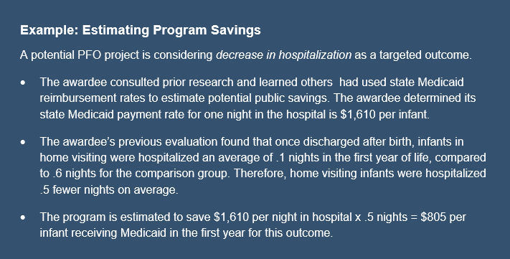
Module 2
Notes:
We’ve spent a lot of time talking about selecting an outcome for PFO and finding cost figures for that outcome.
But once you have that information, what do you do with it?
Module 2 provides guidance on how you can use this information to calculate a projected cost savings.

Slide 34
Module 3
Outcome Costs in non-Home Visiting Studies
Summarizes monetized outcomes, per unit costs, and data sources used in non-home visiting ROI studies
Informs saving projections and payment models
Preference to use own data
Notes:
Some of the outcome domains have not been monetized in many home visiting studies. For these we considered studies that monetized similar outcomes for other research outside of home visiting. You’ll find those studies in Module 3.

Slide 35
Module 3
Outcome Costs in non-Home Visiting Studies
Prioritized outcomes
- Featured in fewer home visiting cost studies
- Perceived to have highest cost impact
- Could be achieved within 2 years
Organized by HomVEE outcome domain
Organized like Module 2
Notes:
Our team identified outcome domains that appeared to have gaps in the home visiting cost literature. We then worked with expert consultants to determine which outcomes were 1) likely to have the highest potential cost impact or most significant savings, and 2) able to be tracked over 2 years since that was the length of the MIECHV grant funding periods.
Based on that review, our team conducted a literature scan to identify monetized outcomes for
Child development and school readiness which includes internalizing and externalizing behaviors,
Child health which includes child hospitalization and breastfeeding, and
Maternal health such as maternal depression, parenting stress, family functioning, and maternal anxiety
Module 3 is organized in the same way as Module 2. As with the other modules, you will likely go straight to the section based on your interests. For instance, if you are considering using outcomes related to breastfeeding for PFO, then you would go to the section on Child Health. There you would identify one or more studies of interest, and then locate those studies in the Module 3 study profiles for further review.

Slide 36
Module 4
Administrative and Government Cost Data Sources
Summarizes administrative and government cost data sources used in Modules 2 and 3
Organized by HomVEE outcome domain
Use to identify sources for local cost data
Notes:
As we’ve discussed, a key step in determining the feasibility of a PFO approach and structuring a PFO initiative is estimating cost savings associated with achieving targeted outcomes through home visiting. Administrative and government data are common sources to inform these estimates.
Administrative records include client and program-level data collected by local implementing agencies and partner organizations.
In addition, government reports, surveys, or websites may also provide cost data for a region, state, or other locality.
Module 4 summarizes administrative and government data sources that ROI studies in this resource used to determine per unit costs of outcomes. Information is organized by the HomVEE outcome domains.
Awardees can use Module 4 to identify sources for local cost data. Awardees can use these administrative and government sources to help find similar data sources for their own location via an Internet search.

Slide 37
Accessing Online
Now available on the DOHVE webpage at James Bell Associates https://www.jbassoc.com/resource
Will be available in OPRE resource library https://www.acf.hhs.gov/opre/resource-library
Recording will be posted
Navigation tool available
Notes:
That covers the content of this new PFO resource. You can find this resource online on the DOHVE webpage at James Bell Associates. Soon you will also be able to find it in the OPRE resource library.
The format on both websites will allow you to easily move among the introduction and modules. For instance, in this snipit of the DOHVE website, the graphics at the bottom will hyperlink you to each of the modules.
The recording of this webinar will be posted on the DOHVE website. And, you will also find a navigation tool to help you consider how to move through the modules.

Slide 38
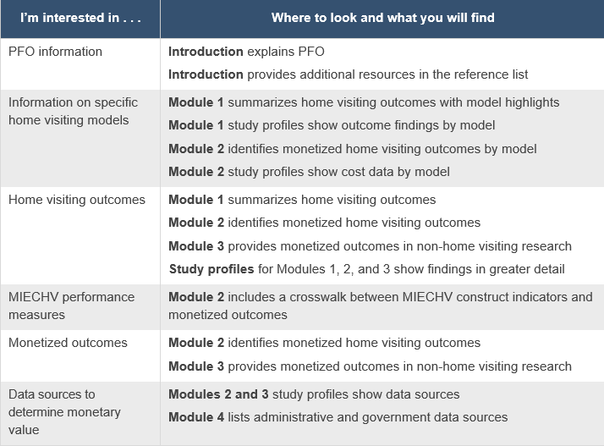
Navigation
Notes:
The navigation tool helps you identify where to find the information you are looking for. Look there for tables such as this one that helps identify which module to consult based on your interests.

Slide 39
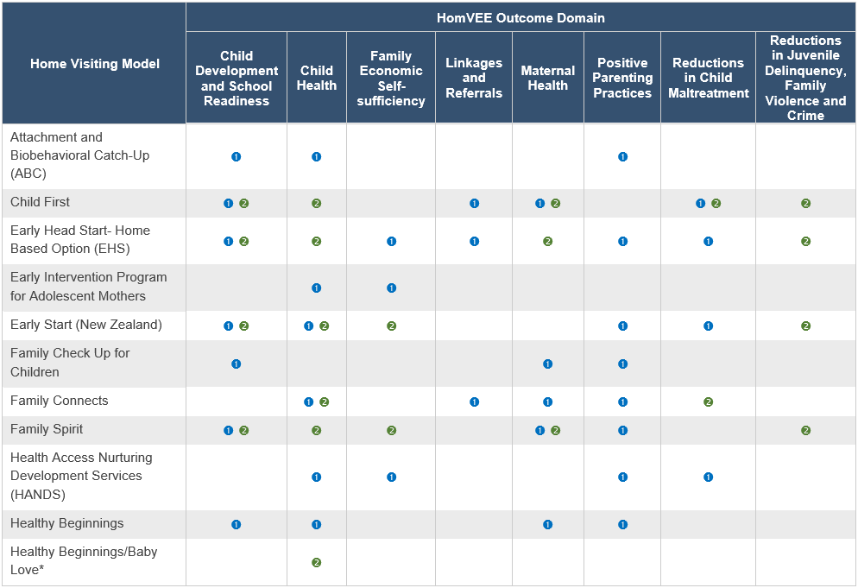
Navigation
Notes:
And this one which drills down where to look by home visiting model and outcome domain.

Slide 40
Questions?
Notes:
We realize that you are in early stages of considering pay for outcomes. We also recognize this is a big resource and we encourage you to look at it at your leisure.
At this point, does anyone have questions about this new resource or how to use it? If you have questions about HRSA guidance on implementing PFO, we can share those with HRSA. And of course, you can follow up with your project officer with questions.
For now, we can answer questions about this resource or how to use it. Feel free to unmute your line or to type a question in chat.

Slide 41
Connect with HRSA
Learn more about our agency at:
www.HRSA.gov
Sign up for the HRSA eNews
FOLLOW US:
Notes:
Please remember to bring any questions about PFO or this new resource to your HRSA project officer.
Thank you for joining us today.
HRSA is on four social media platforms. We encourage you to follow along and share our content on Twitter, Facebook, LinkedIn and Instagram to stay up-to-date on the latest HRSA news. Our account/handle on each platform is @HRSAgov.
Additionally, we also encourage you to sign up for HRSA’s e-News, a biweekly email of comprehensive HRSA news, and to sign up for HRSA press releases. You can also visit our website www.HRSA.gov for more detailed information about all of our programs.

