Slide 2


Slide 9
Starting/ending point
Starting point
Task or Activity
Task or Activity
Decision point
Decision point
Yes
No
Yes
No
Ending point

Slide 10
What stands out to you when you look at the process the group mapped?

Slide 11
What impact do decision points have on the process?

Slide 12
Which steps are confusing or cumbersome?

Slide 13
Which steps seem unnecessary?

Slide 14
Which steps are carried out inconsistently?

Slide 15
Who will share the map, and how?

Slide 16
What is a reasonable timeframe for requesting responses from reviewers?

Slide 17
How will reviewers provide their input?

Slide 18
How will the group review the input and revise the map?

Slide 19


Slide 20
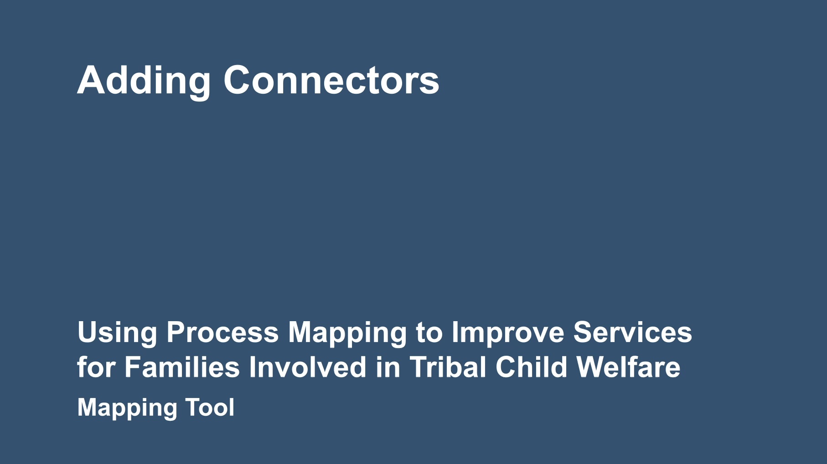

Slide 21


